Slide 1
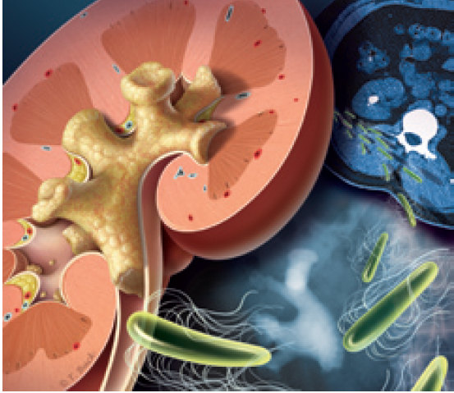
Medical management of urolithiasis
14 July 2015

Slide 2
Urolithiasis: iNTRODUCTION
Urolithiasis: A problem that has confronted clinicians since the time of Hippocrates & many family physicians have extensive experience in its clinical management
In recent years, technological advancements have greatly facilitated diagnosis of stone disease
Management of urolithiasis is also becoming increasingly well defined
Portis AJ, et al. Am Fam Physician 2001;63:1329-38.

Slide 3
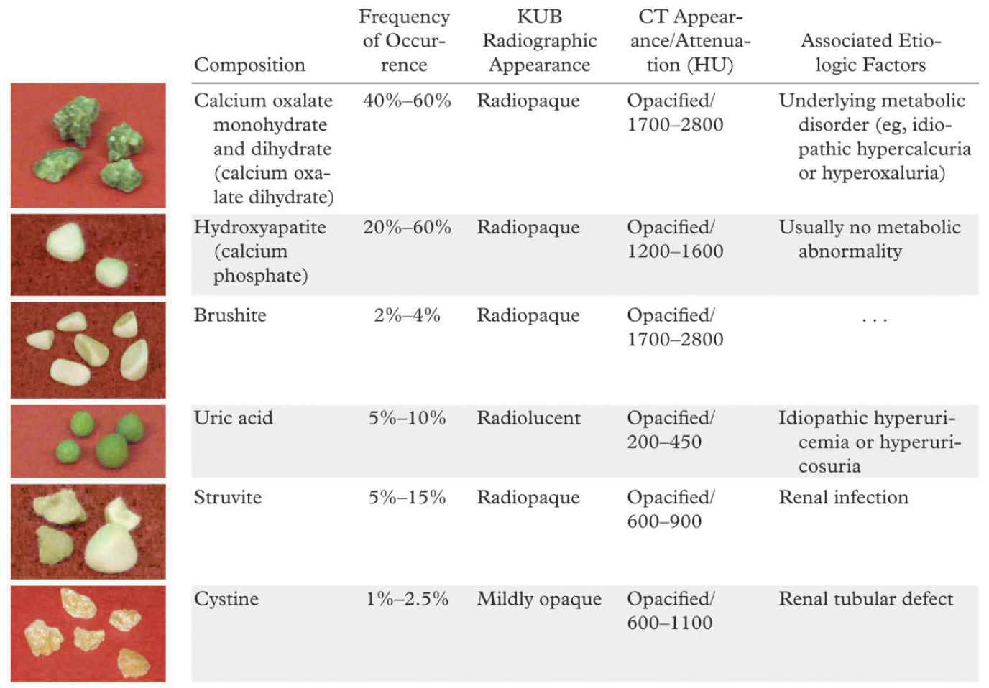
commonly occurring urinary tract stones and their salient features
Kambadakone AR, et al. RadioGraphics 2010; 30:603–623.

Slide 4
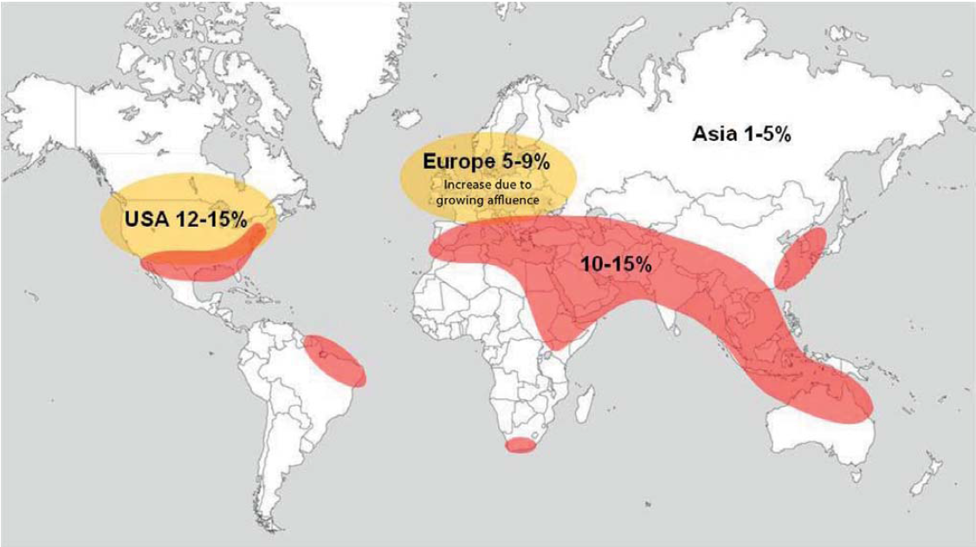
Urolithiasis: Epidemiology
The so-called stone belt (red) extends all the way around world & is characterized by urinary stone prevalence of 10 to 15%
Fisang C, et al. Dtsch Arztebl Int 2015; 112: 83–91.

Slide 5
Urolithiasis: Epidemiology
≈ 50% patients with previous urinary calculi: recurrence within 10 yrs
2 to 3 times more common in males than in females
Occurs more often in adults than in elderly persons & more often in elderly persons than in children
Whites are affected more often than persons of Asian ethnicity, who are affected more often than blacks
Portis AJ, et al. Am Fam Physician 2001;63:1329-38.

Slide 6
Urolithiasis: factors…
Occurs more frequently in hot, arid areas than in temperate regions
Decreased fluid intake & consequent urine concentration: most important factors influencing stone formation
Certain medications: triamterene, indinavir & acetazolamide
Dietary oxalate is another possible cause:
But role of dietary calcium is less clear & calcium restriction is no longer universally recommended
Portis AJ, et al. Am Fam Physician 2001;63:1329-38.

Slide 7
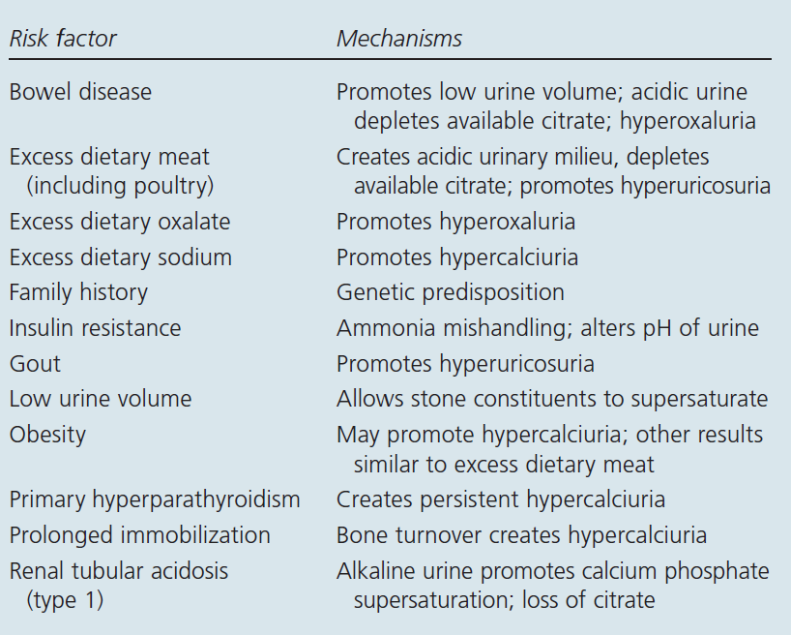
Development of Urinary Calculi: RISK FACTORS
Pietrow PK, et al. Am Fam Physician. 2006;74:86-94, 99-100.

Slide 8
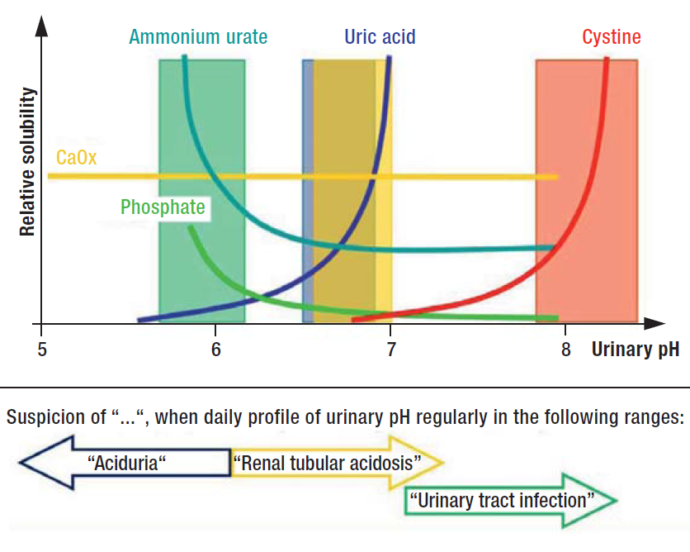
Dependence of lithogenesis on urinary pH
Fisang C, et al. Dtsch Arztebl Int 2015; 112: 83–91.

Slide 9
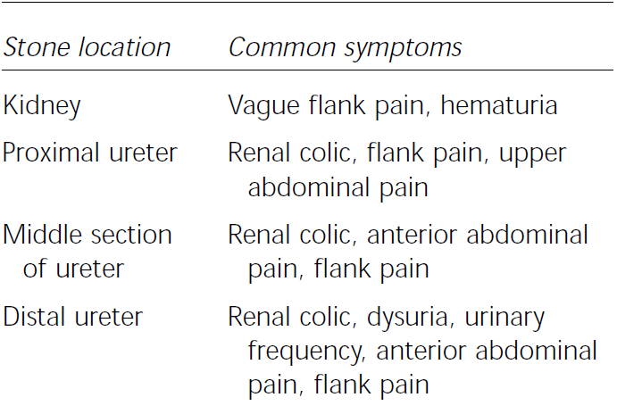
Relationship of Stone Location to Symptoms
Portis AJ, et al. Am Fam Physician 2001;63:1329-38.

Slide 10
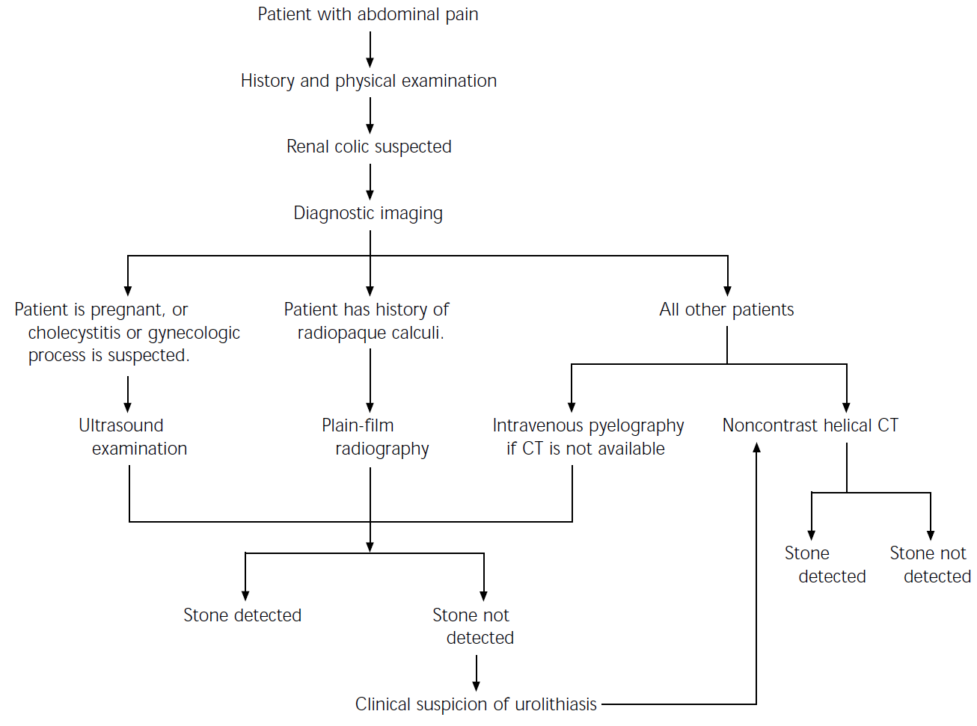
Diagnostic approach: Suspected renal colic

Slide 11
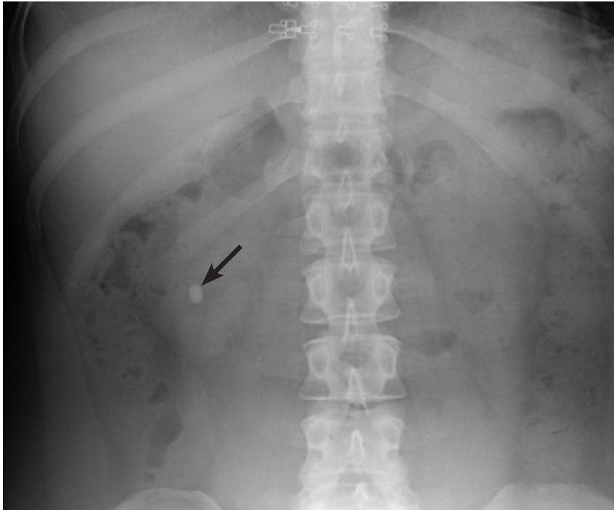
Plain film radiograph: calcium oxalate stone (arrow) in lower pole of rt kidney
Pietrow PK, et al. Am Fam Physician. 2006;74:86-94, 99-100.

Slide 12
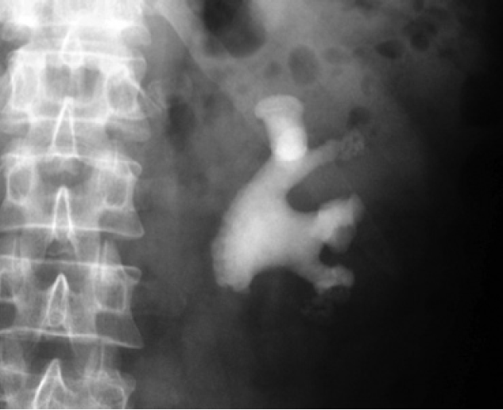
Radiograph: left kidney and upper bladder showing complete staghorn calculus
Pietrow PK, et al. Am Fam Physician. 2006;74:86-94, 99-100.

Slide 13
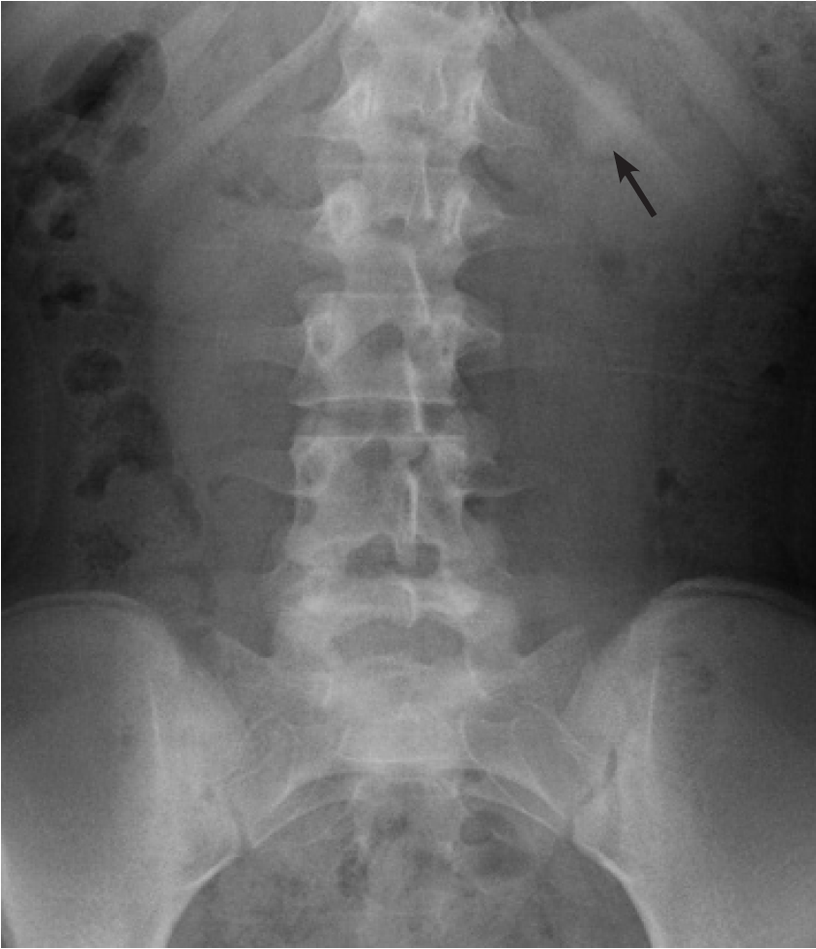
Radiograph: a faintly radiopaque cystine calculus (arrow) overlying 12th rib in left kidney of 13-yr-girl
Pietrow PK, et al. Am Fam Physician. 2006;74:86-94, 99-100.

Slide 14
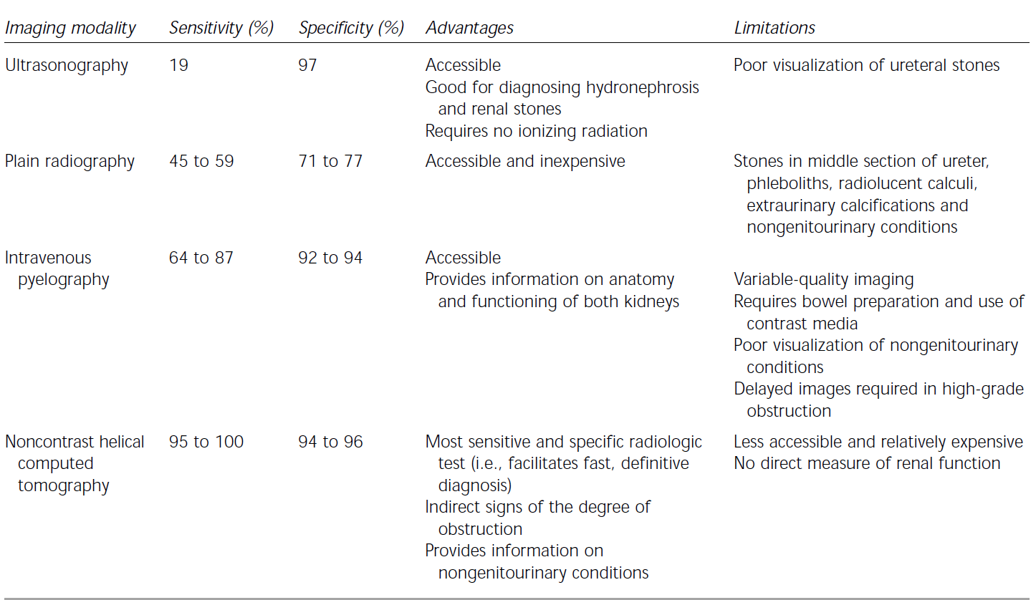
Imaging Modalities: Diagnosis of Ureteral Calculi

Slide 15
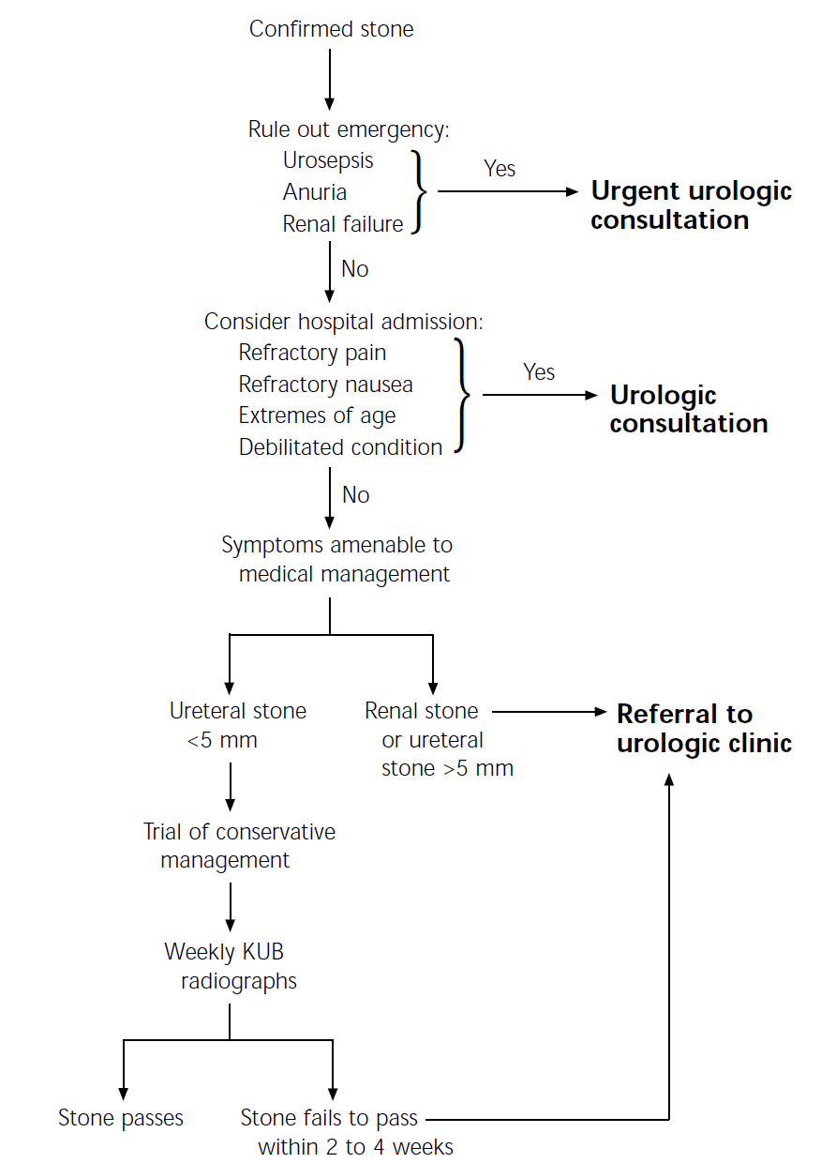
Initial management of radiologically confirmed urolithiasis
(KUB = kidney, ureters and bladder)

Slide 16
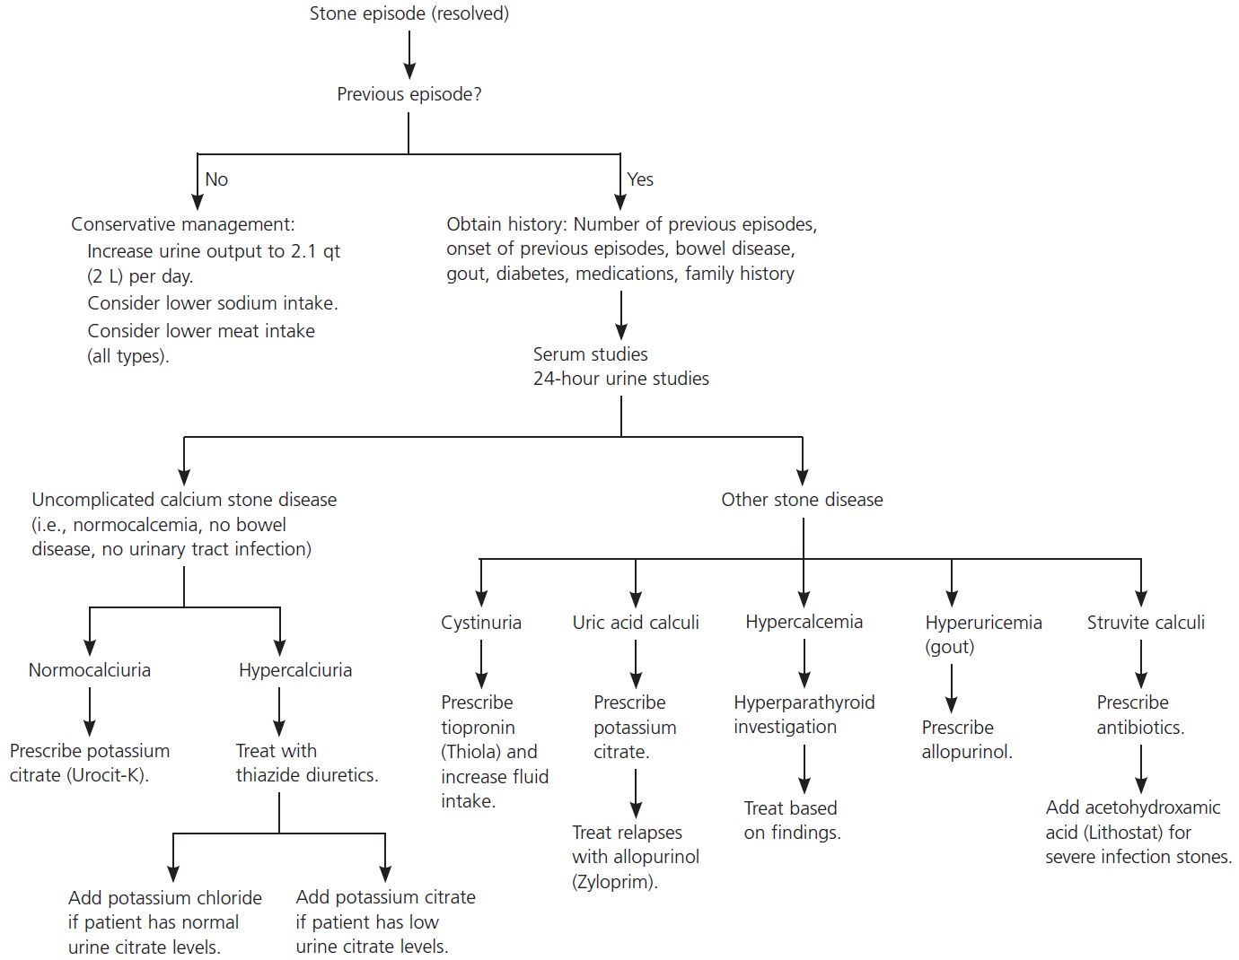
Medical Management of Nephrolithiasis
Pietrow PK, et al. Am Fam Physician. 2006;74:86-94, 99-100.

Slide 17
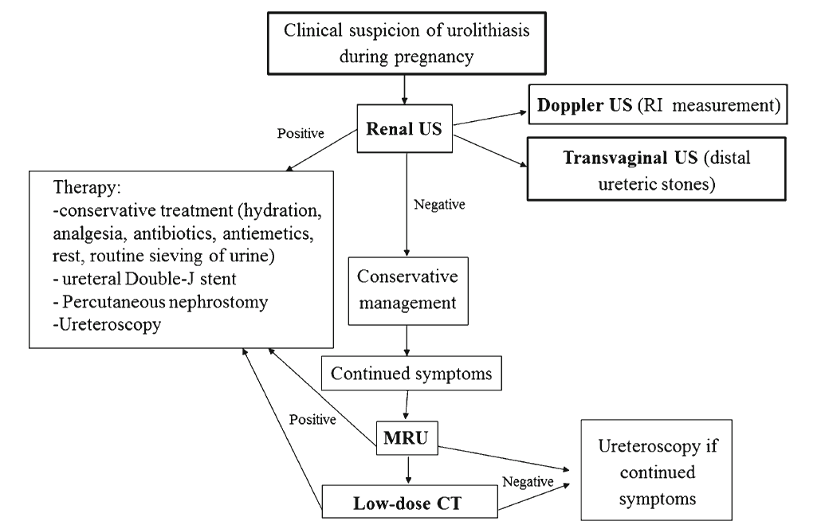
Algorithm: management of urolithiasis during pregnancy
Masselli G, et al. Insights Imaging. 2014; 5: 691–696.

Slide 18
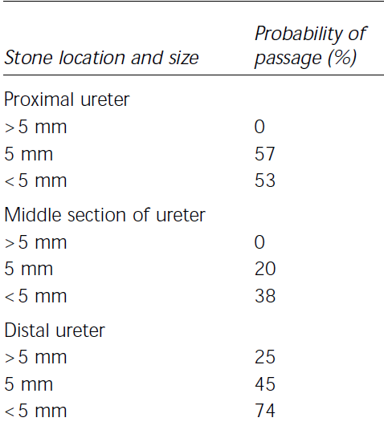
Probability of Stone Passage*
Portis AJ, et al. Am Fam Physician 2001;63:1329-38.

Slide 19
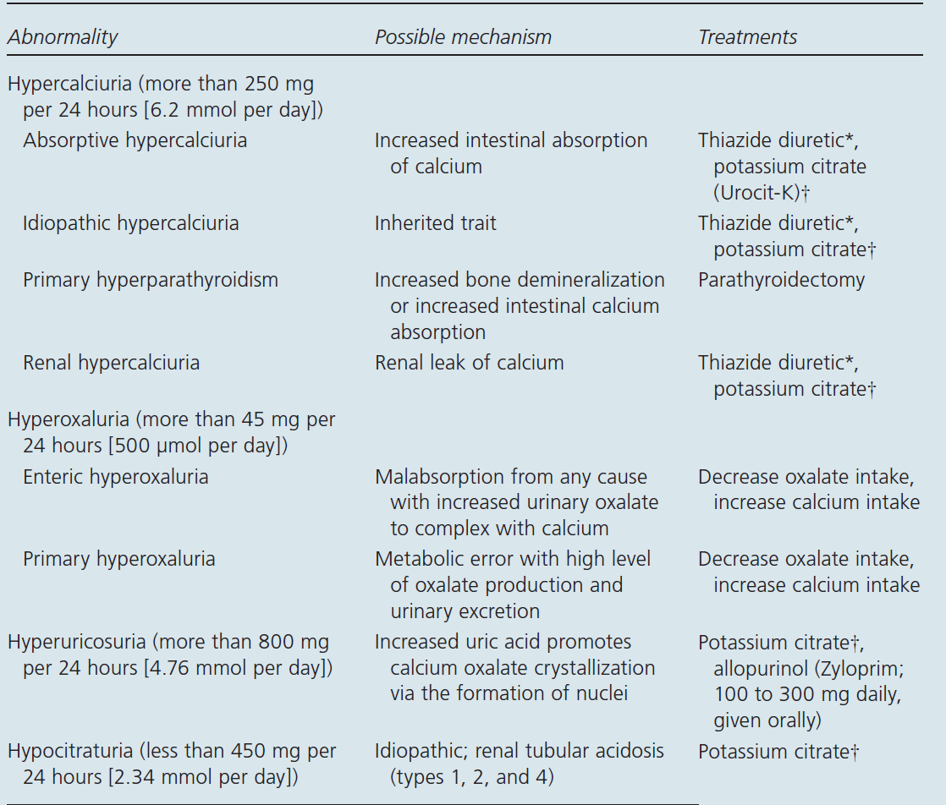
Pietrow PK, et al. Am Fam Physician. 2006;74:86-94, 99-100.

Slide 20
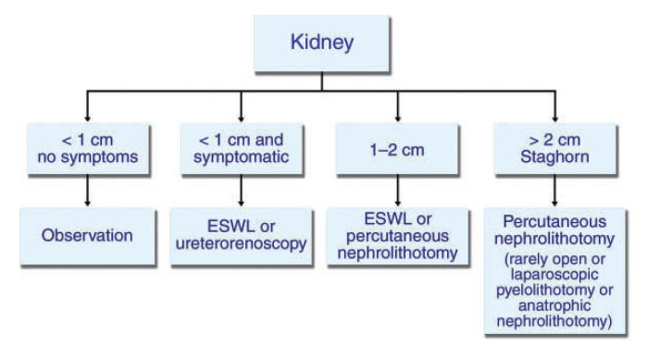
TREATMENT DECISION BASED ON STONE LOCATION: KIDNEY
Kambadakone AR, et al. RadioGraphics 2010; 30:603–623.

Slide 21
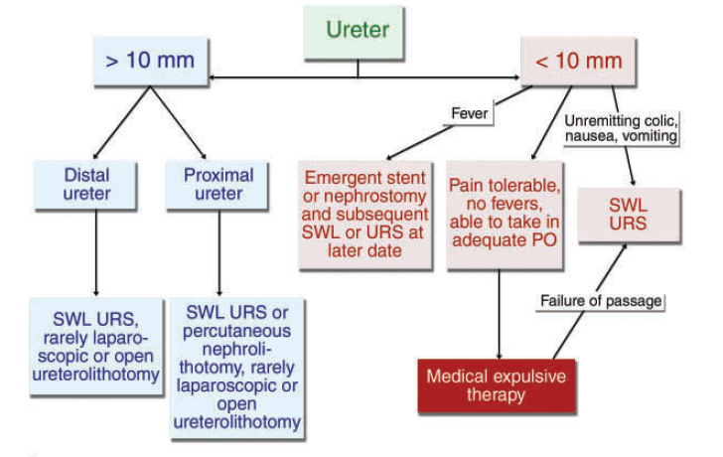
TREATMENT DECISION BASED ON STONE LOCATION: URETER
Kambadakone AR, et al. RadioGraphics 2010; 30:603–623.

Slide 22
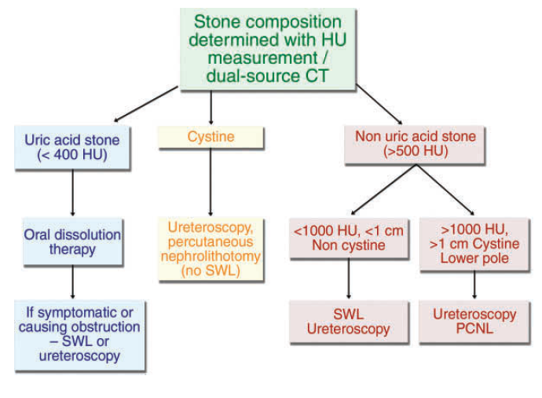
TREATMENT DECISION BASED ON STONE COMPOSITION
Kambadakone AR, et al. RadioGraphics 2010; 30:603–623.

Slide 23
PROPHYLACTIC MANAGEMENT IN URINARY STONE FORMER
All patients presenting with renal colic should be given general medical advice to decrease risk of future stone episode
This advice includes increasing fluid intake so that urine output is > 2L/day
Best estimation of urine output is clear looking urine. This prevents urine stagnation & thus decreases stone risk
Spernat D, et al. BJU International. 2011; 108: 9-13.

Slide 24
PROPHYLACTIC MANAGEMENT IN URINARY STONE FORMER
Patients should ↑ their urinary citrate level through ↑ consumption of citric juices
Urinary citrate: A potent stone inhibitor
Citrate binds calcium in urine, decreasing supersaturation & ↓ growth of crystals
↑ in urinary citrate level even in patients with normal urinary citrate helps prevent stone recurrence
Purine intake (animal meat) should be moderated as it ↑ urinary calcium, oxalate & uric acid secretion
Restricting animal protein & salt while maintaining normal calcium intake ↓ stone recurrence rates compared with low calcium diet
Spernat D, et al. BJU International. 2011; 108: 9-13.

Slide 25
PROPHYLACTIC MANAGEMENT IN URINARY STONE FORMER
High sodium load can ↑ risk of calcium oxalate stone formation & thus salt restriction is also advised
Obesity ↑ risk of stone disease by ↑ urinary acidity, hypocitraturia & hyperuricosuria
Weight loss & low fat diet should be encouraged. This is especially important in patients with bowel disease or malabsorptive conditions
Spernat D, et al. BJU International. 2011; 108: 9-13.

Slide 26
PROPHYLACTIC MANAGEMENT IN URINARY STONE FORMER
Calcium intake within dietary recommendations should be continued even in patients with calcium oxalate stones
Low dietary calcium leads to increased unbound oxalate to be reabsorbed in the gut & thus further ↑ risk of calcium oxalate stones
Patients should also avoid excessive (maximum daily dose 2 g) vitamin C supplements, as this can increase oxalate excretion
Spernat D, et al. BJU International. 2011; 108: 9-13.

Slide 27
PROPHYLACTIC MEDICATIONS: Thiazide diuretics
Thiazides stimulate calcium reabsorption in distal nephron while promoting excretion of sodium. This ↓ urinary calcium excretion but may lead to hypokalemia
Hypokalemia can in turn cause hypocitraturia. Thus potassium citrate supplementation (40 – 60 mEq/day) is recommended with thiazide diuretics
A recent Cochrane review has demonstrated that, in patients with idiopathic hypercalciuria & recurrent stones: Addition of thiazides to normal or modified diet ↓ stone recurrence & formation rate
Spernat D, et al. BJU International. 2011; 108: 9-13.

Slide 28
PROPHYLACTIC MEDICATIONS: Potassium citrate
Potassium citrate has several features
It maintains urine pH above pK_{a} for uric acid thus promoting dissolution of uric acid crystals. This ↓ uric acid & calcium stone formation by ↓ formation of a nidus
Citrate also directly prevents complexation of calcium
In patients with either hypocitraturia or acidic urine pH, treatment with this medication ↑ urinary citrate levels, pH and potassium. This is associated with remission rate of stone disease of up to 91%
Spernat D, et al. BJU International. 2011; 108: 9-13.

Slide 29
PROPHYLACTIC MEDICATIONS: Allopurinol
Allopurinol inhibits xanthine oxidase converting xanthine to uric acid & therefore ↓ uric acid production & hyperuricosuria
This in turn ↓ spontaneous nucleation of calcium oxalate
Randomized controlled trials have demonstrated that allopurinol ↓ stone recurrence in patients with idiopathic calcium oxalate stones who had hyperuricosuria
Allopurinol is therefore effective in ↓ pure uric acid calculi & calcium based calculi
Spernat D, et al. BJU International. 2011; 108: 9-13.

Slide 30
PROPHYLACTIC MEDICATIONS: UroPhos-K
UroPhos-K: A slow release neutral form of potassium phosphate
It produces sustained hypocalciuric response & maintains bone mass in patients with absorptive hypercalciuria
This effect is achieved by directly impairing renal tubular reabsorption of calcium & by binding calcium in gut
It also raises urine pH
UroPhos-K causes a sustained & marked ↓ in urinary calcium. This effect occurs by combination of ↓ intestinal absorption, bone reabsorption & improved renal calcium reabsorption
Well tolerated compared with placebo
Spernat D, et al. BJU International. 2011; 108: 9-13.

Slide 31
PROPHYLACTIC MEDICATIONS: Sodium bicarbonate
Major goal of therapy: To ↑ urine pH above 5.5 & preferably to 6.5 – 7.0. This treatment enhances dissociation of uric acid & inhibits uric acid stone formation
However, treatment may be complicated by calcium oxalate (due to sodium load) or calcium phosphate (due to pH above 7.0) stone formation
Thus potassium citrate is preferable as it avoids sodium load that may precipitate calcium oxalate stone formation
Spernat D, et al. BJU International. 2011; 108: 9-13.

Slide 32
DISSOLUTION THERAPY
Oral Medications:
Sodium bicarbonate
Potassium citrate
Percutaneous Instillation:
Calcium oxalate stones are resistant to dissolution therapy. However, struvite calculi have been associated with (limited) successful dissolution therapies since 1943 (Suby’s solution G). The following two solutions are still used in limited cases:
Hemiacidrin/renacidrin
Tham E
Spernat D, et al. BJU International. 2011; 108: 9-13.

Slide 33
MEDICAL EXPULSION THERAPY
Medical expulsion therapy (MET): Beneficial for distal ureteric calculi
No evidence that MET improves spontaneous stone passage rate of proximal ureteric calculi
However, tamsulosin has been shown to significantly ↑ passage of stones between 5 & 10 mm from proximal to distal ureter
Spernat D, et al. BJU International. 2011; 108: 9-13.

Slide 34
High Fluid intake
A large diuresis that pushes stone into bladder sounds plausible; however, studies have demonstrated that it is actually more likely to counteract passage of stone & to cause more pain
Cochrane database review from 2005: No evidence to support diuresis as method of pain relief or stone expulsion
Spernat D, et al. BJU International. 2011; 108: 9-13.

Slide 35
Alpha blockers
Alpha blockers inhibit ureteral muscle contraction, reduce basal tone & decrease peristaltic frequency and colic pain facilitating ureteral stone expulsion
Meta-analysis has demonstrated: Advantage to alpha blocker use that it increases spontaneous stone passage rate by 14 – 29% which is statistically significant. This is the recommended MET (combined AUA and European Association of Urology (EAU) guidelines 2007)
Spernat D, et al. BJU International. 2011; 108: 9-13.

Slide 36
Alpha blockers: Spontaneous stone passage at one month
Tamsulosin is most commonly used and studied agent
Spernat D, et al. BJU International. 2011; 108: 9-13.

Slide 37
Use of alpha-blockers in patients with ureteral stones results in higher stone-free rate & shorter time to stone expulsion
Alpha-blockers should therefore be offered as part of medical expulsive therapy as 1 of primary treatment modalities

Slide 38
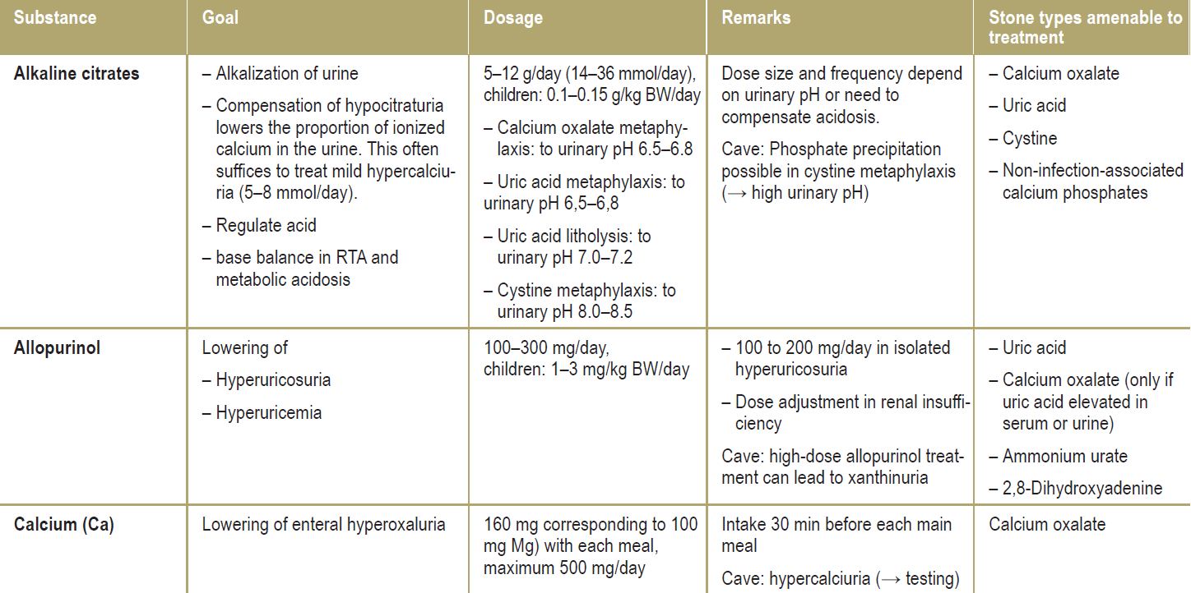
Principal substances used in medicinal prophylaxis of urinary stones
Fisang C, et al. Dtsch Arztebl Int 2015; 112: 83–91.

Slide 39
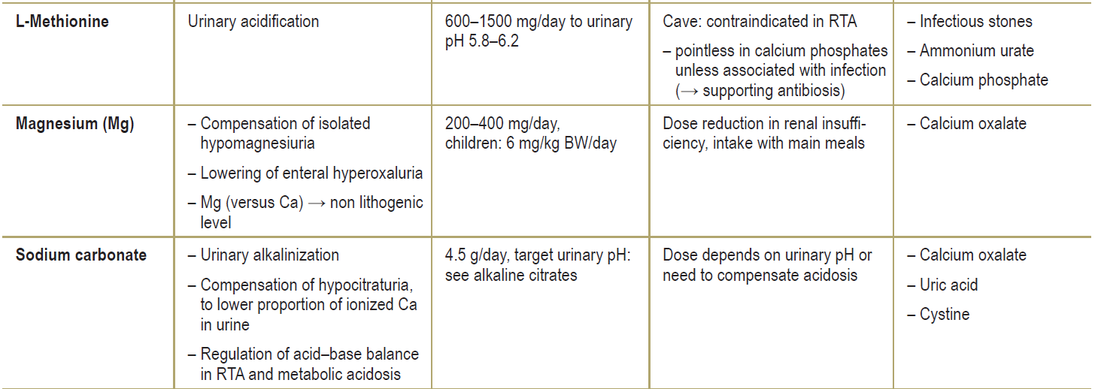
Principal substances used in medicinal prophylaxis of urinary stones
Fisang C, et al. Dtsch Arztebl Int 2015; 112: 83–91.

Slide 40
Principal substances used in medicinal prophylaxis of urinary stones
Fisang C, et al. Dtsch Arztebl Int 2015; 112: 83–91.

Slide 41
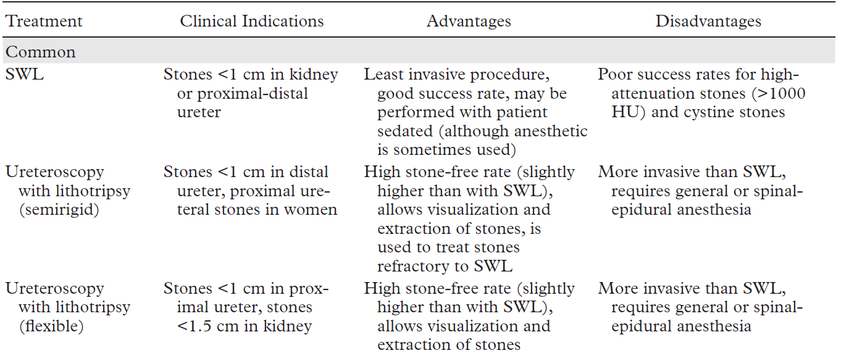
Salient Features of Various Urologic Interventional Procedures for Urolithiasis
Kambadakone AR, et al. RadioGraphics 2010; 30:603–623.

Slide 42
Salient Features of Various Urologic Interventional Procedures for Urolithiasis
Kambadakone AR, et al. RadioGraphics 2010; 30:603–623.

Slide 43
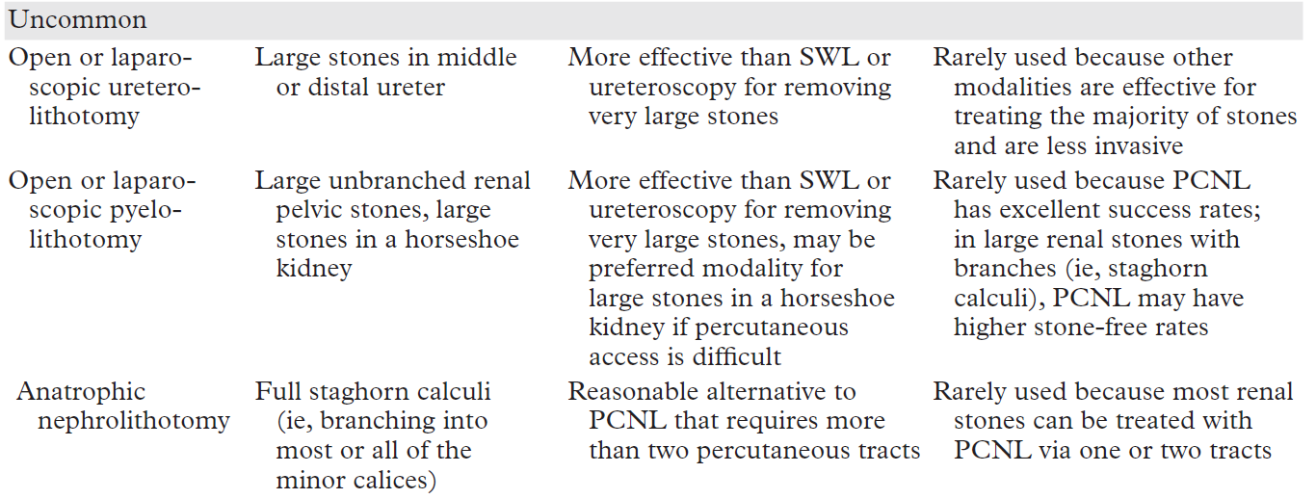
Salient Features of Various Urologic Interventional Procedures for Urolithiasis
Kambadakone AR, et al. RadioGraphics 2010; 30:603–623.

Slide 44
COMPLICATIONS OF UROLITHIASIS
Renal failure
Ureteral stricture
Infection, sepsis
Urine extravasation
Perinephric abscess
Xanthogranulomatous pyelonephritis
Portis AJ, et al. Am Fam Physician 2001;63:1329-38.

Slide 45
THANK YOU!!!

