Slide 1
Detrusor Sphincter Dyssynergia
September 2015

Slide 2
Normal micturition
Normal micturition: Result of synergic action between bladder smooth muscle (detrusor muscle) & striated smooth muscle of urethral sphincter
Process consists of relaxation of urethral sphincter followed by detrusor contraction which expels urine stored in bladder
Synergy between detrusor muscle & external urethral sphincter is controlled by pontine micturition centre
Disruption of pathways between this area & caudal part of spinal cord (SC) often results in detrusor-sphincter dyssynergia (DSD)
Castro-Diaz D, et al. Int J Clin Pract Suppl. 2006; 151: 17-21.

Slide 3
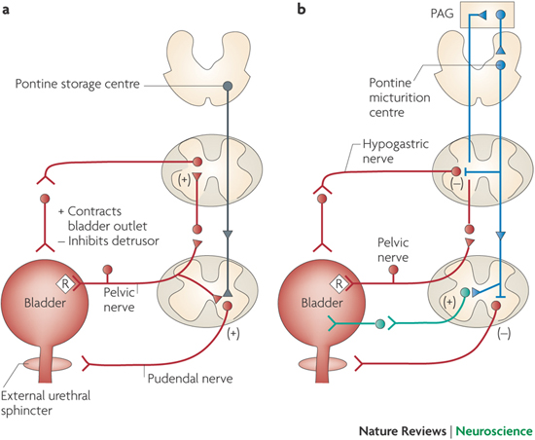
PAG
Pontine storage centre
Pontine micturition centre
Hypogastric nerve
+ Contracts bladder outlet
- Inhibits detrusor
Pelvic nerve
Pelvic nerve
Pudendal nerve
External urethral sphincter
Fowler CJ, et al. Nature Reviews Neuroscience. 2008; 9: 453-66.
Notes:
a | Urine storage reflexes. During the storage of urine, distention of the bladder produces low-level vesical afferent firing. This in turn stimulates the sympathetic outflow in the hypogastric nerve to the bladder outlet (the bladder base and the urethra) and the pudendal outflow to the external urethral sphincter. These responses occur by spinal reflex pathways and represent guarding reflexes, which promote continence. Sympathetic firing also inhibits contraction of the detrusor muscle and modulates neurotransmission in bladder ganglia. A region in the rostral pons (the pontine storage centre) might increase striated urethral sphincter activity.
b | Voiding reflexes. During the elimination of urine, intense bladder-afferent firing in the pelvic nerve activates spinobulbospinal reflex pathways (shown in blue) that pass through the pontine micturition centre. This stimulates the parasympathetic outflow to the bladder and to the urethral smooth muscle (shown in green) and inhibits the sympathetic and pudendal outflow to the urethral outlet (shown in red). Ascending afferent input from the spinal cord might pass through relay neurons in the periaqueductal grey (PAG) before reaching the pontine micturition centre. Note that these diagrams do not address the generation of conscious bladder sensations, nor the mechanisms that underlie the switch from storage to voiding, both of which presumably involve cerebral circuits above the PAG. R represents receptors on afferent nerve terminals.
Normal micturition: Result of synergic action between bladder smooth muscle (detrusor muscle) & striated smooth muscle of urethral sphincter
Process consists of relaxation of urethral sphincter followed by detrusor contraction which expels urine stored in bladder
Synergy between detrusor muscle & external urethral sphincter is controlled by pontine micturition centre
Disruption of pathways between this area & caudal part of spinal cord (SC) often results in detrusor-sphincter dyssynergia (DSD)

Slide 4
DSD: Definition
Involuntary detrusor contractions concurrent with involuntary contraction of urethral striated muscle &/or periurethral striated muscle
Karsenty G, et al. Urology. 2005; 66: 763-8.
Notes:
Loss of reciprocal inhibition of sphincter & activation of detrusor following disconnection from pons results in DSD

Slide 5
DSD: Causes
Neurologic condition due to interruption of spinal pathways connecting pontine & sacral micturition centers
Can occur after any spinal cord injury (SCI) or disease below pons & above sacral cord
More frequent in patients with complete spinal cord lesion & in such cases is more likely to be continuous
Most common causes of DSD:
Spinal cord injury, multiple sclerosis, acute transverse myelitis & myelomeningocele
- Castro-Diaz, et al. Int J Clin Pract Suppl. 2006; 151: 17-21.
Karsenty G, et al. Urology. 2005; 66: 763-8.

Slide 6
Without adequate treatment
> 50% will develop severe complications
Maybe due to lower detrusor pressures, complications are less common
Castro-Diaz, et al. Int J Clin Pract Suppl. 2006; 151: 17-21.
Notes:
Without adequate treatment more
than 50% of men with DSD will develop severe complications
(3). In women, maybe due to lower detrusor
pressures, these complications are less common.

Slide 7
Complications…
DSD prevents adequate voiding & which might lead to low compliant and thick-walled bladder
Elevated retrograde pressures in ureter & pelvis
Hydronephrosis
Renal scarring
Terminal kidney failure
Castro-Diaz D, et al. Int J Clin Pract Suppl. 2006; 151: 17-21.

Slide 8
Pathophysiologic mechanisms
Exact pathophysiologic mechanisms that explain EUS & bladder cocontraction: Not fully understood
Unclear: 1st EUS or detrusor (DSD chronology) contracts??
Yalla et al: Sphincter starts to contract “just before or at same time as bladder”
Blaivas et al: “Dyssynergic sphincter contraction occurs simultaneously with or immediately after onset of bladder contraction in majority of patients”
Karsenty G, et al: EUS starts to contract just before detrusor
Karsenty G, et al. Urology. 2005; 66: 763-8.

Slide 9
Pathophysiologic mechanisms
Pontine micturition centre is connected to sacral SC through ascendant & descendant neural pathways
When there is abnormality (i.e. disruption) in these pathways, synergic action between detrusor & external sphincter is lost
Few wks after signalling breakdown, detrusor muscle contraction becomes synchronised with external sphincter contractions instead of relaxation
Castro-Diaz D, et al. Int J Clin Pract Suppl. 2006; 151: 17-21.

Slide 10
Routine & Optional Tests: Evaluation of DSD following SC injury
Routine
optimal
Voiding diary
Urinalysis & culture
Levels of plasma electrolytes & creatinine
Renal tract ultrasound (with measurement of post-void residual urine volume)
Videourodynamic studies
Urine cytology
24 h creatinine clearance
Cystoscopy
Isotope studies (^{99m}Tc-labelled pentavalent dimercaptosuccinic acid imaging)
Electromyography
Ahmed HU, et al. Nature Clinical Practice: Urology. 2006; 3(7): 368-380.

Slide 11
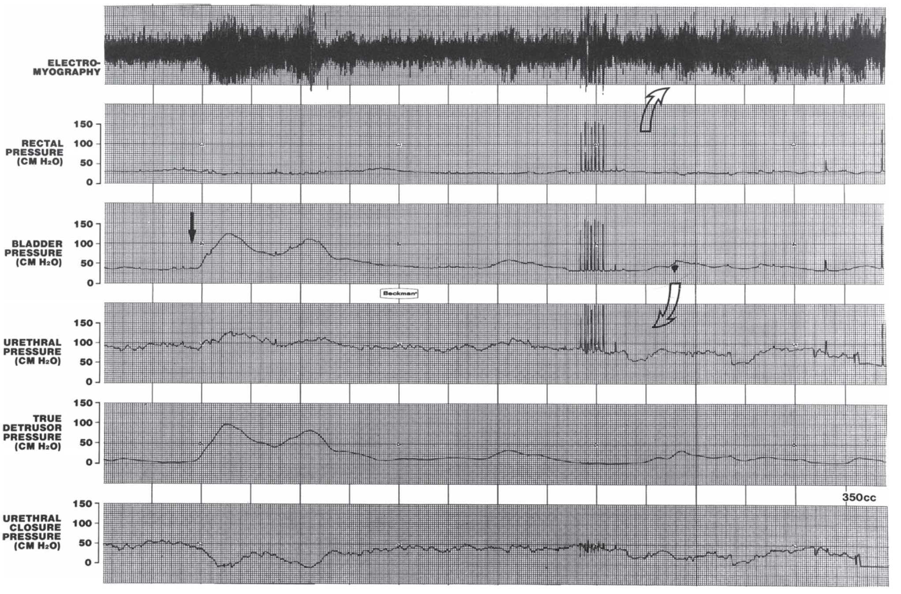
Detrusor sphincter dyssynergia during a pressure voiding study.

Slide 12
3 Types of DSD identified on EMG
Type 1
Type 2
Type 3
Simultaneous increase of detrusor pressure & external sphincter EMG activity that reaches its maximum at peak of detrusor contraction
As detrusor pressure begins to decline, sudden complete external relaxation occurs
Clonic contractions of external urethral sphincter interspersed throughout detrusor contraction
Patients usually void with an interrupted stream
External sphincter contraction persists throughout entire detrusor contraction
These patients void with obstructive stream or cannot void at all
Types 2 & 3 DSD are considered to have a greater risk of urological complication, as bladder outflow obstruction is continuous throughout detrusor contraction
Castro-Diaz D, et al. Int J Clin Pract Suppl. 2006; 151: 17-21.

Slide 13
Most available therapies for DSD: Focused on decreasing or even eliminating abnormal activity of external sphincter
- Castro-Diaz, et al. Int J Clin Pract Suppl. 2006; 151: 17-21.

Slide 14
Management
Type 1 DSD:
Usually managed conservatively by means of watchful waiting, with exception of those patients having vesicoureteric reflux, hydronephrosis or autonomic dysreflexia
Types 2 & 3 DSD:
Should be treated in order to avoid complications
For most part:
Pharmacological therapy for DSD has not provided acceptable outcomes
Castro-Diaz D, et al. Int J Clin Pract Suppl. 2006; 151: 17-21.

Slide 15
Drugs
Alpha-blocking agents & those that might relax striated sphincter should, at least theoretically, decrease urethra resistance during micturition
This approach can be beneficial in neurologically normal patient, but their use in patient with neurological disease is not very effective
Benzodiazepines:
Seem to potentiate action of GABA at both presynaptic & postsynaptic sites in brain & SC
No evidence of any benefit of these compounds in DSD
Castro-Diaz D, et al. Int J Clin Pract Suppl. 2006; 151: 17-21.

Slide 16
Baclofen
Glycine & GABA agonist: Depresses excitation of motor neurons & interneurons in SC
Useful: Treatment of skeletal spasticity attributable to variety of causes, especially MS & traumatic spinal cord lesions
Utility for treatment of DSD: Not been thoroughly proven
Intravenous, but not oral, baclofen was found effective for patients with DSD, but AEs of weakness & dizziness were common
Castro-Diaz D, et al. Int J Clin Pract Suppl. 2006; 151: 17-21.

Slide 17
Baclofen
High oral doses might decrease intravesical pressure in some patients, but because of its potential AEs this drug cannot be readily recommended for treatment of DSD
Has been used through intrathecally implanted pump, showing promising results in some patients with DSD
Castro-Diaz D, et al. Int J Clin Pract Suppl. 2006; 151: 17-21.

Slide 18
Botulinum toxin A
Has also been used for treatment of DSD
Toxin acts at neuromuscular junction of external sphincter to block vesicle transport of acetylcholine, thus producing chemical denervation
Clinical effects begin within 2–3 days & are reversible as terminal nerve sprouting occurs within 3–6 months
Castro-Diaz D, et al. Int J Clin Pract Suppl. 2006; 151: 17-21.

Slide 19
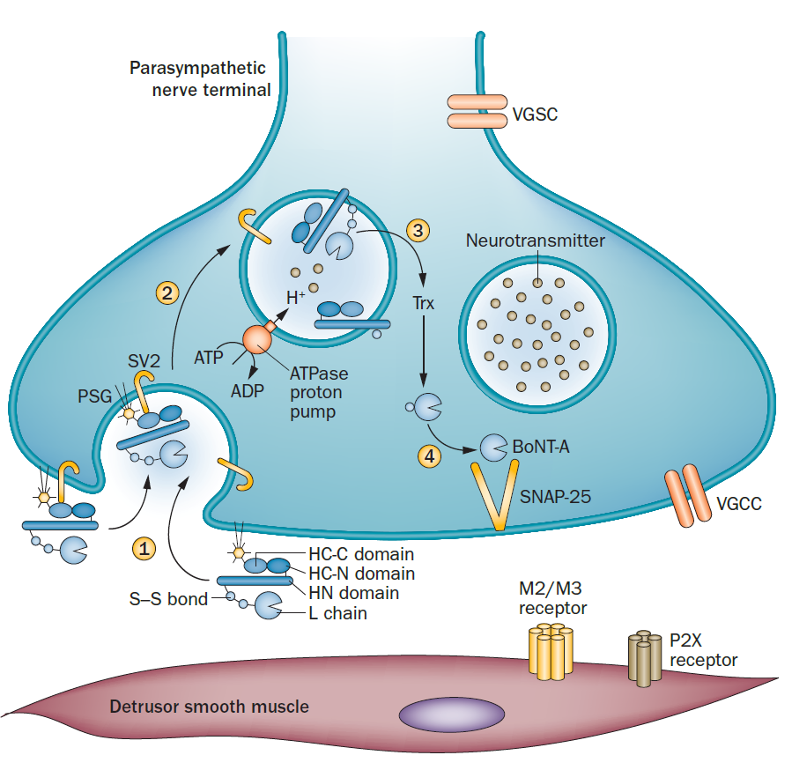
Effects of BoNT‑A on detrusor smooth muscle contraction
Jiang YH, et al. Nat Rev Urol. 2015; 12(9): 519-33.

Slide 20
TURS
Transurethral incision of external urinary sphincter (TURS): Used to promote bladder emptying & prevent urological complications in male spinal cord injured patients for nearly 50 years
Procedure helps decrease urinary outflow resistance because of DSD
Goal: To reduce intravesical voiding pressure mediated by bladder contractions against dyssynergically contracted external urethral sphincter
Primary indication for sphincterotomy: Individuals who have elevated residual urine volumes in presence of good but involuntary detrusor contractions & in those who have failed conservative management
Castro-Diaz D, et al. Int J Clin Pract Suppl. 2006; 151: 17-21.

Slide 21
External sphincter stents
External sphincter stents have potential to reduce dyssynergic external sphincter activity & reduce incidence of recurrent obstruction
Some stents may be truly reversible
Castro-Diaz D, et al. Int J Clin Pract Suppl. 2006; 151: 17-21.

Slide 22
Summary
Detrusor-sphincter dyssynergia: A dangerous condition which might lead to severe upper urinary tract complications
Aim of therapy: To significantly decrease or eliminate abnormal activity of external urethral sphincter
Castro-Diaz D, et al. Int J Clin Pract Suppl. 2006; 151: 17-21.

Slide 23
THANK YOU!!!

