Slide 1
Genitourinary TB
November 2015

Slide 2
Genitourinary TB
Genitourinary tuberculosis (GUTB): Not very common¹
Considered: Severe form of extra-pulmonary tuberculosis¹
GUTB: Infectious disease of kidneys, urinary tract & male genitals caused by mycobacterium tuberculosis (MTB)²
Clear definition & classification necessary for correct therapy²
Cek M, et al. EAU Guidelines for the Management of Genitourinary Tuberculosis. Eur Urol. 2005; 48: 353-362/ 2. Kulchavenya E. Ther Adv Urol. 2013; 5(3): 143-151.

Slide 3
Classification
I. KTB:
Level 1: Nondestructive form, TB of parenchyma
Level 2: Small destructive form, TB papillitis
Level 3: Destructive form with 1 or 2 caverns (cavernous kidney TB)
Level 4: Widespread destructive form with > 2 caverns (polycavernous kidney TB)
Complications of KTB:
TB of urinary tract (TB of ureter, bladder grades 1–4, urethra), strictures, fistula & renal failure
Kulchavenya E. Ther Adv Urol. 2013; 5(3): 143-151.

Slide 4
Classification
II. MGTB:
Orchiepididymitis (monolateral and bilateral)
Prostate TB (infiltrative or cavernous forms)
TB of seminal vesicles
TB of penis
Complications of MGTB:
Strictures, fistula, infertility, sexual dysfunction
Kulchavenya E. Ther Adv Urol. 2013; 5(3): 143-151.

Slide 5
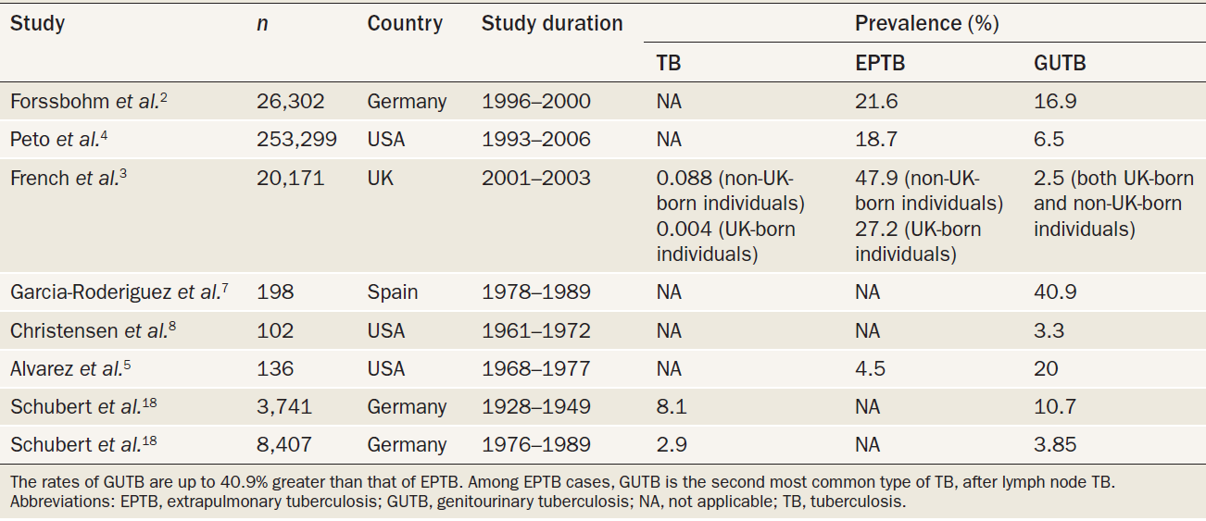
Prevalence of TB, EPTB & GUTB
Abbara A, et al. Nat Rev Urol. 2011; 8: 678-688.

Slide 6
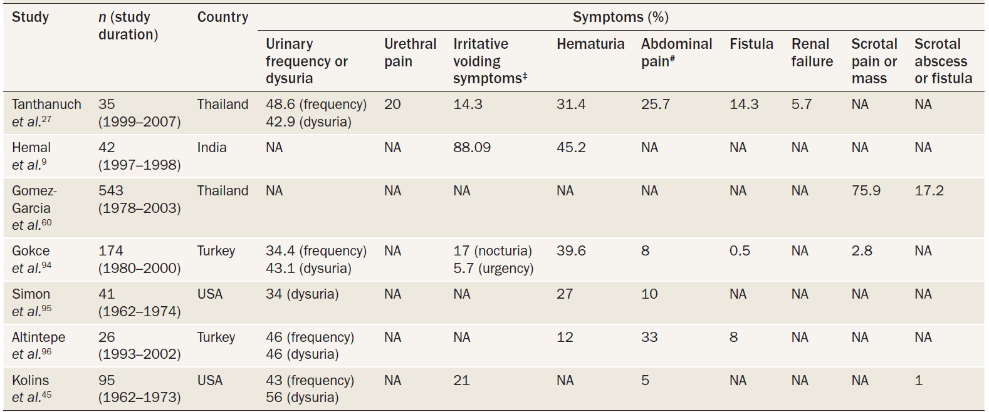
Symptoms of GUTB
Abbara A, et al. Nat Rev Urol. 2011; 8: 678-688.
Notes:
*The symptoms of GUTB are related to the site of the disease; they can be nonspecific and can occur in late-stage disease. The most commonly reported symptoms are irritative voiding symptoms and hematuria. ‡Irritative voiding symptoms include urinary frequency, urgency, dysuria and nocturia. #Abdominal pain can be flank or suprapubic. Abbreviations: GUTB, genitourinary tuberculosis; NA, not applicable

Slide 7
Affected organs & symptoms: Women with GUTB
Abbara A, et al. Nat Rev Urol. 2011; 8: 678-688.
Notes:
*The symptoms of GUTB are related to the site of the disease; they can be nonspecific and can occur in late-stage disease. The most commonly reported symptoms are irritative voiding symptoms and hematuria. ‡Irritative voiding symptoms include urinary frequency, urgency, dysuria and nocturia. #Abdominal pain can be flank or suprapubic. Abbreviations: GUTB, genitourinary tuberculosis; NA, not applicable

Slide 8
Diagrammatic representation: Varied effects of tuberculosis of urinary tract
Merchant S, et al. Indian Journal of Radiology and Imaging. 2013; 23 (1): 46-63.

Slide 9
Diagrammatic representation: Varied effects of tuberculosis of urinary tract
Merchant S, et al. Indian Journal of Radiology and Imaging. 2013; 23 (1): 46-63.

Slide 10
Diagrammatic representation: Varied effects of tuberculosis of urinary tract
Merchant S, et al. Indian Journal of Radiology and Imaging. 2013; 23 (1): 46-63.

Slide 11
Diagrammatic representation: Varied effects of tuberculosis of urinary tract
Merchant S, et al. Indian Journal of Radiology and Imaging. 2013; 23 (1): 46-63.

Slide 12
GUTB: Diagnosis
Difficult>> Symptoms are non-specific
Most important step: Patient history
Knowledge of TB infection early in life either as primary pulmonary manifestation or as extra-pulmonary manifestation gives important clue in large number of cases
Latency between pulmonary manifestation & GUTB: Enormous (some cases: > 30 yrs before GUTB becomes evident)
Cek M, et al. EAU Guidelines for the Management of Genitourinary Tuberculosis. Eur Urol. 2005; 48: 353-362.

Slide 13
GUTB: Diagnosis
Urinary TB: voiding problems & chronic urgency non-responding to antibacterial drug regimens are indicative of GUTB
In men: Chronic epididymitis is typical manifestation of TB of male genital tract, mostly combined with scrotal fistulas
Other symptoms: back, flank & suprapubic pain, hematuria, frequency & nocturia
Cek M, et al. EAU Guidelines for the Management of Genitourinary Tuberculosis. Eur Urol. 2005; 48: 353-362.

Slide 14
GUTB: Diagnosis
Renal colic: Uncommon (occurring in fewer than 10% of pts)
Constitutional symptoms: Fever, weight loss & night sweats are unusual
Commonly: Symptoms are intermittent & have been present for some time before patient seeks medical advice
Cek M, et al. EAU Guidelines for the Management of Genitourinary Tuberculosis. Eur Urol. 2005; 48: 353-362.

Slide 15
Microbiologic Diagnosis
Usually made: Isolation of causative organism from urine or biopsy material on conventional solid media or by automated system such as radiometry
Cek M, et al. EAU Guidelines for the Management of Genitourinary Tuberculosis. Eur Urol. 2005; 48: 353-362.

Slide 16
Diagnosis
Positive culture or histological analysis of biopsy specimens possibly combined with PCR is still required in most patients for definite diagnosis
25–30% diagnosis of GUTB is established on basis of histological pattern and/or by detection of Mycobacterium tuberculosis complex by PCR
Detection of acid-fast bacilli from urine samples by microscopy (Ziehl-Neelsen acid fast stain) is not reliable because of possible presence of M. smegmatis, which are acid- fast bacilli too
Biological activity of TB can only be assessed by cultivating mycobacteria
Cek M, et al. EAU Guidelines for the Management of Genitourinary Tuberculosis. Eur Urol. 2005; 48: 353-362.

Slide 17
Bacillary load, extent of disease & anatomical site are considerations in determining disease severity & therefore appropriate treatment
Genitourinary TB, together with some other forms of EPTB (extra-pulmonary TB) is classified as severe TB
Cek M, et al. EAU Guidelines for the Management of Genitourinary Tuberculosis. Eur Urol. 2005; 48: 353-362.

Slide 18
Diagnosis
GUTB is a form of secondary TB with vague symptoms. Therefore, urologists should always consider diagnosis of genitourinary TB in patient presenting with vague, long-standing urinary symptoms for which there are no obvious cause
There is often latent period of 20 years or more between infection with tubercle bacillus & expression of GUTB
Cek M, et al. EAU Guidelines for the Management of Genitourinary Tuberculosis. Eur Urol. 2005; 48: 353-362.

Slide 19
Diagnosis
Most common laboratory abnormalities: Pyuria, albuminuria & hematuria
75% of patients has abnormal chest X-ray
88% of patients tested have positive skin tests & 63% tested have abnormal excretory urography
16% show renal calcification
Renal TB is accompanied by manifestations of urinary syndrome in 70.4% of cases & by presence of Mycobacteria tuberculosis in 100%
Cek M, et al. EAU Guidelines for the Management of Genitourinary Tuberculosis. Eur Urol. 2005; 48: 353-362.

Slide 20
GUTB in Children
Genitourinary TB is very uncommon in children because symptoms of renal TB do not appear for 3 to 10 or more years after primary infection
Cek M, et al. EAU Guidelines for the Management of Genitourinary Tuberculosis. Eur Urol. 2005; 48: 353-362.

Slide 21
Diagnosis
Patient usually complains of frequent painless micturition, at 1st only at night but later during day as well
Urgency is uncommon unless there is extensive bladder involvement
Urine is normally sterile & in high proportion of patients, it contains leukocytes
Up to 20% of patients may not have any leukocytes in urine
Overt hematuria is present in only 10% of patients, but microscopic hematuria is present in up to 50%
Cek M, et al. EAU Guidelines for the Management of Genitourinary Tuberculosis. Eur Urol. 2005; 48: 353-362.

Slide 22
Diagnosis
Renal & suprapubic pain is rare presenting symptom and usually means extensive involvement of kidney & bladder
Suprapubic pain is always accompanie by very frequent micturition
Although hematospermia is a rare presenting symptom, TB should always be considered in patients who are seen with repeated attacks of hematospermia as only presenting symptom, even if there is no other evidence of GUTB
Cek M, et al. EAU Guidelines for the Management of Genitourinary Tuberculosis. Eur Urol. 2005; 48: 353-362.

Slide 23
Diagnosis
Recurrent cystitis is also a warning sign. It may be necessary to repeat investigations, because M. tuberculosis may be difficult to isolate from urine
Only presenting symptom may be a painful testicular swelling
Early morning specimens of urine should be examined if it is difficult to differentiate between TB & nonspecific epididiymoorchitis
Rarely, diagnosis is incidental finding that is made after transurethral resection of prostate when pathologist reports foci of TB. These patients should be given antituberculous chemotherapy (Level 4)
Cek M, et al. EAU Guidelines for the Management of Genitourinary Tuberculosis. Eur Urol. 2005; 48: 353-362.

Slide 24
Tuberculin test
A person’s ability to respond to local concentration of injection may be decreased by malignancy, nutritional deficiencies, steroid therapy, irradiation & AIDS
A positive skin test supports diagnosis of TB, but a negative skin test does not necessarily exclude extra-pulmonary manifestation. This is especially true in cases of GUTB
Cek M, et al. EAU Guidelines for the Management of Genitourinary Tuberculosis. Eur Urol. 2005; 48: 353-362.

Slide 25
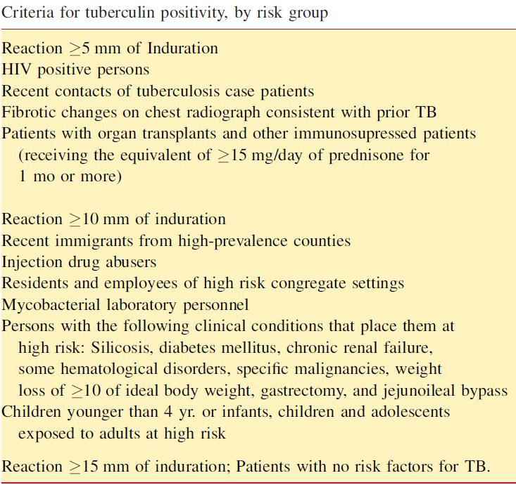
Tuberculin test
CDC has recommended 3 cut points for defining positive tuberculin reaction: induration of 5 mm or greater, 10 mm or greater, and 15 mm or greater
Cek M, et al. EAU Guidelines for the Management of Genitourinary Tuberculosis. Eur Urol. 2005; 48: 353-362.

Slide 26
Urine examination
Urine is examined for RBCs & leukocytes and pH and concentration are noted
Urine is also cultured for other potential uropathogens since secondary bacterial infections may be detected in about 20% of cases
‘‘Sterile pyuria’’ is classic urinary finding on routine urinalysis & culture
Cek M, et al. EAU Guidelines for the Management of Genitourinary Tuberculosis. Eur Urol. 2005; 48: 353-362.

Slide 27
Diagnosis of genitourinary tuberculosis is made based on culture studies
At least 3, but preferably 5, consecutive early morning specimens of urine should be cultured, each onto 2 slants
Cek M, et al. EAU Guidelines for the Management of Genitourinary Tuberculosis. Eur Urol. 2005; 48: 353-362.

Slide 28
Plain X-ray films of urinary tract are important
because they may show calcification in renal areas & in lower genitourinary tract
Renal calcification may not represent inactive process which requires further evaluation
Cek M, et al. EAU Guidelines for the Management of Genitourinary Tuberculosis. Eur Urol. 2005; 48: 353-362.

Slide 29
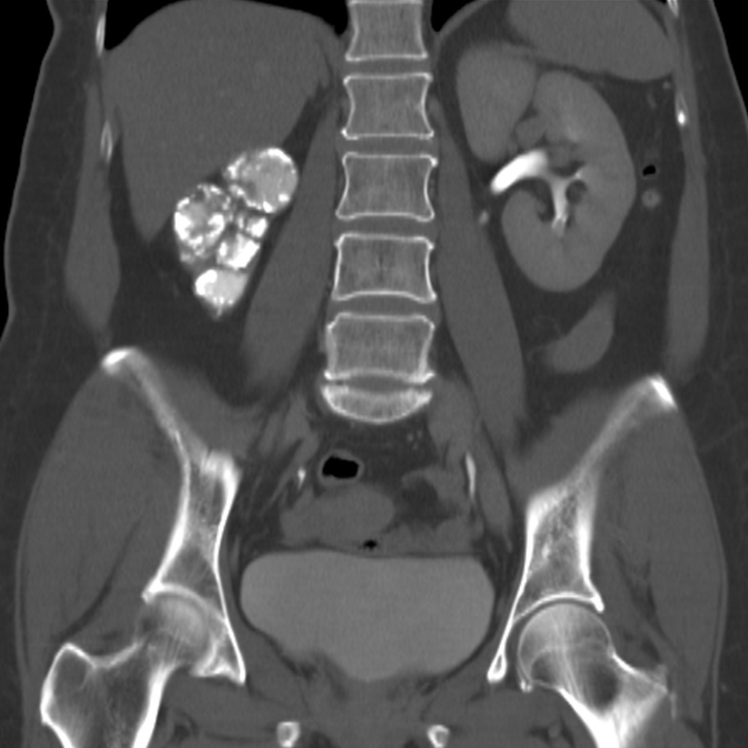

Slide 30
Intravenous Urography
Radiological imaging can be helpful to detect GUTB
Characteristic signs on intravenous pyelogram & CT are useful in depicting GUTB
Radiologically detectable manifestations of TB allow earlier diagnosis & timely initiation of appropriate therapy>> reducing patient morbidity
Cek M, et al. EAU Guidelines for the Management of Genitourinary Tuberculosis. Eur Urol. 2005; 48: 353-362.

Slide 31
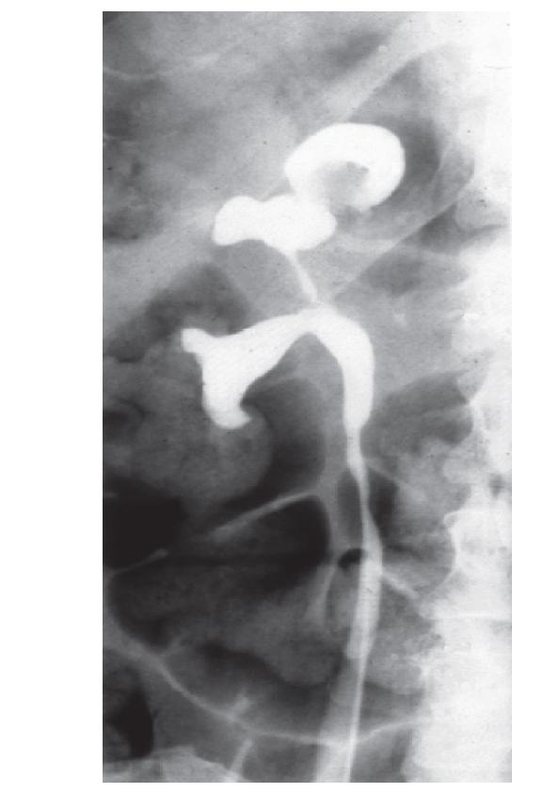
Intravenous urographic imaging of a patient with urological TB. Pelvicalyceal dilatation & ureteric stricture can be observed. This feature is characteristic of TB, particularly if multiple strictures exist with dilatation of collecting system
Abbara A, et al. Nat Rev Urol. 2011; 8: 678-688.

Slide 32
Intravenous Urography
In early course of disease, it is often possible on intravenous urography to detect changes in single calyx with evidence of parenchymal necrosis
Renal lesion may appear as distortion of calyx, as a calyx that is fibrosed & completely occluded (lost calyx from infundibular stenosis), as multiple small calyceal deformities, or as severe calyceal & parenchymal destruction
In more advanced disease, urography will show calyceal distortion, ureteric strictures & bladder fibrosis
Cek M, et al. EAU Guidelines for the Management of Genitourinary Tuberculosis. Eur Urol. 2005; 48: 353-362.

Slide 33
Intravenous Urography
Introduction of high-dose intravenous urogram is now accepted as standard practice
A dynamic study of diseased ureter can be performed by utilizing image-intensified endoscopy. This functional information about ureteral peristalsis provides further information about extent of disease, peristaltic activity, amount of fibrosis that is present & length of stricture, particularly at ureterovesical junction
A nonfunctioning or extensively diseased kidney indicates irreversible tuberculous disease
Cek M, et al. EAU Guidelines for the Management of Genitourinary Tuberculosis. Eur Urol. 2005; 48: 353-362.

Slide 34
Retrograde pyelography
Retrograde pyelography is now rarely necessary, but there are 2 indications for its use:
Stricture at lower end of ureter, when it is necessary to try to delineate length of stricture & amount of obstruction and dilatation above stricture
Ureteral catheterization, which may be required to obtain urine samples for culture from each kidney
Cek M, et al. EAU Guidelines for the Management of Genitourinary Tuberculosis. Eur Urol. 2005; 48: 353-362.

Slide 35
Ultrasonography & CT
Ultrasound examination of urinary tract may reveal renal calyceal dilation & more overt evidence of obstruction
CT & nuclear magnetic imaging are important for differential diagnosis (renal parenchymal masses, scarring, autonephrectomy)
Cek M, et al. EAU Guidelines for the Management of Genitourinary Tuberculosis. Eur Urol. 2005; 48: 353-362.

Slide 36
Cystoscopy & ureteroscopy
Endoscopy must always be performed with patient under GA with muscle relaxant to reduce risk of hemorrhage
Phase of bladder filling should be performed under direct vision
Indications for ureteroscopy are rare
Renal TB should be included in differential diagnosis of lateralizing hematuria, especially in absence of obvious cause for bleeding. Direct culture of urine from renal pelvis may have more sensitivity than culture of voided urine in this circumstance
Cek M, et al. EAU Guidelines for the Management of Genitourinary Tuberculosis. Eur Urol. 2005; 48: 353-362.

Slide 37
Bladder biopsy
Bladder biopsy is contraindicated in presence of acute tuberculous cystitis
It is acceptable only in patients with tubercles or with ulcers some distance from a normal ureteral orifice, because a diagnosis of carcinoma must be excluded if such lesions are seen
Cek M, et al. EAU Guidelines for the Management of Genitourinary Tuberculosis. Eur Urol. 2005; 48: 353-362.

Slide 38
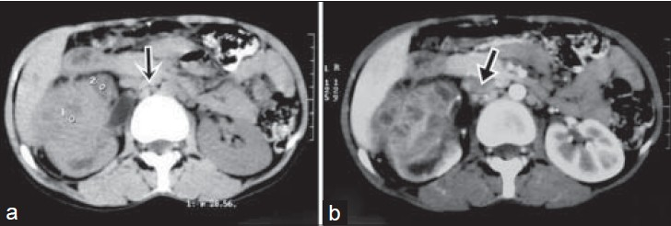
34-yr-old woman with intermittent right flank pain diagnosed with GUTB:
CT: Heterogeneous enhancing mass involving upper & mid pole of right kidney with aortocaval and paracaval lymphadenopathy(arrow)
Contrast enhanced CT scan of abdomen: Presence of rim enhancement with central necrosis in lymph nodes (arrow)
Kumar S, et al. Journal of Clinical Imaging Science. 2014; 4 (2): 1-3.

Slide 39
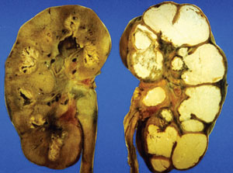
Post-mortem specimen: Caseation in renal cortices of patient affected by tuberculosis
Abbara A, et al. Nature Reviews Urology. 2011; 8: 678-688.
Notes:
Following primary pulmonary infection, mycobacteria spread to the renal tract hematogenously. Caseating granulomata can form, which are usually bilateral and cortical; these granulomata can erode into the calyceal system resulting in disease spread to the rest of the renal tract. Reprinted from Slide Atlas of Infectious Diseases, Harold P. Lambert and W. Edmund Farrar, Unit 12 Tuberculosis, Figure 12.34 Renal tuberculosis: gross specimens of kidneys

Slide 40
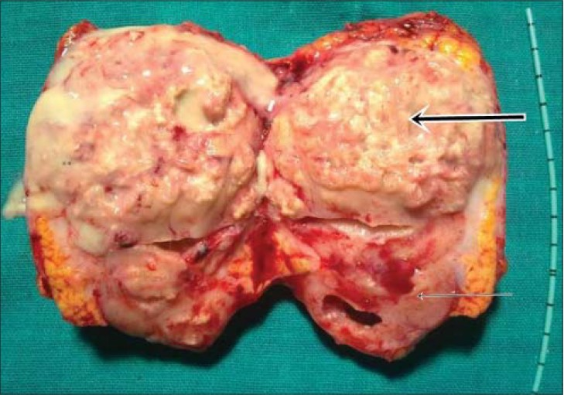
34-yr-old woman with intermittent right flank pain diagnosed with GUTB:
Section removed during right side nephrectomy shows normal looking kidney (thin arrow & renal mass with pus around it (thick arrow)
Kumar S, et al. Journal of Clinical Imaging Science. 2014; 4 (2): 1-3.

Slide 41
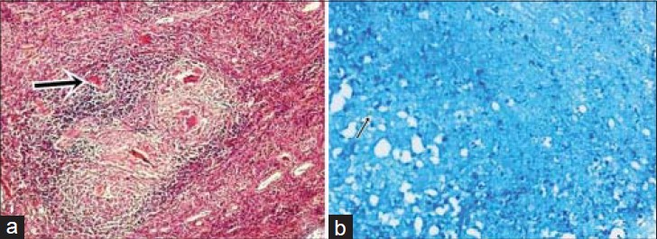
34-yr-old woman with intermittent right flank pain diagnosed with GUTB:
Histopathology slides (a) stained with hematoxylin and eosin (×100) shows presence of multiple granulomas (thick arrow) and (b) stained with Ziehl-Neelsen stain (×100) shows presence of acid-fast bacilli (thin arrow)
Kumar S, et al. Journal of Clinical Imaging Science. 2014; 4 (2): 1-3.

Slide 42
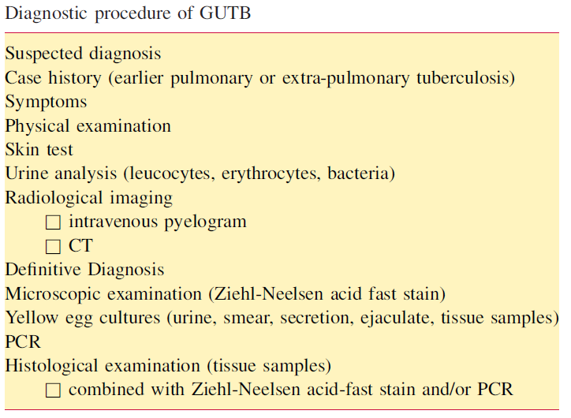
Cek M, et al. EAU Guidelines for the Management of Genitourinary Tuberculosis. Eur Urol. 2005; 48: 353-362.

Slide 43
Medical treatment
Modern short-course anti-tuberculous drug regimens are effective in all forms of tuberculosis
Cek M, et al. EAU Guidelines for the Management of Genitourinary Tuberculosis. Eur Urol. 2005; 48: 353-362.

Slide 44
Drug treatments for TB
First-line* (oral administration):
Rifampicin
Isoniazid
Pyrazinamide
Ethambutol
Second-line:
Aminoglycosides (intravenous administration)
Kanamycin
Amikacin
Streptomycin
Abbara A, et al. Nat Rev Urol. 2011; 8: 678-688.
Notes:
*A standard course of treatment for a fully-sensitive isolate is 6 months first-line therapy: quadruple therapy (usually rifampicin, isoniazid, pyrazinamide and ethambutol) for 2 months and dual therapy (usually rifampicin and isoniazid) for 4 months. ‡The efficacy of the third-line drugs is unclear

Slide 45
Drug treatments for TB
Second-line
Fluoroquinolones
Moxifloxacin
Levofloxacin
Ofloxacin
Ciprofloxacin
Thioamides (oral administration)
Ethionamide
Protionamide
Cyscloserine
p-aminosalicylic acid
Abbara A, et al. Nat Rev Urol. 2011; 8: 678-688.

Slide 46
Drug treatments for TB
Third-line‡
Linezolid
Thioacetazone
Clarithromycin
Imipenem
Other
TMC207# (also called R207910: diarylquinoline, which is in late-stage clinical trials)
Abbara A, et al. Nat Rev Urol. 2011; 8: 678-688.

Slide 47
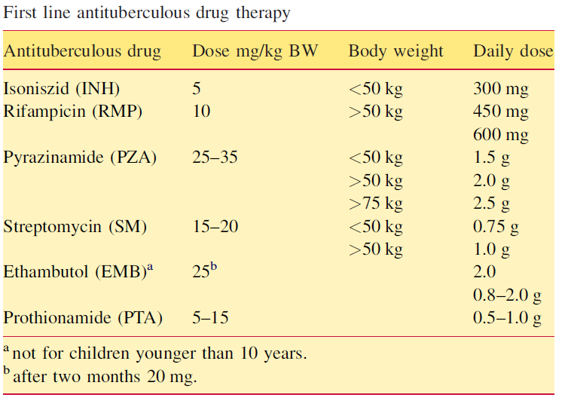
Cek M, et al. EAU Guidelines for the Management of Genitourinary Tuberculosis. Eur Urol. 2005; 48: 353-362.

Slide 48
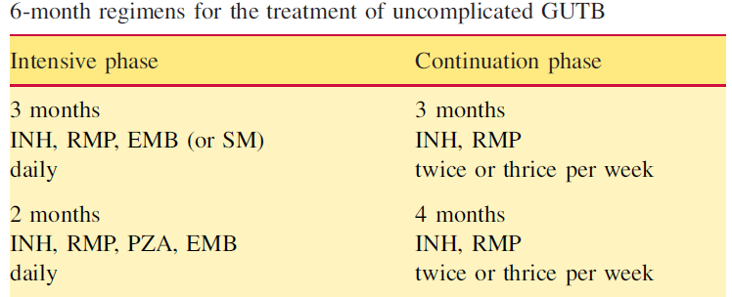
Cek M, et al. EAU Guidelines for the Management of Genitourinary Tuberculosis. Eur Urol. 2005; 48: 353-362.

Slide 49
Treatment
Duration of medical therapy has been reduced to 6 months in uncomplicated cases
Only in complicated cases (recurrences of TB, immunosuppression & HIV/Aids) a 9 to 12 month therapy is necessary (Grade B)
Early ureteral stenting or percutaneous nephrostomy (PCN) in patients with tuberculous ureteral strictures may increase opportunity for later reconstructive surgery & decrease likelihood of renal loss (Level 2a)
In all other situations, patients should have at least 4 weeks of extensive chemotherapy before surgery (Level 4)
Cek M, et al. EAU Guidelines for the Management of Genitourinary Tuberculosis. Eur Urol. 2005; 48: 353-362.

Slide 50
Treatment
Double J ureteral catheters may be used in all types of ureteral strictures for several purposes like stenting after dilatation, maintaining adequate drainage during healing process of either medical therapy or surgery & to assess efficacy of therapy (Grade B)
Despite sterile urine after chemotherapy, 50% of histologic preparations of nephrectomy tissues show active TB (Level 3)
Nephrectomy may be recommended in those patients in whom hypertension is a complication of tuberculous nephropathy (Grade B)
Cek M, et al. EAU Guidelines for the Management of Genitourinary Tuberculosis. Eur Urol. 2005; 48: 353-362.

Slide 51
Treatment
A high proportion (50–75%) of men with genital TB have radiologic abnormalities in urinary tract (Level 4). Urinary tract of all such patients with primary location of tuberculous infection on epididymis should be investigated (Grade B)
Early exploration is suggested if a rapid response to antituberculous chemotherapy does not occur in cases of suspected tuberculous epididymitis & orchitis (Grade 3)
Previous tuberculous epididymitis in patients with obstructive azoospermia does not seem to affect outcome of sperm retrieval & ICSI
Outcome of sperm retrieval followed by intracytoplasmatic sperm injection is not affected (Level 3)
Cek M, et al. EAU Guidelines for the Management of Genitourinary Tuberculosis. Eur Urol. 2005; 48: 353-362.

Slide 52
Treatment
Diagnosis of tuberculous prostatitis may depend on an incidental finding that is made after transurethral resection of the prostate when the pathologist reports foci of TB (Level 3)
These patients should be given antituberculous chemotherapy (Grade C)
Cek M, et al. EAU Guidelines for the Management of Genitourinary Tuberculosis. Eur Urol. 2005; 48: 353-362.

Slide 53
Summary
GUTB remains a cause of morbidity, particularly in developing countries, where incidence of TB is very high
Sequelae: Structural damage, particularly renal failure & infertility, especially in women
Sequelae result in prolonged morbidity & socioeconomic consequences
Abbara A, et al. Nat Rev Urol. 2011; 8: 678-688.

Slide 54
Summary
Owing to late onset & nonspecific nature of GUTB symptoms, diagnosis is often delayed, which can result in further morbidity
As a result, high degree of suspicion must be exercised during investigation
A microbiological diagnosis should be sought, but culture yield can be low
Abbara A, et al. Nat Rev Urol. 2011; 8: 678-688.

Slide 55
Summary
Nucleic acid amplification tests show promise in achieving fast diagnosis & high sensitivity from extrapulmonary sites, but further evaluation is required
As more patients with TB develop drug resistance & number of HIV–TB co-infected patients increases, need for novel drugs with adequate penetration of genitourinary tract becomes urgent
Abbara A, et al. Nat Rev Urol. 2011; 8: 678-688.

Slide 56
Summary
New techniques with high sensitivities & specificities should be identified to predict patterns for drug resistance; these techniques will also enable faster diagnosis & improve prognosis
Abbara A, et al. Nat Rev Urol. 2011; 8: 678-688.

Slide 57
THANK YOU!

