Slide 1
Benign Prostatic Hyperplasia Management
29th August 2015

Slide 2
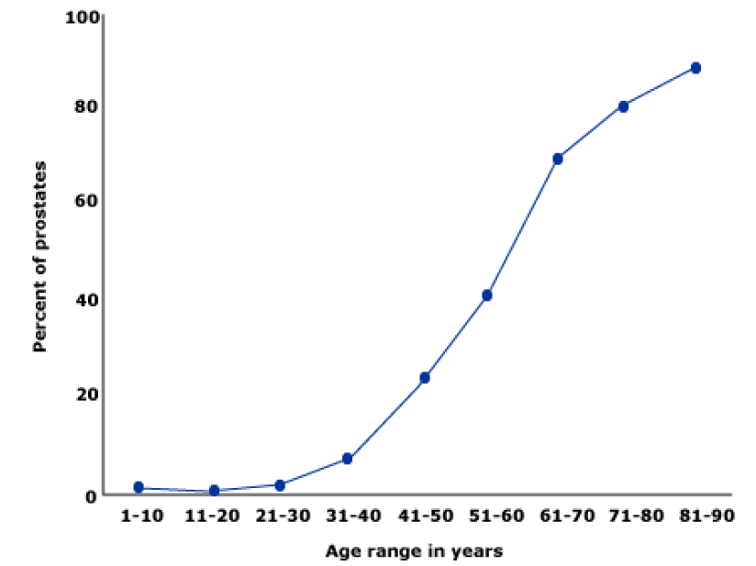
Benign Prostatic Hyperplasia: Introduction
Benign prostatic hyperplasia (BPH): Common problem among older men
Prevalence of histologically diagnosed prostatic hyperplasia increases from
31 - 40 yrs: 8%
51 - 60 yrs: 40 – 50%
> 80 yrs: 80%
Age-associated ↑ in pathologic evidence of BPH in 1075 men at autopsy. Percentage with BPH was determined during 10 yr intervals from 5 different studies; mean values are shown.
1. Cunningham GR, et al. UpToDate 2015 / 2. Berry SJ, et al. J Urol. 1984; 132: 474.

Slide 3
BPH and BOO
Benign Prostatic Hypertrophy
mechanical compression by growth
Static Factor
Dynamic Factor
contraction of SMC
to reduce prostate size
Bladder Outlet Obstruction
to relax SMC
hormonal therapy
blockade of SNS
BOO: Bladder Outlet Obstruction
3
Notes:
3

Slide 4
BPH and BOO
Normal prostate
Enlarged prostate
Obstruction to urine flow
BOO & LUTS
4
Notes:
4

Slide 5
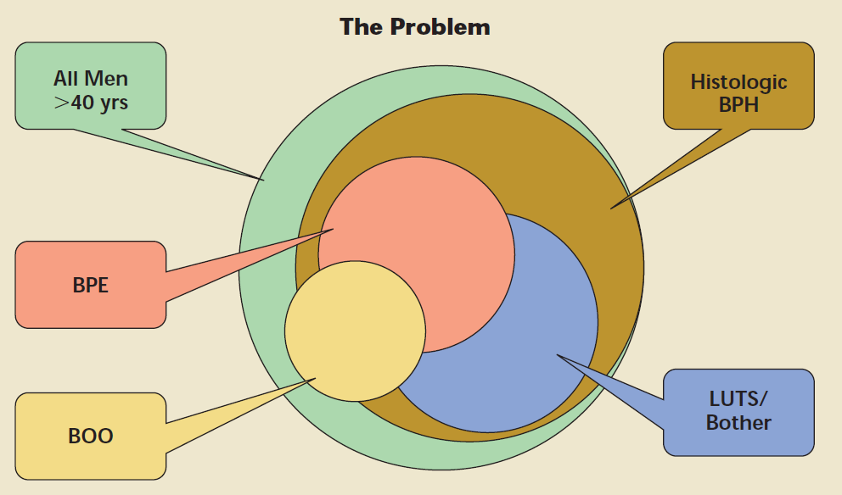
Complex relationship: BPH, LUTS, BPE & BOO
Roehrborn CG. Rev Urol. 2005; 7(suppl 9): S3-S14.

Slide 6
Understanding LUTS
Voiding symptoms
Storage symptoms
Hesitancy: delay in onset of micturition (time required by the detrusor muscle to overcome outlet resistance)‏
Urinary frequency: voiding too frequently during day (> 7 times)‏
Poor urinary flow & straining to void (flow rate <10 mL/s is suggestive of obstruction)‏
Nocturia is defined having to wake at night to void
Sensation of incomplete bladder emptying (bladder is unable to empty itself completely, causing residual urine)‏
Urgency (sudden compelling desire to void, which is difficult to defer)‏
Terminal or post-micturition dribbling (weakness in bulbo-spongiosus muscle, which aids urethral emptying)‏
Urge incontinence (involuntary leakage of urine accompanied by urgency)‏
Prolonged urination (reduced flow rate results in increased time taken to void)‏
Thorpe A, et al. Lancet. 2003; 361(9366): 1359-67.
6
Notes:
6

Slide 7
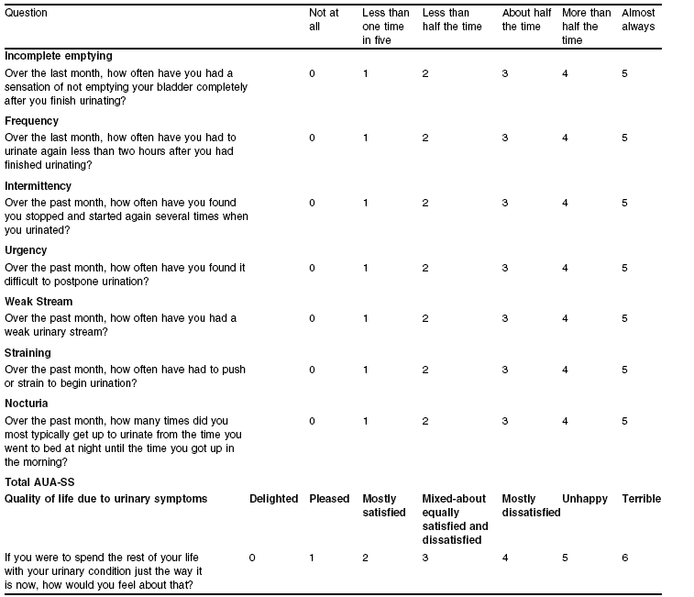
Scoring for BPH: AUA-SS and IPSS
7
Notes:
7

Slide 8
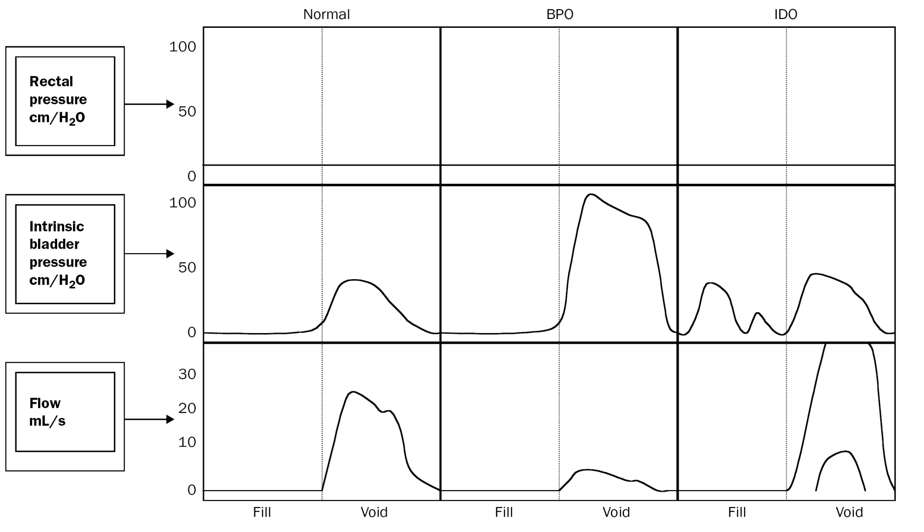
Urodynamic Studies and Detrusor Overactivity
Thorpe A, et al. Lancet. 2003; 361(9366): 1359-67.
8
Notes:
8

Slide 9
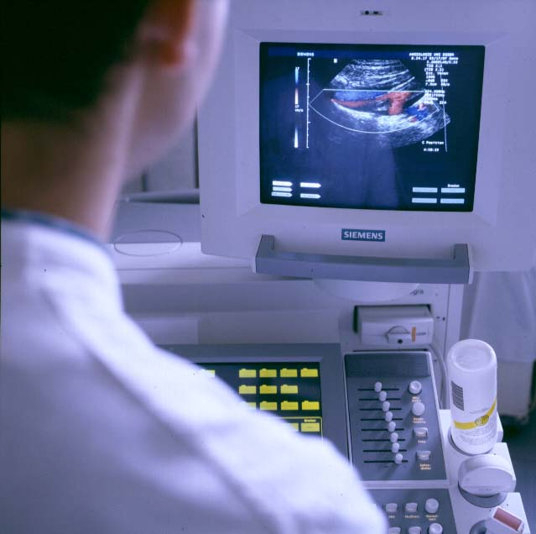
Diagnosis
Based on symptoms
Digital Rectal examination (DRE)
PSA
TRUS guided biopsy (transrectal ultrasonography)‏
Sonography
9
Notes:
9

Slide 10
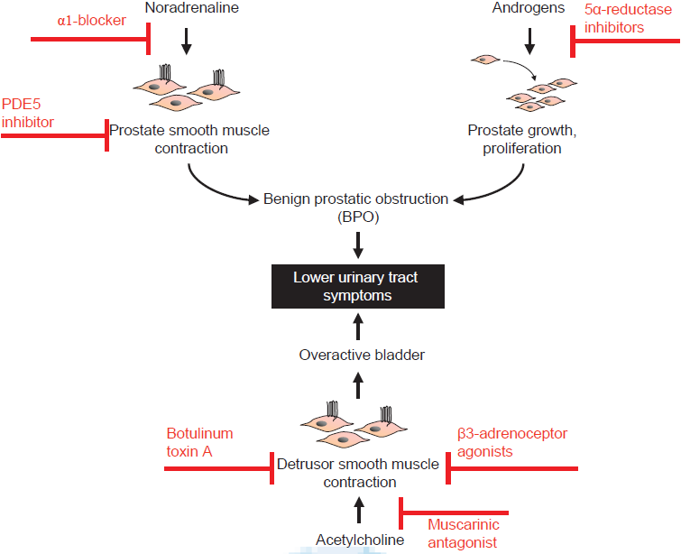
Pathophysiology & medical therapy of LUTS
Hennenberg M, et al. Indian J Urol. 2014; 30(2): 181-8.

Slide 11
Management of BPH
American Urological Association (AUA) symptom assessment
Symptoms
BPH with obstructing symptoms causing:
Kidney damage
Bladder stone
Haematuria
Urinary retention
Physical Examination
Moderate to severe
Symptoms interfere with daily life
Pharmacological treatment:
α-adrenergic blocker
5 α-reductase inhibitor
Novel therapies
Phytotherapy
Mild
Symptoms don’t interfere with daily life
Surgical treatment
Watchful waiting
Dhingra N, et al. Indian J Pharmacol. 2011; 43(1): 6-12.

Slide 12
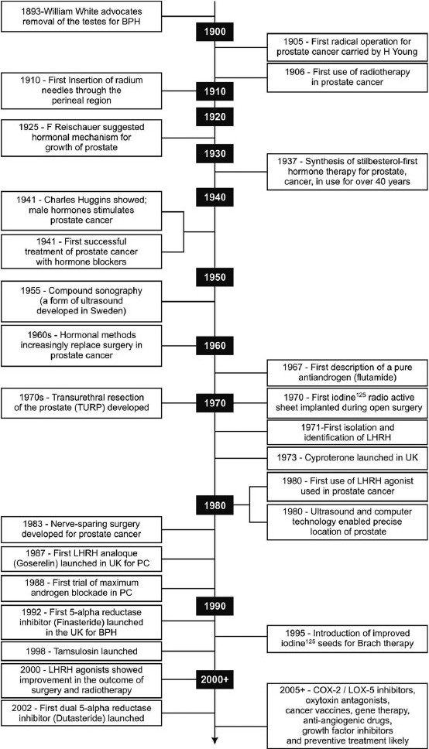
Milestones in understanding & treatment of BPH
Dhingra N, et al. Indian J Pharmacol. 2011; 43(1): 6-12.

Slide 13
Milestones in understanding & treatment of BPH
Dhingra N, et al. Indian J Pharmacol. 2011; 43(1): 6-12.

Slide 14
Medical Management of BPH
Pharmacologic options:
α-adrenergic-receptor blocker, 5α-reductase inhibitor (if there is evidence of prostatic enlargement or PSA level >1.5 ng per milliliter), phosphodiesterase-5 inhibitor, or antimuscarinic therapy
Combination therapy with α-blocker & 5α-reductase inhibitor is more effective than monotherapy with either agent but has more side effects
Addition of antimuscarinic therapy may be useful in men with clinically significant storage symptoms not controlled with use of α-blocker alone
Sarma AV, et al. N Engl J Med. 2012; 367: 248-57.

Slide 15
Behavioural Modifications
Behavioural modifications may be helpful for all patients
Patients may also benefit from voiding in sitting position (rather than standing)
Avoid medications that can exacerbate symptoms or induce urinary retention: diuretics, sedating antihistamines & adrenergic agents such as decongestants
Behavioural modifications include:
Avoiding fluids prior to bedtime or before going out
Reducing consumption of mild diuretics such as caffeine & alcohol
Double voiding to empty bladder more completely
Cunningham GR, et al. UpToDate 2015.

Slide 16
Nutrition and BPH
Nutritional practices may provide for prevention & treatment of BPH and LUTS
Espinosa G. Curr Opin Urol. 2013; 23: 38–41.

Slide 17
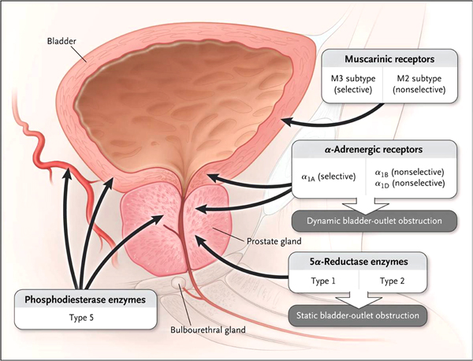
Different Pharmacological Agents
Sarma AV, et al. N Engl J Med. 2012; 367(3): 248-57.

Slide 18
Alpha Blockers
Hollingsworth JM, et al. BMJ 2014; 349: g4474.

Slide 19
Alpha Blockers
Most commonly used pharmacotherapy for BPH/LUTS
EAU guidelines: α-blockers should be offered to men with moderate-to-severe LUTS & are considered 1st-line drug treatment for these patients
α-blockers rapidly relieve LUTS presumably by relaxing smooth muscle tone in prostate & bladder neck
However, it is also probable that blockade of α1-adrenoceptors outside prostate, in bladder & in spinal cord, plays a relevant role
Silva J, et al. Curr Opin Urol. 2014; 24: 21–28.
EAU: European Association of Urology

Slide 20
Alpha Adrenergic Blockers: AUA Guideline
Alfuzosin, doxazosin, tamsulosin, terazosin are appropriate & effective treatment alternatives for patients with bothersome, moderate to severe LUTS secondary to BPH (AUA Symptom Index score ≥8)
Although there are slight differences in adverse events profiles of these agents, all 4 appear to have equal clinical effectiveness
AUA Guidelines 2010.

Slide 21
5-Alpha Reductase Inhibitors
Hollingsworth JM, et al. BMJ 2014; 349: g4474.

Slide 22
Role of combination medical therapy in BPH
MTOPS Study (Combination: α1-ARA doxazosin & 5αRI finasteride):
Significantly more effective than either component alone in reducing symptoms (P =0.006 vs. doxazosin monotherapy; P<0.001 vs. finasteride monotherapy) & in lowering rate of clinical progression (P<0.001 vs. either monotherapy)
Combination of α1-ARA tamsulosin & 5αRI dutasteride:
Significantly greater ↓ in IPSS when compared with either monotherapy
Combination of α1-ARAs & anti-muscarinic agents:
Statistically significant benefits in QoL scores, patient satisfaction, urinary frequency, storage symptoms & IPSS scores
Studies have not shown increased risk of urinary retention associated with use of anti-muscarinics in highly select cohort of men with BPH
Greco KA, et al. International Journal of Impotence Research. 2008; 20: S33–S43.

Slide 23
Combination therapy on overall disease progression
Combination medical therapy when compared with placebo reduced risk of overall clinical progression by 66% over duration of study (vs. 39% for α1-adrenergic antagonist monotherapy & 34% for ARI monotherapy)
- McConnell JD, et al. N Engl J Med 2003; 349:2387–2398.
As compared with placebo, combination medical therapy reduced 4-yr cumulative incidence of overall clinical progression to 5%
Hollingsworth JM, et al. Current Opinion in Urology. 2010; 20: 1–6.

Slide 24
Role of combination medical therapy in BPH
Available data suggest that combination therapy can be beneficial in treatment of BPH & associated LUTS
Greatest efficacy for α1-ARA & 5αRI combination was shown in patients with larger prostate size & more severe symptoms
Combination of α1-ARAs & 5αRIs appears to prevent disease progression in these patients
Combination of α1-ARAs with anti-muscarinic agents is useful for relieving symptoms of BOO & detrusor overactivity
Greco KA, et al. International Journal of Impotence Research. 2008; 20: S33–S43.

Slide 25
Antimuscarinic Agents
Hollingsworth JM, et al. BMJ 2014; 349: g4474.

Slide 26
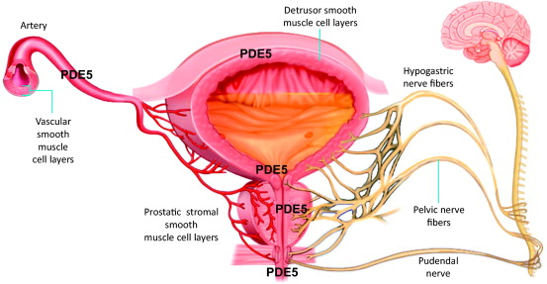
PDE5 inhibitors for LUTS secondary to BPH
PDE (phosphodiesterase) 5 inhibitors:
Effective & well tolerated, providing significant improvement in BPH-LUTS and QoL in addition to their established effects on improving erectile function (ED)
Laydner HK, et al. BJU International. 2010; 107: 1104-1109/ Giuliano F, et al. Eur Urol. 2013; 63(3): 506-516.

Slide 27
Phosphodiesterase type 5 inhibitors
Hollingsworth JM, et al. BMJ 2014; 349: g4474.

Slide 28
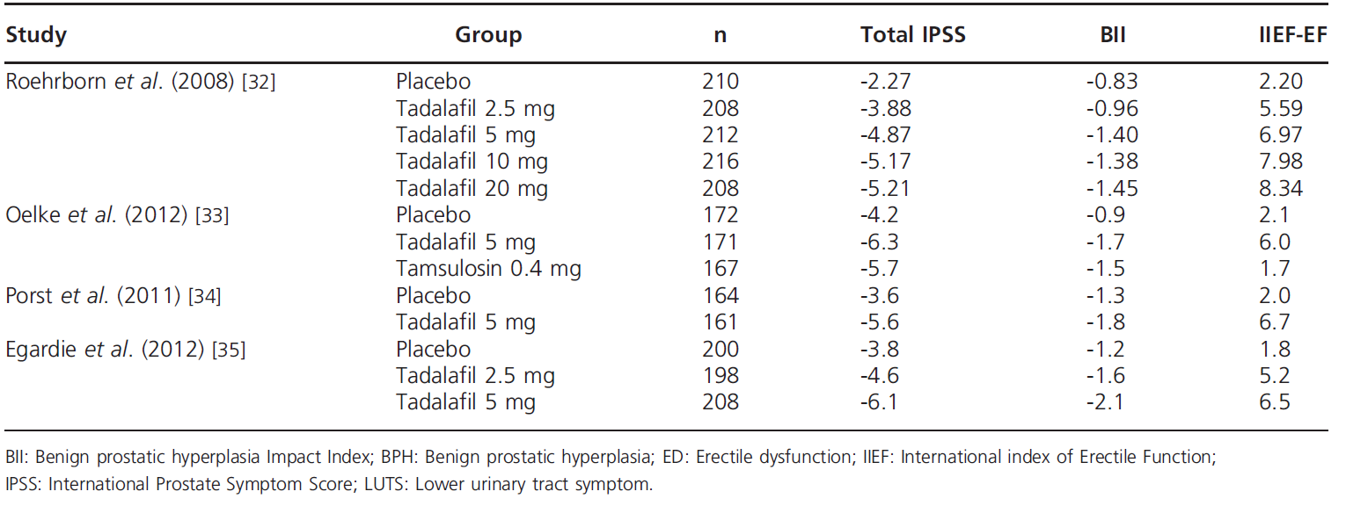
Total IPSS, BII & IIEF-EF change in BPH-LUTS patients with and without ED treated with tadalafil among Phase III clinical trials
Russo A, et al. Expert Opin Pharmacother. 2015.

Slide 29
Latest pharmacotherapy options: BPH
Spectrum of available drugs for the treatment of LUTS is rapidly expanding ranging from α1-adrenoreceptor antagonists, 5α-reductase inhibitors, antimuscarinics to PDE5 type 5 inhibitors
Silodosin: α1-adrenoreceptor antagonist with almost no effects on BP &/ or heart rate, which makes it a very interesting therapeutic option for elderly men & for patients treated with several anti-hypertensive drugs
Tadalafil: Only PDE5i currently approved for LUTS in patients with or without ED & has shown to improve IPSS & QoL scores
Russo A, et al. Expert Opin Pharmacother. 2015.

Slide 30
Latest pharmacotherapy options: BPH
Russo A, et al. Expert Opin Pharmacother. 2015.

Slide 31
Surgical Treatments
Transurethral resection of the prostate (TURP)
Open prostatectomy
Transurethral holmium laser ablation of the prostate (HoLAP)
Transurethral holmium laser enucleation of the prostate (HoLEP)
Holmium laser resection of the prostate (HoLRP)
Photoselective vaporization of the prostate (PVP)
Transurethral incision of the prostate (TUIP)
Transurethral vaporization of the prostate (TUVP)
AUA Guidelines 2010.

Slide 32
Indications for surgery in BPH
Most common indication for surgery:
LUTS refractory to medical treatment
Other indications:
Recurrent UTIs, recurrent haematuria, renal insufficiency due to obstruction or bladder stones
Rieken M, et al. World J Urol. 2010; 28:53–62.

Slide 33
TURP AND OP
TURP (Transurethral Resection of the Prostate)
Gold standard:
In men with prostates from 30-80 ml
Open Prostatectomy
Treatment of choice:
Larger sized prostates
Rieken M, et al. World J Urol. 2010; 28:53–62.

Slide 34
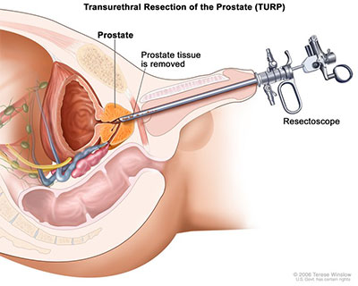

Slide 35
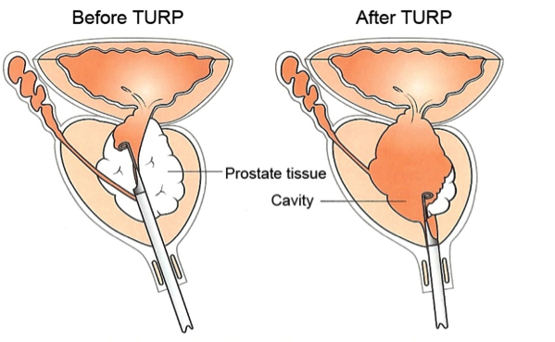

Slide 36
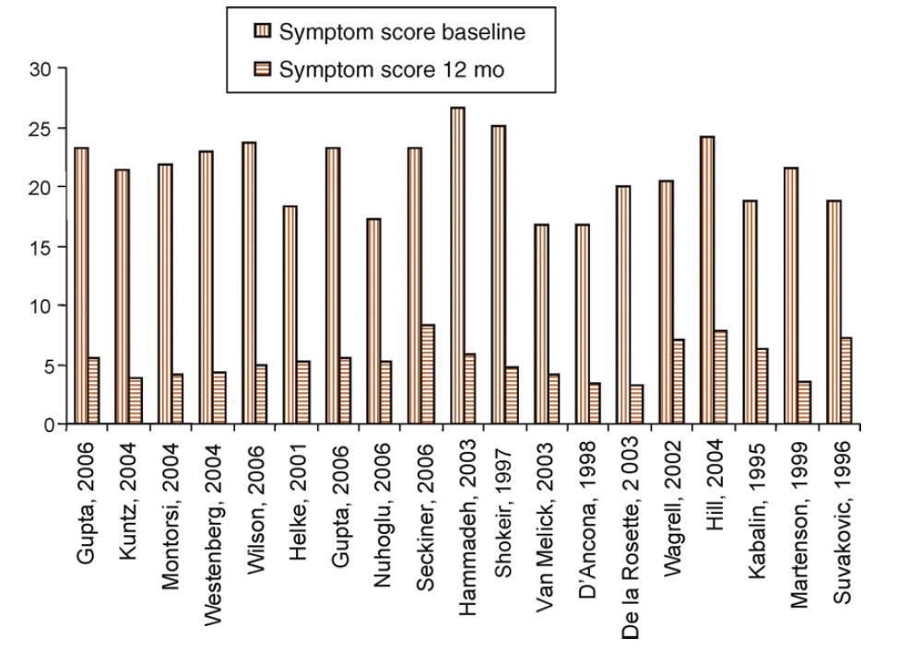
Improvement of symptom scores 12 mo after TURP
Marszalek M, et al. EU supplements. 2009; 8: 504-512.

Slide 37
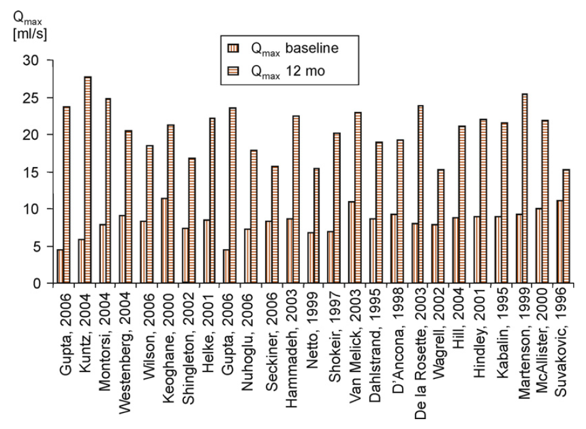
Improvement of maximum flow rate 12 mo after TURP
Marszalek M, et al. EU supplements. 2009; 8: 504-512.

Slide 38
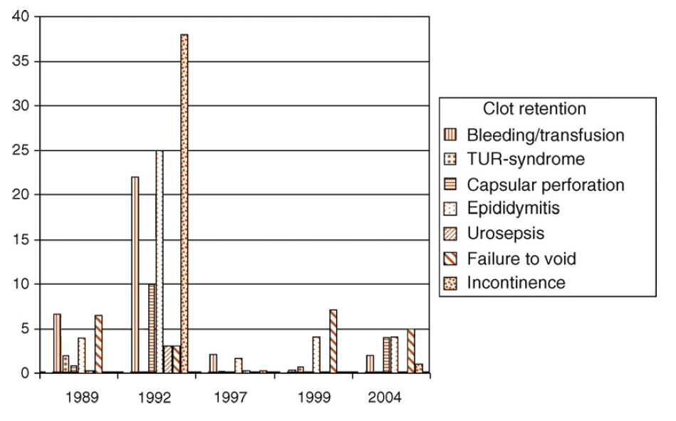
Complications of TURP in different surgical times
Marszalek M, et al. EU supplements. 2009; 8: 504-512.

Slide 39
Key Points of TURP
Various technical improvements such as video-TURP, continuous-flow instruments & bipolar TURP have substantially decreased mortality & morbidity of TURP today
Bipolar transurethral resection era, bleeding remains most significant intra- and perioperative complication
Short-term & particularly, long-term efficacy of TURP is unsurpassed, as documented by substantial improvements in symptoms, maximum flow rate & post-void residual volume
Retreatment rate of TURP: 8–12% within a decade after primary surgery, a value reached by many minimally invasive procedures as early as within 1–2yr
Marszalek M, et al. EU supplements. 2009; 8: 504-512.

Slide 40
Open Prostatectomy
1st proposed by Eugene Fuller & Peter Freyer in 1895 and 1900

Slide 41
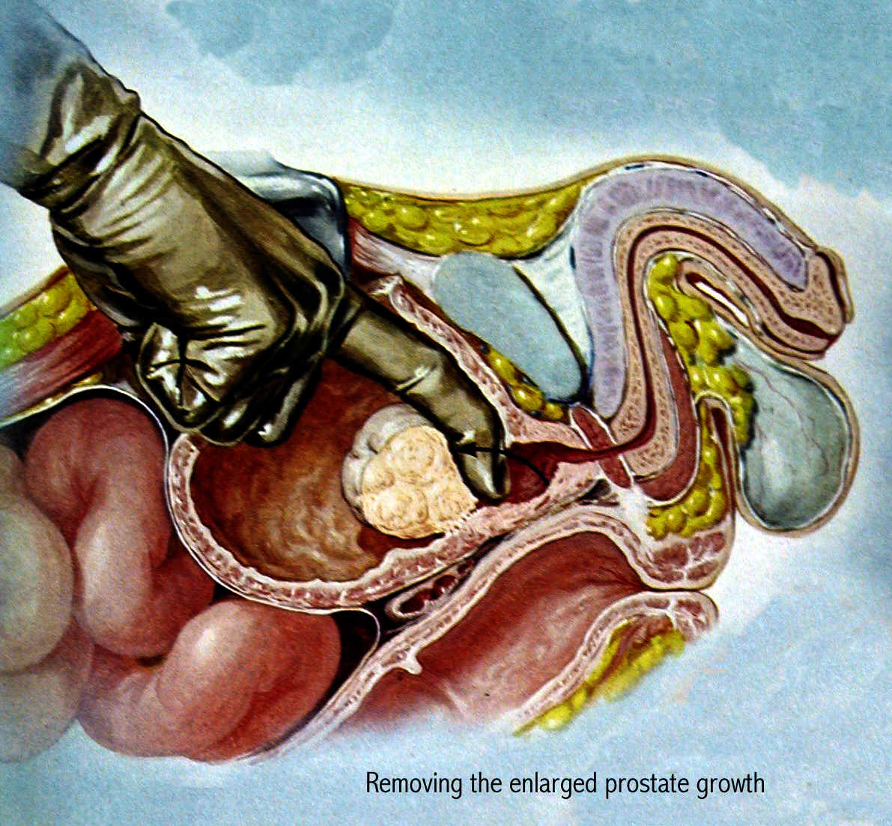
OP
OP remains gold standard gold standard in terms of symptom relief but associated morbidity & complication rates are high
- Rao KR. World Journal of Laparoscopic Surgery. 2012; 5(3): 137-138.

Slide 42
Laparoscopic extraperitoneal Millin prostatectomy
Possibility to perform Millin’s prostatectomy in laparoscopy was proven by Porpiglia and coworkers in 2005
Laparoscopic transvescical approach has been proposed by Sotelo and co-workers and permitted concomitant management of any coexistent intravesical pathology, such as bladder calculi
Tubaro A, et al. EAU Update Series. 2006; 4: 191-201.

Slide 43
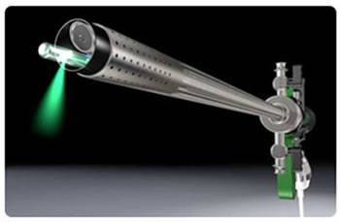
Laser procedures
Laser techniques for treatment of BOO due to BPE:
Emerged as alternative to TURP & OP
Rieken M, et al. World J Urol. 2010; 28:53–62.

Slide 44
Laser Therapies
2 basic principles of laser therapy for BPH based on final tissue effect: Laser vaporization & laser coagulation
Laser vaporization techniques: Higher-density laser thermal energy is used; effects range from complete tissue vaporization to incision, resection, or enucleation of obstructing prostatic tissue
Interstitial laser coagulation (ILC) requires lower therapeutic temperatures
Urethral preservation & lack of tissue evaporation/resection with ILC make this treatment different from conventional transurethral free-beam laser prostatectomy
Issa MM, et al. Rev Urol. 2005; 7(suppl 9): S15-S22.

Slide 45
Visual laser ablation of the prostate
Laser vaporization of the prostate
Issa MM, et al. Rev Urol. 2005; 7(suppl 9): S15-S22.

Slide 46
Laser resection of the prostate
Laser enucleation of the prostate
Issa MM, et al. Rev Urol. 2005; 7(suppl 9): S15-S22.

Slide 49
Laser incision of the prostate
Interstitial laser coagulation of the prostate
Issa MM, et al. Rev Urol. 2005; 7(suppl 9): S15-S22.

Slide 50
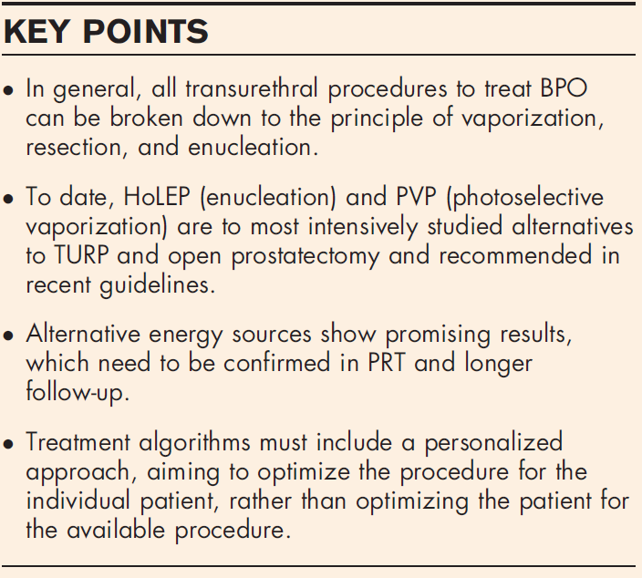
Vaporization vs. enucleation techniques for BPO
HoLEP & PVP are recommended alternatives to TURP in men with moderate-to-severe LUTS
- Gravas S, et al. Guidelines on the management of non-neurogenic male lower urinary tract symptoms (LUTS), incl. benign prostatic obstruction (BPO) European Association of Urology 2014.
Netsch C, et al. Curr Opin Urol. 2015; 25: 45–52.

Slide 51
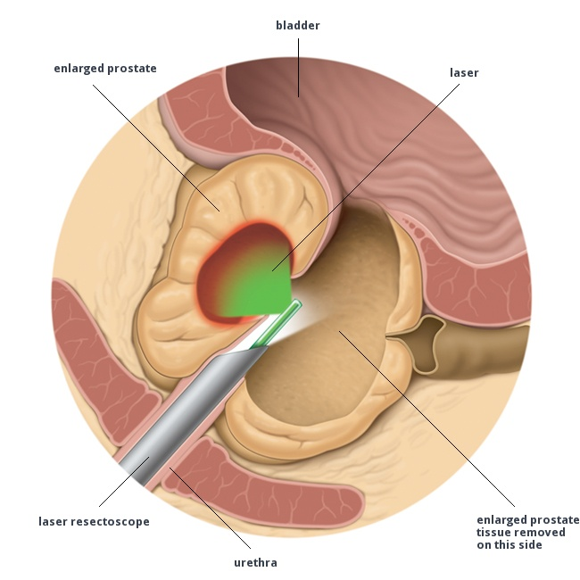
Different laser procedures
Variety of laser technologies mimicking HoLEP & PVP:
ThuVEP, ThuLEP, GreenLight laser enucleation of prostate, DiLEP, ELAP, BipolEP, PkEP, bipolar plasma enuclation of prostate, TUERP, ThuVAP & BPVP
No clear algorithms exist to which procedure to choose in which clinical situation
Netsch C, et al. Curr Opin Urol. 2015; 25: 45–52.

Slide 52
Main characteristics of different lasers
Gravas S, et al. BJU International. 2011; 107: 1030-1043.

Slide 53
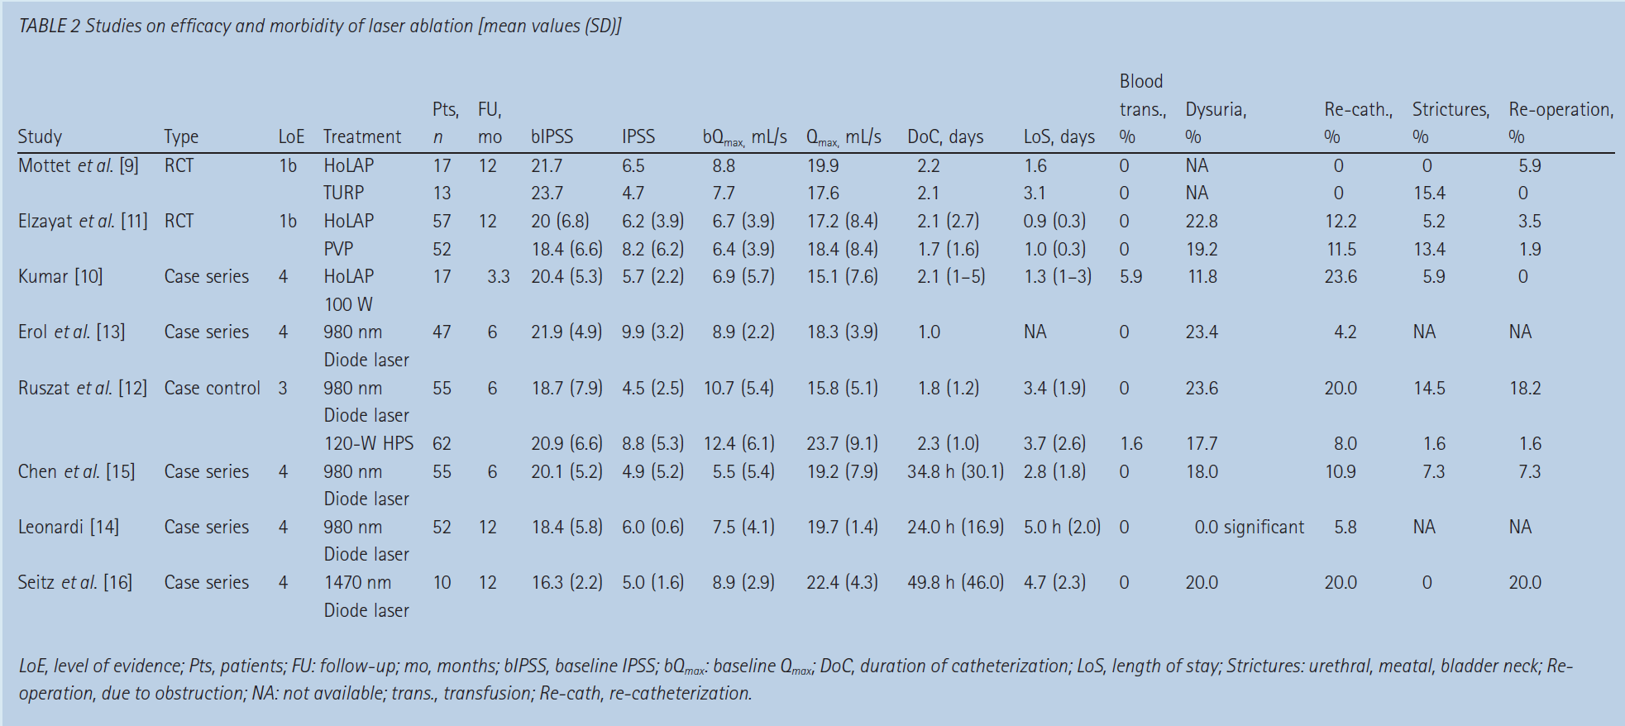

Slide 54
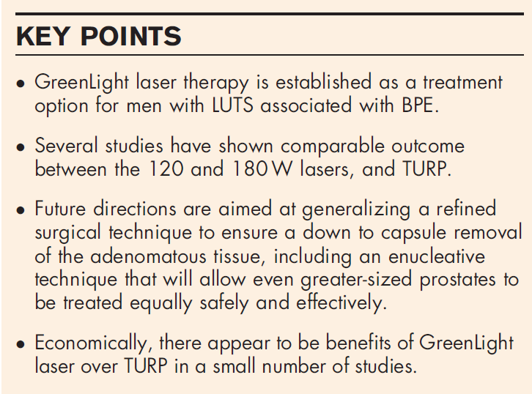
Green light vaporization of the prostate
Greenlight Laser therapy:
Can be used safely & effectively in men on anticoagulants, in retention and with prostates of size greater than 80 ml
Gomez-Sancha F. Curr Opin Urol. 2015; 25: 40–44.

Slide 55
Green light vaporization of the prostate

Slide 56
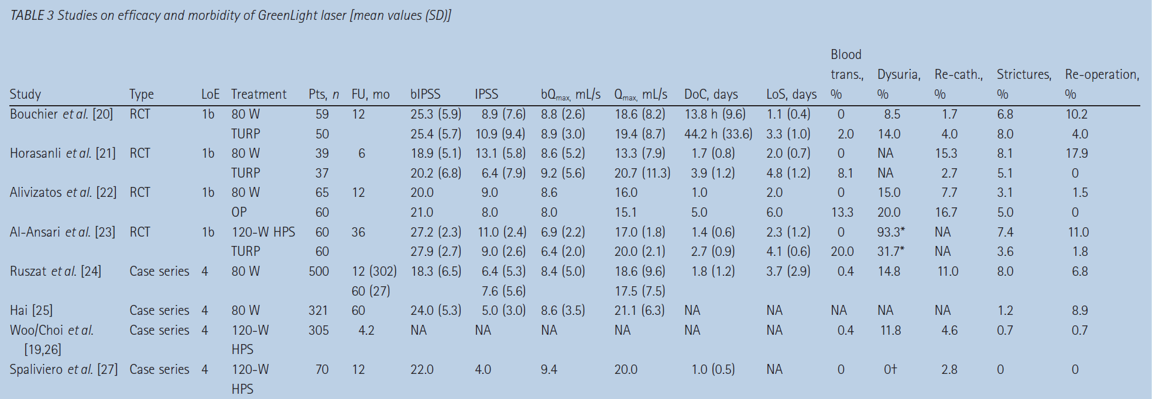

Slide 57
HoLAP
Transurethral Holmium Laser Ablation of the Prostate (HoLAP):
Holmium:YAG laser may be used to treat prostatic tissue transurethrally using 550 micron side-firing laser fiber in noncontact mode
This technology delivers laser energy at wavelength of 2120 nm (infrared range) which is absorbed primarily by water & results in optical penetration depth of 0.4 mm
HoLAP procedure is intended to be comparable to TURP in that prostatic lobes may be vaporized down to surgical capsule resulting in TURP-like effect
AUA Guidelines 2010.

Slide 58
HoLEP
Holmium laser has been used to enucleate prostate adenoma, separating adenoma from surgical capsule, from apex to base, after any median lobe has been freed from bladder neck
Typically, technology is utilized for larger glands that previously would have been treated surgically with open prostatectomy
Generally, results compare favourably to open prostatectomy in hands of experienced surgeon
In other trials, improvements in symptom scores, QoL indices & flow rate, approach those obtained after TURP
AUA Guidelines 2010.

Slide 59
HoLEP
Nonetheless, long-term data beyond 2 yrs are still lacking & procedure requires specialized training and equipment
Operative times for holmium enucleation have been improved significantly with the advent of the tissue morcellator
By morcellating tissue within bladder, resection technique could be modified to allow complete enucleation of median & lateral lobes of prostate
AUA Guidelines 2010.

Slide 60
TUIP
Transurethral incision of the prostate (TUIP) or bladder neck incision: Recommended for smaller gland weighing <25 g and has been found to be less invasive than TURP, but long-term effectiveness in comparison with TURP is yet to be determined
Dhingra N, et al. Indian J Pharmacol. 2011; 43(1): 6-12.

Slide 61
MIT and TUVP
Minimal invasive procedures (MIT):
Over last few years, number of MIT has been established to achieve substantial improvement in symptoms attributed to BPH
These MIT utilizes endoscopic approach to ablate obstructing prostatic tissue
Transurethral electrovaporization (TUVP)
TUVP is modification of TURP & TUIP
Utilize high electrical current to vaporize & coagulate obstructing prostate tissue
Long-term efficiency is comparable with TURP, but number of patients has been found to experience irritative side effects
Dhingra N, et al. Indian J Pharmacol. 2011; 43(1): 6-12.

Slide 62
TUMT & TUNA
Transurethral microwave thermotherapy (TUMT):
More specific destruction of malignant cells without affecting normal cells can be achieved by raising temperature of cells using low-level radiofrequency (microwave) in prostate up to 40 - 45°C (hyperthermia), 46 to 60°C (thermotherapy) & 61 - 75°C (transrectal thermal ablation)
Found to be safe & cost effective, with reasonable improvement in urine flow rate & minimal impairment on sexual function
Transurethral needle ablation (TUNA):
Simple & relatively inexpensive procedure which utilizes needle to deliver high-frequency radio waves to destroy the enlarged prostatic tissue
Successful treatment for small-sized gland
Poses low or no risk for incontinence & impotence
Dhingra N, et al. Indian J Pharmacol. 2011; 43(1): 6-12.

Slide 63
HIFU & Transurethral ethanol ablation of prostate
High-intensity focused ultrasound (HIFU):
Effective protein denaturation & coagulative necrosis of prostatic tissue have been achieved by using HIFU frequencies of 4 MHZ
Significant ↑ in uroflow & ↓ in postvoid residual volume have been observed, but cost is 3 times higher than that of TURP
Transurethral ethanol ablation of the prostate:
Transurethral injection of absolute ethanol into lateral lobes of prostate produces necrotic effect on prostatic tissues, leading to fibrosis & shrinkage
Significant improvement has been reported in AUA symptoms score
Continual research is going on to dilute negative factors like urinary retention, pain, dysuria & prolonged period of catheterization with aim to deliver safe, effective, and economical potential treatment
Dhingra N, et al. Indian J Pharmacol. 2011; 43(1): 6-12.

Slide 64
Water-induced thermotherapy & Plasma kinetic tissue management system
Water-induced thermotherapy:
Simple technique that uses cylindrical balloon to circulate hot water, resulting in even coagulation necrosis in prostate by raising temperature of prostatic cells up to 60 - 70°C, without having major effect on nontargeted tissues
Plasma kinetic tissue management system (Gyrus):
Gyrus: New technique under development & vaporizes obstructing tissue by using plasma energy in saline environment
Procedure has been found to be safe & effective with minimal risk of water intoxication (TURP syndrome) & generally reserved for patients on high risk
Dhingra N, et al. Indian J Pharmacol. 2011; 43(1): 6-12.

Slide 65
THANK YOU!!!

