Slide 1
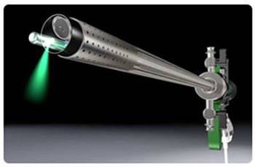
Laser Prostatectomy
Complications

Slide 2
Benign prostatic hyperplasia (bph)

Slide 3
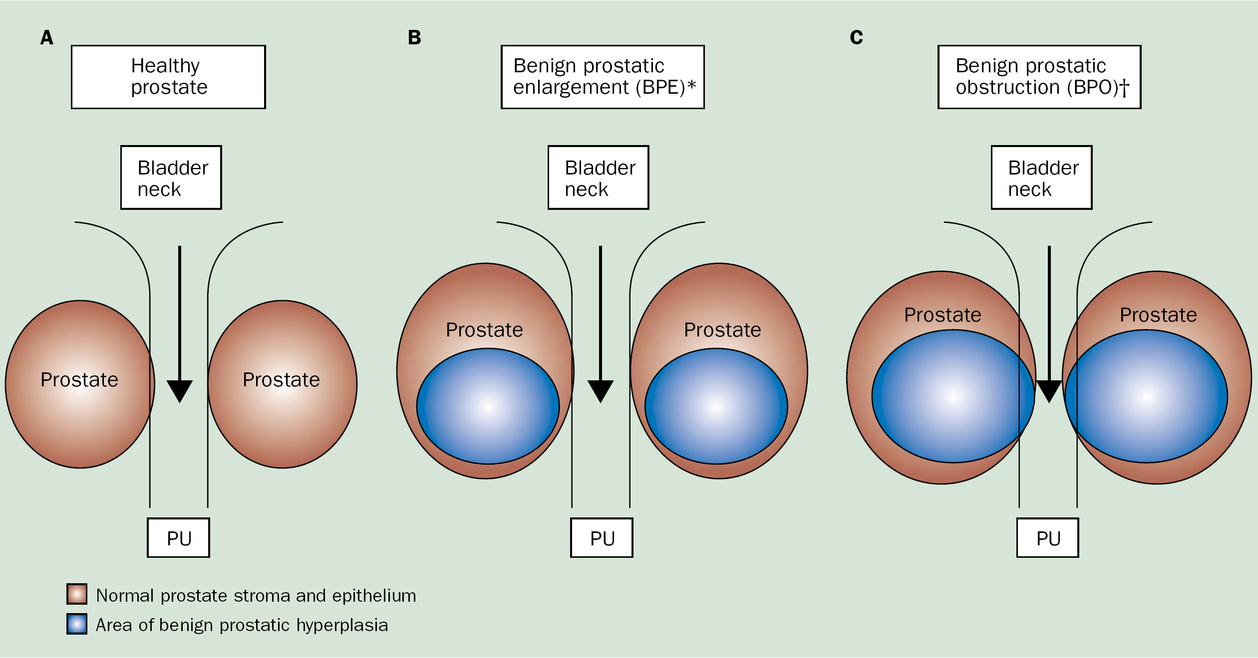
Healthy prostate, bpe & boo
Thorpe A, et al. Lancet. 2003; 361(9366): 1359-67.

Slide 4
Indications for surgery in bph
Lower urinary tract symptoms (LUTS) due to benign prostate enlargement (BPE): Highly prevalent disease
Most common indication for surgery:
LUTS refractory to medical treatment
Other indications:
Recurrent UTIs, recurrent haematuria, renal insufficiency due to obstruction or bladder stones
Rieken M, et al. World J Urol. 2010; 28:53–62.

Slide 5
Turp and op
TURP (Transurethral Resection of the Prostate)
Gold standard:
In men with prostates from 30-80 ml
Open Prostatectomy
Treatment of choice:
Larger sized prostates
Rieken M, et al. World J Urol. 2010; 28:53–62.

Slide 6
Laser procedures
Laser techniques for treatment of BOO due to BPE:
Emerged as alternative to TURP & OP
Rieken M, et al. World J Urol. 2010; 28:53–62.

Slide 7
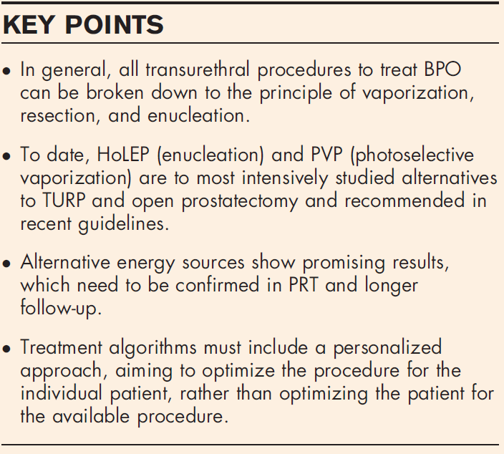
Vaporization vs. enucleation techniques for BPO
HoLEP & PVP are recommended alternatives to TURP in men with moderate-to-severe LUTS
- Gravas S, et al. Guidelines on the management of non-neurogenic male lower urinary tract symptoms (LUTS), incl. benign prostatic obstruction (BPO) European Association of Urology 2014.
Netsch C, et al. Curr Opin Urol. 2015; 25: 45–52.

Slide 8
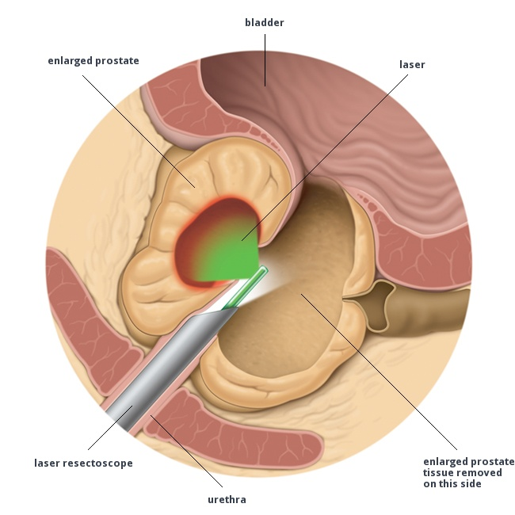
Different laser procedures
Variety of laser technologies mimicking HoLEP & PVP:
ThuVEP, ThuLEP, GreenLight laser enucleation of prostate, DiLEP, ELAP, BipolEP, PkEP, bipolar plasma enuclation of prostate, TUERP, ThuVAP & BPVP
No clear algorithms exist to which procedure to choose in which clinical situation
Netsch C, et al. Curr Opin Urol. 2015; 25: 45–52.

Slide 9
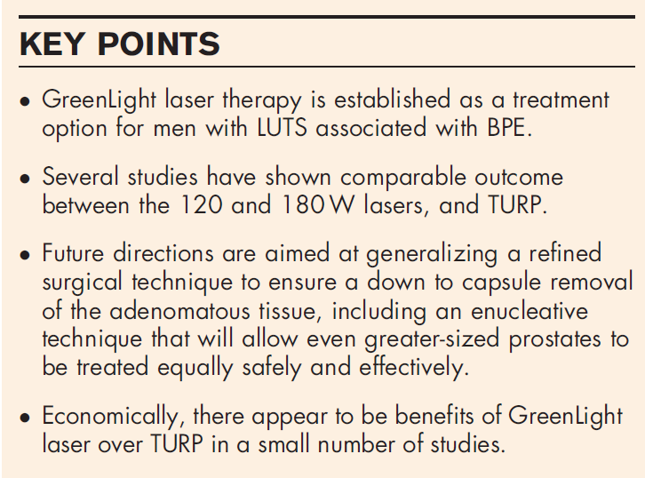
Green light vaporization of the prostate
Greenlight Laser therapy:
Can be used safely & effectively in men on anticoagulants, in retention and with prostates of size greater than 80 ml
Gomez-Sancha F. Curr Opin Urol. 2015; 25: 40–44.

Slide 10
Green light vaporization of the prostate

Slide 11
Intra and early postop Complications of laser procedures

Slide 12
intraoperative complications after Holep
Author, Year | No. of patients | Follow-up (month) | Intraoperative complications (%)
 |  |  | Blood transfusion | Capsular perforation | Bladder/ureteric orifice injury
Montorsi, 2008 | 52 | 12 | 0 | - | 18.2
Naspro, 2006 | 41 | 24 | 4 | - | 7.3
Placer, 2009 | 125 | 24 | 0.8 | 10.4 | 4
Shah, 2007 | 280 | 24 | 0.35 | 9.6 | 6
Vavassori, 2008 | 330 | 36 | - | - | 5.7
Wilson, 2006 | 30 | 24 | 0 | - | -
Rieken M, et al. World J Urol. 2010; 28:53–62.

Slide 13
intraoperative complications after pvp
Author, Year | No. of patients | Follow-up (month) | Intraoperative complications (%)
 |  |  | Blood transfusion | Capsular perforation | Bladder/ureteric orifice injury
Bouchier-Hayes, 2006 | 76 | 12 | 0 | - | -
Choi, 2008 | 305 | 6 | 0.4 | 1 | -
Horasanli, 2008 | 39 | 6 | 0 | 0 | -
Rajbabu, 2007 | 54 | 24 | - | - | 1.8
Ruszat, 2008 | 500 | 60 | 0 | 0.2 | -
Ruszat, 2008 | 269 | 24 | 0 | 0.4 | -
Skolarios, 2008 | 65 | 18 | 0 | - | -
Spaliviero, 2009 | 70 | 12 | 0 | 0 | 0
Rieken M, et al. World J Urol. 2010; 28:53–62.

Slide 14
intraoperative complications after Diode laser vaporization
Author, Year | No. of patients | Follow-up (month) | Intraoperative complications (%)
 |  |  | Blood transfusion | Capsular perforation | Bladder/ureteric orifice injury
Rieken, 2009 | 56 | 12 | 0 | 0 | 0
Seitz, 2007 | 10 | 12 | 0 | 0 | 0
Rieken M, et al. World J Urol. 2010; 28:53–62.

Slide 15
intraoperative complications after laser procedures
Thulium-laser vaporesection/laser enucleation
Author, Year | No. of patients | Follow-up (month) | Intraoperative complications (%)
 |  |  | Blood transfusion | Capsular perforation | Bladder/ureteric orifice injury
Bach, 2007 | 54 | 12 | 0 | - | -
Bach, 2009 | 208 | 1 | 0.9 | - | -
Xia, 2008 | 52 | 12 | 0 | - | -
 | No. of patients | Follow-up (month) | Intraoperative complications (%)
Median laser techniques |  |  | Blood transfusion | Capsular perforation | Bladder/ureteric orifice injury
 | 65 | 12 | 0 | 0.2 | 4
Rieken M, et al. World J Urol. 2010; 28:53–62.

Slide 16
Intraoperative complications after TURP and OP
Author, Year | No. of patients | Follow-up (month) | Intraoperative complications (%)
 |  |  | Blood transfusion | Capsular perforation | Bladder/ureteric orifice injury
TURP
Reich, 2008 | 10654 | < 1 | 2.9 | - | -
OP
Gratzke, 2007 | 902 | < 1 | 7.5 | - | -
Rieken M, et al. World J Urol. 2010; 28:53–62.

Slide 17
early postoperative complications after holep
Author, Year | No. of patients | Follow-up (month) | Early postoperative complications (%)
 |  |  | Transitory urge/ storage symptoms | Dysuria | Recatheterization
Montorsi, 2008 | 52 | 12 | 44 | 58.9 | -
Naspro, 2006 | 41 | 24 | 34.1 | 68.2 | -
Placer, 2009 | 125 | 24 | 19.2 | 2.4 | -
Shah, 2007 | 280 | 24 | 10.7 | - | 3.9
Vavassori, 2008 | 330 | 36 | 28 | - | -
Wilson, 2006 | 30 | 24 | - | - | 17
Rieken M, et al. World J Urol. 2010; 28:53–62.

Slide 18
early postoperative complications after PVP
Author, Year | No. of patients | Follow-up (month) | Early postoperative complications (%)
 |  |  | Transitory urge/ storage symptoms | Dysuria | Recatheterization
Bouchier-Hayes, 2006 | 76 | 12 | 10.5 | - | 3.9
Choi, 2008 | 305 | 6 | - | 11.8 | 4.6
Horasanli, 2008 | 39 | 6 | - | - | 15.3
Rajbabu, 2007 | 54 | 24 | 5.5 | - | -
Ruszat, 2008 | 500 | 60 | 2.4 | 14.8 | -
Ruszat, 2008 | 269 | 24 | - | 13 | -
Skolarios, 2008 | 65 | 18 | - | 7.6 | 10.7
Spaliviero, 2009 | 70 | 12 | 8.6 | - | -
Rieken M, et al. World J Urol. 2010; 28:53–62.

Slide 19
early postoperative complications after Diode laser vaporization
Author, Year | No. of patients | Follow-up (month) | Early postoperative complications (%)
 |  |  | Transitory urge/ storage symptoms | Dysuria | Recatheterization
Rieken, 2009 | 56 | 12 | 30.3 | - | 19.6
Seitz, 2007 | 10 | 12 | - | 20 | 20
Rieken M, et al. World J Urol. 2010; 28:53–62.

Slide 20
Early postoperative complications after laser procedures
Thulium-laser vaporesection/laser enucleation
Author, Year | No. of patients | Follow-up (month) | Early postoperative complications (%)
 |  |  | Transitory urge/ storage symptoms | Dysuria | Recatheterization
Bach, 2007 | 54 | 12 | - | 10.7 | 0
Bach, 2009 | 208 | 1 | - | - | 3.8
Xia, 2008 | 52 | 12 | 23.1 | - | 0
 | No. of patients | Follow-up (month) | Early postoperative complications (%)
Median laser techniques |  |  | Transitory urge/ storage symptoms | Dysuria | Recatheterization
 | 65 | 12 | 19.2 | 13 | 4.6
Rieken M, et al. World J Urol. 2010; 28:53–62.

Slide 21
STRESS INCONTINENCE
ONE OF THE postoperative Complications

Slide 22
One of the risks of surgery for BPH:
Postoperative Urinary Incontinence (UI)
- Tibaek S, et al. Scand J Urol Nephrol. 2007; 41: 329–34.

Slide 23
Incidence of early postoperative ui
Montorsi F, et al. J Urol. 2004; 172: 1926–9.

Slide 24
UI can cause….
Stress
Anxiety
Economic cost
Major impacts on patient's QoL
Social withdrawal
Isolation &
Depression
Cho CM, et al. Neurourology and Urodynamics. 2011; 30: 1343–1349.

Slide 25
Although almost all incidents of Stress Urinary Incontinence (SUI) show spontaneous recovery within 1 year
It reduces interest in HoLEP adoption as a procedure
Endo F, et al. Urology. 2010; 76: 1451–1456.

Slide 26
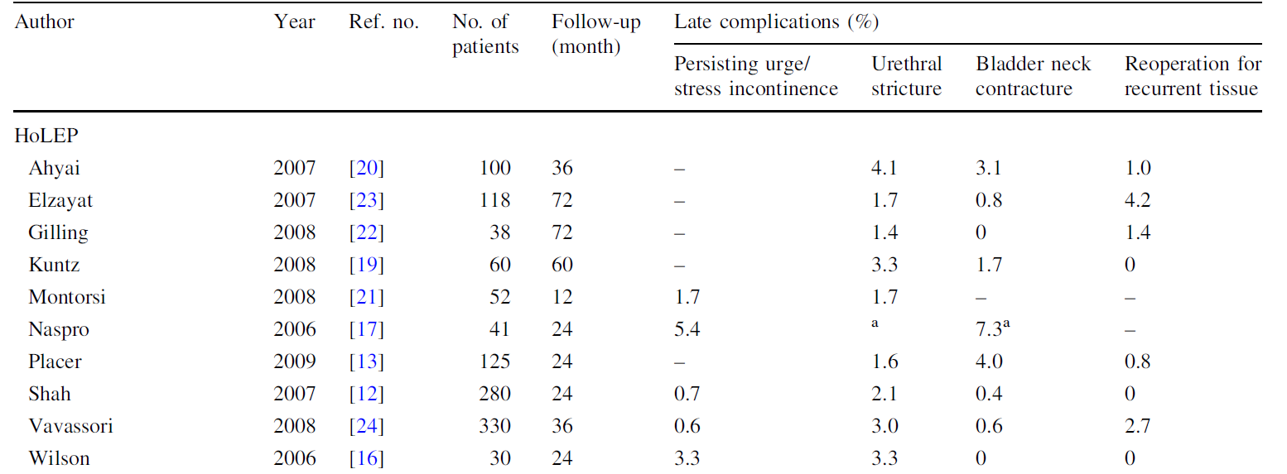
Late complications after Holep
Rieken M, et al. World J Urol. 2010; 28:53–62.

Slide 27
Late complications after pvp
Rieken M, et al. World J Urol. 2010; 28:53–62.

Slide 28
Late complications after various other laser, turp and op
Rieken M, et al. World J Urol. 2010; 28:53–62.

Slide 29
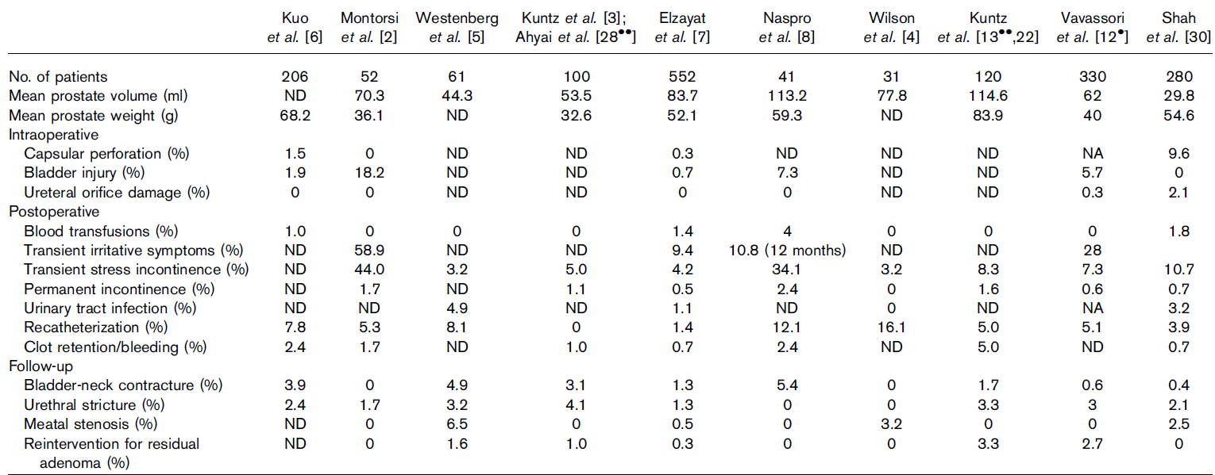
Complications related to HoLEP
Suardi N, et al. Current Opinion in Urology. 2009; 19: 38–43.

Slide 30
Perioperative storage symptoms & continence rates after ThuVEP combined with mechanical morcellation
Stress incontinence at 12 months follow-up
%
Netsch C, et al. World J Urol. 2015; 33: 517–524.

Slide 31
SUI: 80-W potassium titanyl phosphate (KTP) laser vaporization
Author | Stress urinary incontinence, %
Bouchier-Hayes et al | 0
Te et al | 0
Monoski et al | NA
Araki et al | 0
Rajbabu et al | 0
Heinrich et al | 0
Ruszat et al | 2.6
Horasanli et al | 0
Pfitzenmaier et al | 1.1
Ruszat et al | 1.2
Alivizatos et al | 0
Hamann et al | 0
Naspro R, et al. European Urology. 2009; 55: 1345–1357.

Slide 32
HolEP: Outcome & Complications of Self-taught Learning Curve
Persistent SUI (> 6 months)
Patients |  |  |  |  |  | Comment
1-25 | 26-50 | 51-75 | 76-100 | 101-125 | All (%)
3 | 2 | 1 | 0 | 0 | 6 (4.8) | Age 73 y (62-84) Prostate volume 98 cm³ (48-123) Enucleated tissue weight 70.6 g (32-90)
These patients had SUI (mild to moderate) & required pads
Placer J, et al. Urology. 2009; 73: 1042–1048.

Slide 33
Holep: possible reasons… sui
3 of these patients were > 80 yrs of age & it is well known that intrinsic sphincter deficiency is common in older people:
Major reason for SUI: Probably thermal sphincteric injury caused by laser energy
Most difficult step of surgery: Incision of anteroapical mucosal attachments of lateral lobes, especially in large-size prostates
If dissection of lobes is not properly performed, external sphincter can be damaged
Placer J, et al. Urology. 2009; 73: 1042–1048.

Slide 34
Holep: possible reasons… sui
Because all except for 1 of cases of persistent SUI were within 1st 40 HoLEPs performed & average prostate volume of these patients was 98 cm³ (range 48-123)
It is essential to avoid performing HoLEP in large-size prostates during 1st stages of learning curve to prevent sphincteric injury
This unusually high rate of SUI stresses importance of case selection during learning process, especially if procedure is self-taught & accomplished without mentoring
Placer J, et al. Urology. 2009; 73: 1042–1048.

Slide 35
Retrospective study: Predictors of de novo ui after hOLEP
July 2008 & March 2009
Aim:
To investigate incidence of de novo UI after HoLEP for BPH
Determine predictors of early postoperative de novo UI
Patients:
204 men who underwent HoLEP for LUTS with BPH refractory to medical therapy with alpha-blocker & in whom 12-month follow-up data on UI were available
Cho CM, et al. Neurourology and Urodynamics. 2011; 30: 1343–1349.

Slide 36
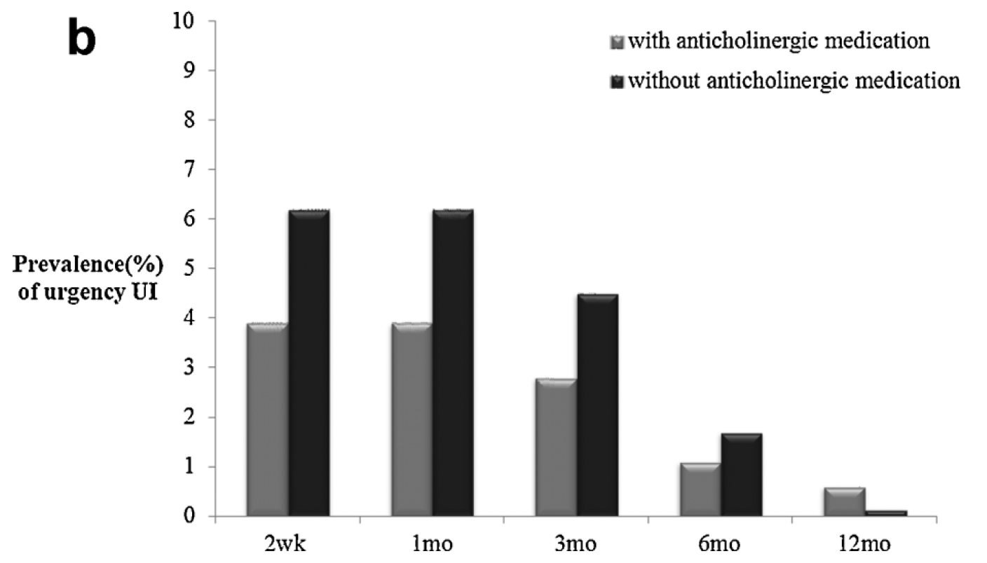
Prevalence of de novo urgency UI
18 patients: patients with (n=7) & without (n=11) anticholinergic
medications
Cho CM, et al. Neurourology and Urodynamics. 2011; 30: 1343–1349.

Slide 37
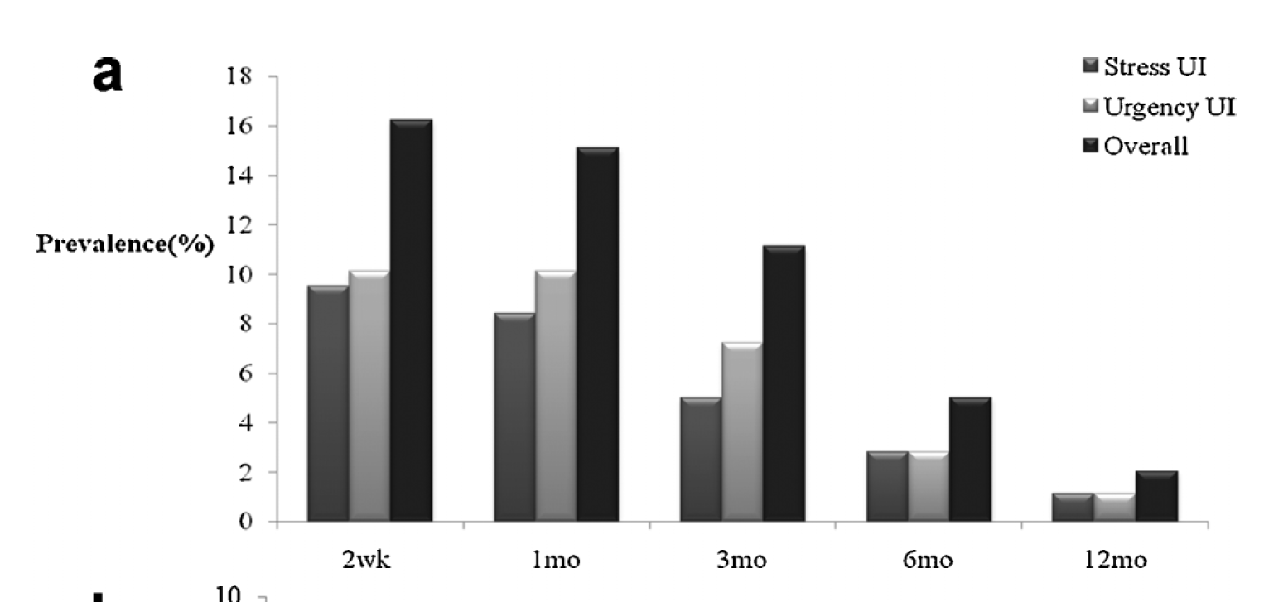
Prevalence of de novo UI
179 patients without preoperative UI
Following HoLEP, patients may have stress UI, urgency UI, or a combination of both types
58.6% of the patients with de novo UI after HoLEP had symptoms of stress UI (pure stress UI plus mixed UI)
Cho CM, et al. Neurourology and Urodynamics. 2011; 30: 1343–1349.

Slide 38
Reasons for ui…
Probably due to more complete removal of adenoma → results in larger prostatic fossa postop & can lead to urine trapping and leakage with stress maneuvers in short-term
Higher risk of harmful effect to external sphincter while making 12 o’clock incision because there is no landmark such as verumontanum
Cho CM, et al. Neurourology and Urodynamics. 2011; 30: 1343–1349.

Slide 39
Reasons for ui…
Overall incidence of de novo UI after HoLEP was higher than that after OP, while 2 were similar in that considerable number of patients with de novo UI after surgeries had symptoms of stress UI
This may be attributed to laser exposure of prostatic capsule during HoLEP
Applied laser energy may be beneficial with respect to hemostasis, but some patients have to pay the price of postoperative urgency UI
Cho CM, et al. Neurourology and Urodynamics. 2011; 30: 1343–1349.

Slide 40
Reasons for ui…Bladder mucosal injury
Presence or absence of bladder mucosal injury during morcellation & MUCP on baseline urodynamics were independent predicting factors of de novo overall UI or urgency UI after HoLEP
To avoid bladder mucosal injury during morcellation: including thorough hemostasis for best view before morcellation & avoidance of bladder collapse during morcellation
Bladder mucosal injuries: Generally minor & uneventful
Present Study: No case of bladder perforation & only superficial mucosal injuries occurred. These injured areas were coagulated by holmium laser without further sequelae
Cho CM, et al. Neurourology and Urodynamics. 2011; 30: 1343–1349.
Notes:
maximum urethral closure pressure: MUCP

Slide 41
few mechanisms: HoLEP increases risk of de novo sUI…
Postop sphincteric weakness
Internal urethral sphincter at bladder neck is damaged
More radical deobstruction
Enlarged prostate may be limiting incontinence, as obstruction is preventing leakage that only occurs once patient has undergone surgery to remove obstruction
Cho CM, et al. Neurourology and Urodynamics. 2011; 30: 1343–1349.
Notes:
External urethral sphincter may be weakened from disuse during period when urethra is compressed by enlarged prostate

Slide 42
Risk Factors for Transient UI after Holep
Univariate and multivariate predictors of postoperative transient incontinence
Nam JK, et al. World J Mens Health. 2015; 33(2): 88-94.

Slide 43
Diabetes & development of SUI: RISK???
Presence of diabetes mellitus, large prostate volume & greater reduction in postop PSA remained statistically significant for development of SUI
Patients with diabetes, especially those with a large prostate, should be encouraged to start Kegel exercises in the immediate postoperative period
Elmansy HM, et al. J Urol. 2011; 186(5): 1977-81.

Slide 44
Reducing sui

Slide 45
Research into interventions that shorten UI period should be encouraged
Clinicians should consider inquiring about UI while improvement in micturition parameters occurs in early postop period & pursue adequate treatment protocol or prevention measure
Cho CM, et al. Neurourology and Urodynamics. 2011; 30: 1343–1349.

Slide 46
Transurethral vaporization methods, such as holmium laser ablation of the prostate (HoLAP) & photoselective vaporization of the prostate (PVP), which require less of a learning curve & have lower risks for SUI, are becoming more widespread
- Endo F, et al. Urology. 2010; 76: 1451–1456.

Slide 47
pelvic floor muscle exercises (PFME)
Pelvic PFME can reduce distress:
PFME might quicken progressive improvement of UI, particularly during immediate early postop period
Internal urethral sphincter of bladder neck is damaged after HoLEP, continence relies on competent external urethral sphincter, reinforced by pelvic floor musculature
Cho CM, et al. Neurourology and Urodynamics. 2011; 30: 1343–1349.
Notes:
Applied laser energy may be beneficial with respect to hemostasis, but some patients have to pay the price of postoperative urgency UI

Slide 48
Severe urgency ui
Severe urgency UI may be treated with anticholinergic medication
Cho CM, et al. Neurourology and Urodynamics. 2011; 30: 1343–1349.
Notes:
Applied laser energy may be beneficial with respect to hemostasis, but some patients have to pay the price of postoperative urgency UI

Slide 49
Anteroposterior Dissection HoLEP: Modification to Prevent Transient SUI
Anteroposterior dissection HoLEP was newly developed to protect urethral sphincter & therefore lower incidence rate of SUI
Aim of the study:
To determine SUI incidence rate after anteroposterior dissection HoLEP
Endo F, et al. Urology. 2010; 76: 1451–1456.

Slide 50
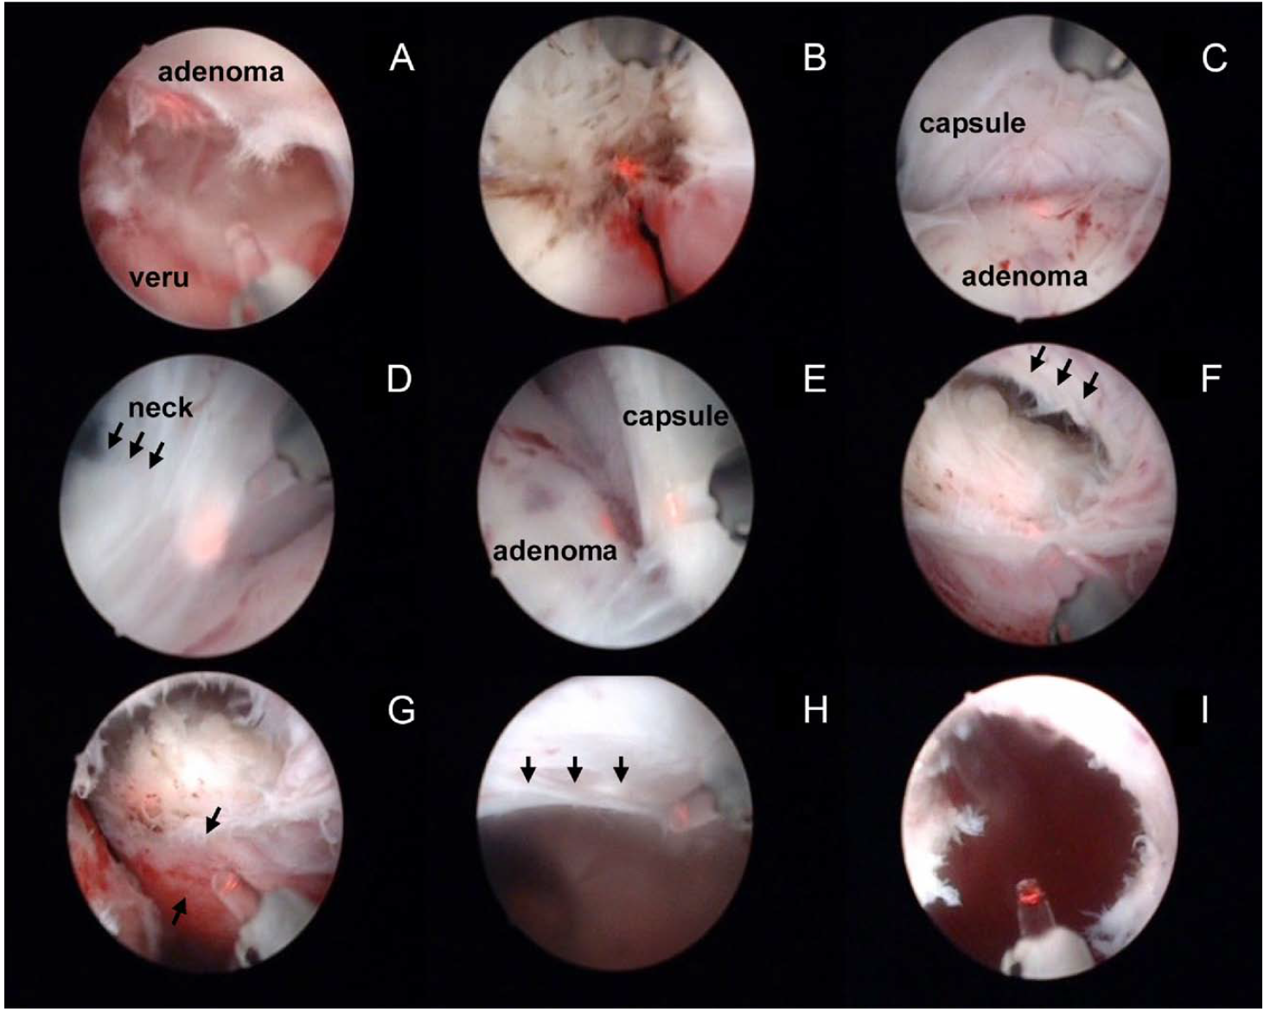
Anteroposterior Dissection HoLEP
Endo F, et al. Urology. 2010; 76: 1451–1456.
Notes:
(A) The urethral mucosa between the lateral lobe and the verumontanum is incised down to the surgical capsule. (B) The 12-o’clock-urethral mucosa directly above the verumontanum is vaporized to the surgical capsule. (C) The separation layer between the lobe and the capsule is created at the middle of the adenoma in the first step. (D) The lateral lobe is dissected from this separation area created toward bladder neck (arrows). (E) This separation layer is extended anteroposteriorly and downwardly towards the 6-o’clock-apical adenoma. This “anteroposterior dissection” extends to the lower edge of the adenoma. (F) After the anteroposterior dissection, the 12-o’clock-to-5-o’clock apical urethral mucosa tears off naturally from the capsule, without damaging the ring formed by sphincter muscle (arrows). (G) The remaining apical belt-shaped urethral mucosa (arrows) is observed. The lateral adenoma apex behind this mucosal belt is completely separated from the surgical capsule and urethral mucosa. (H) An apical mucosa at 12 o’clock is cut adequately without surplus tissue, and no adenoma is found. (I) The intact ring where sphincter forms is clearly observed after the left lateral adenoma is removed.

Slide 51
Anteroposterior Dissection HoLEP: Modification to Prevent Transient SUI: mETHODS
68 consecutive BPH patients underwent HoLEP (Jan - Dec 2008)
First 31 cases (Surgery 1) underwent HoLEP according to Gilling’s method
Next 37 cases (Surgery 2) underwent anteroposterior dissection HoLEP, where adenoma was dissected antegradely. This antegrade movement of cystoscope allows apical gland to be removed from sphincter without causing damage
Surgical quality indexes (hemoglobin change, operating time, resected prostate volume) between 2 groups were compared
All patients were assessed at 2 weeks postoperatively for clinical SUI, IPSS, QoL & peak flow rates (Qmax)
Endo F, et al. Urology. 2010; 76: 1451–1456.

Slide 52
Anteroposterior Dissection HoLEP: results
P value: 0.013*
Endo F, et al. Urology. 2010; 76: 1451–1456.

Slide 53
Anteroposterior Dissection HoLEP: Other results
Parameters | Surgery 1 (HoLEP according to Gilling’s method) | Surgery 2 (Anteroposterior dissection HoLEP) | P value
Symptom score
IPSS | 7.1 ± 3.9 | 6.3 ± 4.7 | .11
QoL | 2.4 ± 1.1 | 1.5 ± 1.1 | .02*
Uroflow
Peak flow rate (mL/s) | 13.0 ± 4.7 | 19.8 ± 8.4 | .02*
Postvoid residual (mL) | 0.9 ± 2.5 | 0.41 ± 2.0 | .38
Endo F, et al. Urology. 2010; 76: 1451–1456.

Slide 54
Points from the study
Learning curve for overcoming SUI is relatively long
Previous studies have reported that it takes experience of 20-30 cases to reduce SUI
Several modifications of HoLEP for incontinence prevention have been reported
SUI decreased dramatically from 46% to 0% by operative methods in which apical adenoma was partially preserved in 10– to 2-o’clock position
Although this method might be promising, other surgical equipment, such as monopolar generator & TUR loop were used to preserve apical adenoma, resulting in more complex than standard HoLEP
Endo F, et al. Urology. 2010; 76: 1451–1456.

Slide 55
Points from the study
Gilling’s method:
Lateral adenoma was enucleated retrogradely from apex to bladder neck
For dissecting apex, urethral mucosa was incised from 6 - 12 o’clock position. This incision should be made to prevent sphincter damage that leads to SUI
By reviewing procedural videos, it was revealed that mucosal incision line was not always made at ideal location, as partially dissected lateral adenoma retracted toward bladder neck & ring structure formed by sphincter muscle was obscure
In some other cases, so-called apical pad (submucosal connective tissue between urethral mucosa & adenoma) was not completely removed & residual adenoma could be seen
Endo F, et al. Urology. 2010; 76: 1451–1456.

Slide 56
Points from the study: Urethral sphintcer
Inner muscle layer of urethral sphincter that surrounds urethra & consists of smooth muscle fibers and elastic tissue
Smooth muscle layer: Subdivided into outer, more circumferential-oriented layer & inner, longitudinal-oriented layer
Retrograde dissection of apex in conventional HoLEP may stretch inner longitudinal-oriented layer around apical gland non-severe & transient SUI
In open prostatectomy, way of dissection from bladder neck to apex does not stretch this inner layer of sphincter. Therefore, no transient SUI was found
Anteroposterior dissection HoLEP simulates this open prostatectomy in terms of dissection of apical adenoma by endoscopic movement
Endo F, et al. Urology. 2010; 76: 1451–1456.

Slide 57
Points from the study: Urethral sphintcer
Dissecting apex of lateral adenoma from capsule is most important step for preserving internal muscle of the sphincter
Dissecting lateral adenoma anteroposteriorly & vertically from 12-o’clock to 6-o’clock position, imitating movements of fingers during open prostatectomy, achieves both complete dissection of apical adenoma & places perfect excision line of urethra without mucosal incision
This new method can eliminate crucial & stressful step to separate sphincter from urethra
Endo F, et al. Urology. 2010; 76: 1451–1456.

Slide 58
Revised HoLEP: Designated the anteroposterior dissection HoLEP, can decrease transient SUI rate
This method is simple & could shorten the learning curve for surgeons
- Endo F, et al. Urology. 2010; 76: 1451–1456.

Slide 59
Small changes can make big differences

Slide 60
THANK YOU!!!

