Slide 1
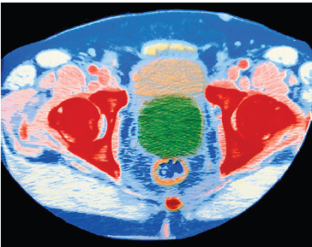
Current treatments available for CRPC
October 19, 2015

Slide 2
Prostate Cancer: Introduction
Prostate cancer: Leading cause for cancer incidence for men with total of 1.4 million cases (2013)¹
Primarily disease of ageing men with median age at diagnosis of 66 yrs²
Clinical behaviour range: Microscopic, well-differentiated to aggressive, high-grade cancer (metastases, morbidity & death)
One of most challenging & controversial issues: Screening & management of early prostate cancer³
1. Global Burden of Disease Cancer Collaboration, Fitzmaurice C, et al. JAMA Oncol. 2015; 1(4): 505-27/ 2. Droz JP, et al. Lancet Oncol. 2014; 15(9): e404-14/ 3. Cuzick J, et al. Lancet Oncol. 2014; 15(11): e484-92.

Slide 3
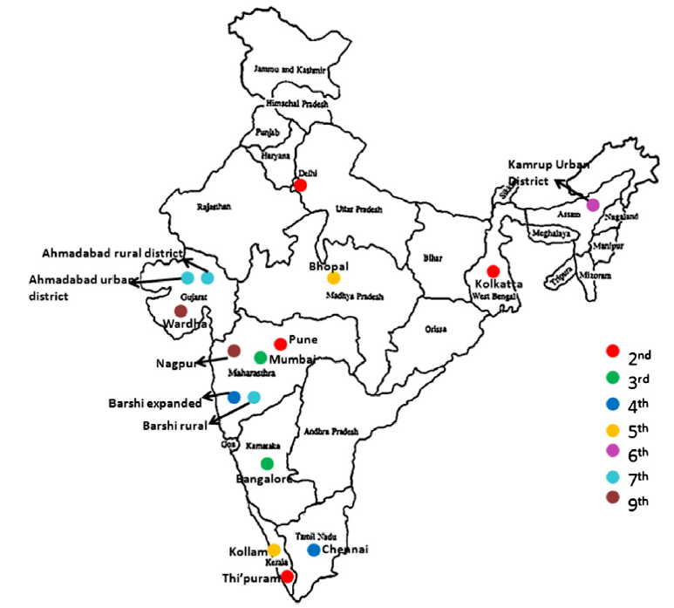
Map of India showing rank of prostate cancer among top 10 leading sites of all cancers, for different population based
cancer registries of India
Jain S, et al. Meta Gene . 2014; 2: 596–605.

Slide 4
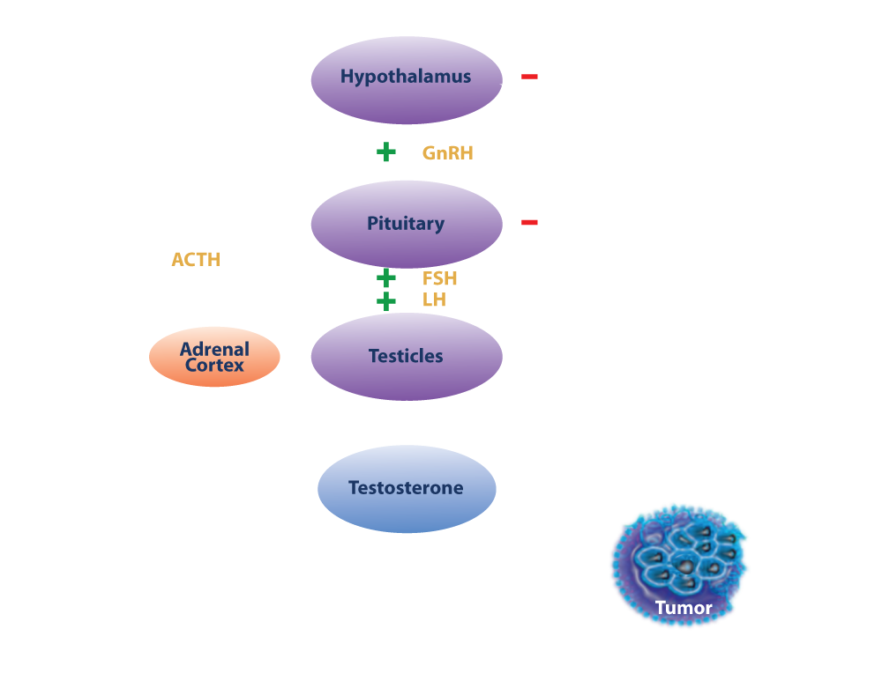
Endocrine Axis in Prostate Cancer

Slide 5
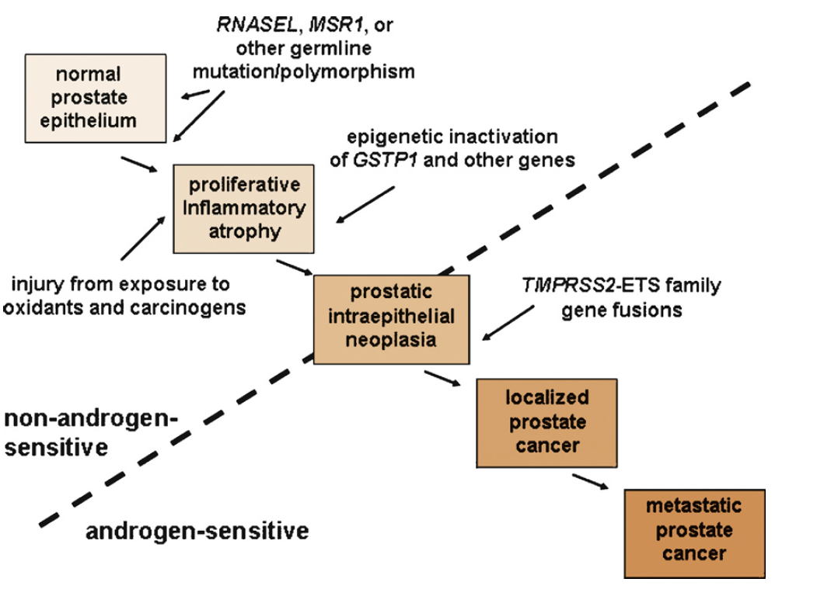
Molecular Pathogenesis of Prostate Cancer
Rittmaster RS, et al. European Urology. 2009; 55: 1064–1074.

Slide 6
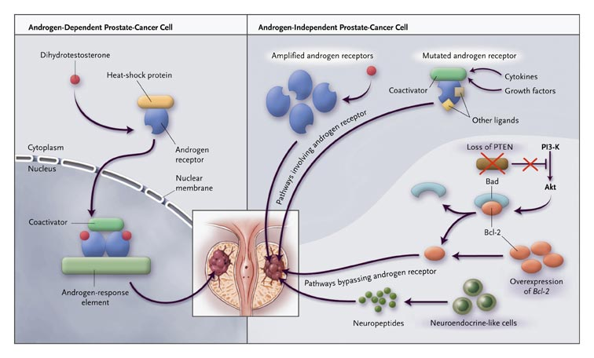

Slide 7
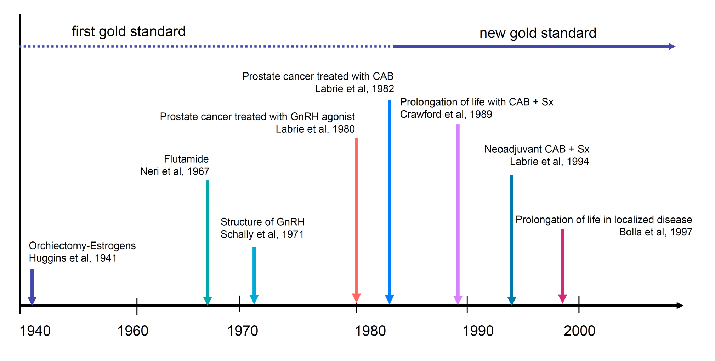
Milestones in management
Labrie F, et al. Endocrine Reviews. 2005; 26 (3): 361-379.

Slide 8
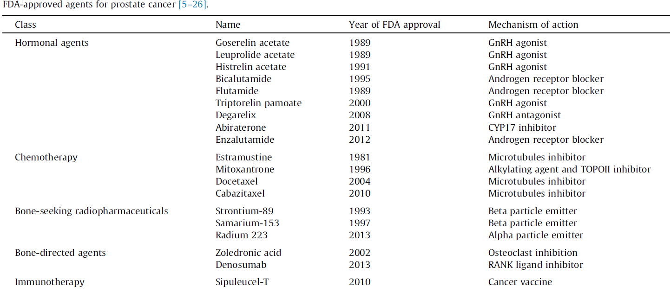
Khemlina G, et al. Cancer Treatment Reviews. 2015.

Slide 9
Treatment Options
Clarke NW. BJU International. 2012; 110 (Suppl. 1): 14-22.

Slide 10
Treatment Options
Clarke NW. BJU International. 2012; 110 (Suppl. 1): 14-22.

Slide 11
Treatment Options
Clarke NW. BJU International. 2012; 110 (Suppl. 1): 14-22.

Slide 12
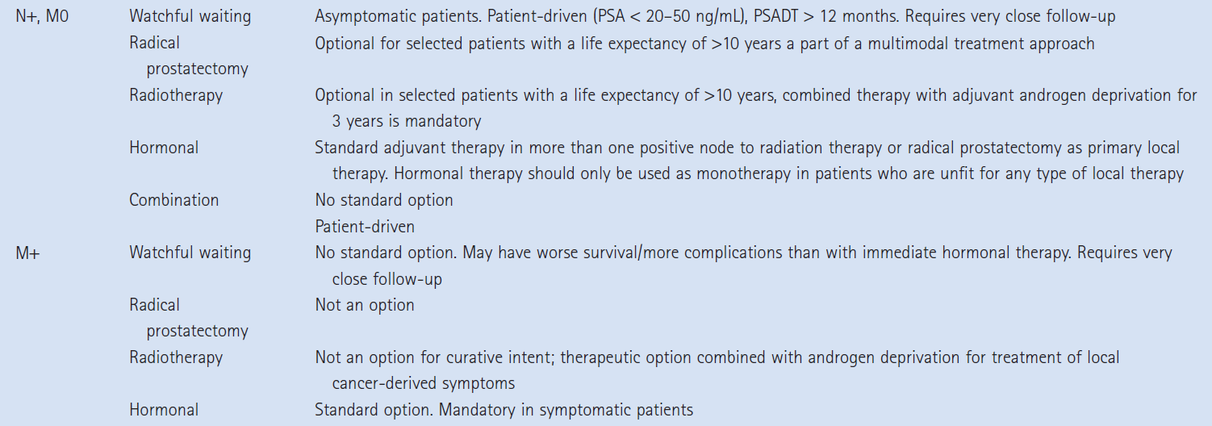
Treatment Options
Clarke NW. BJU International. 2012; 110 (Suppl. 1): 14-22.

Slide 13
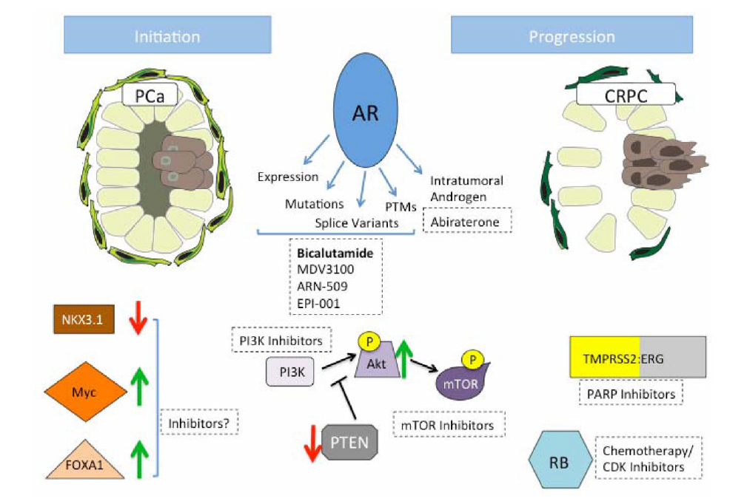
Molecules implicated in PCa initiation and progression
Initiation
Progression
Schrecengost RS, et al. Semin Oncol. 2013; 40(3): 244–258.

Slide 14
“Nature can refuse to
speak but she cannot
give a wrong answer”.
- Charles Brenton Huggins

Slide 15
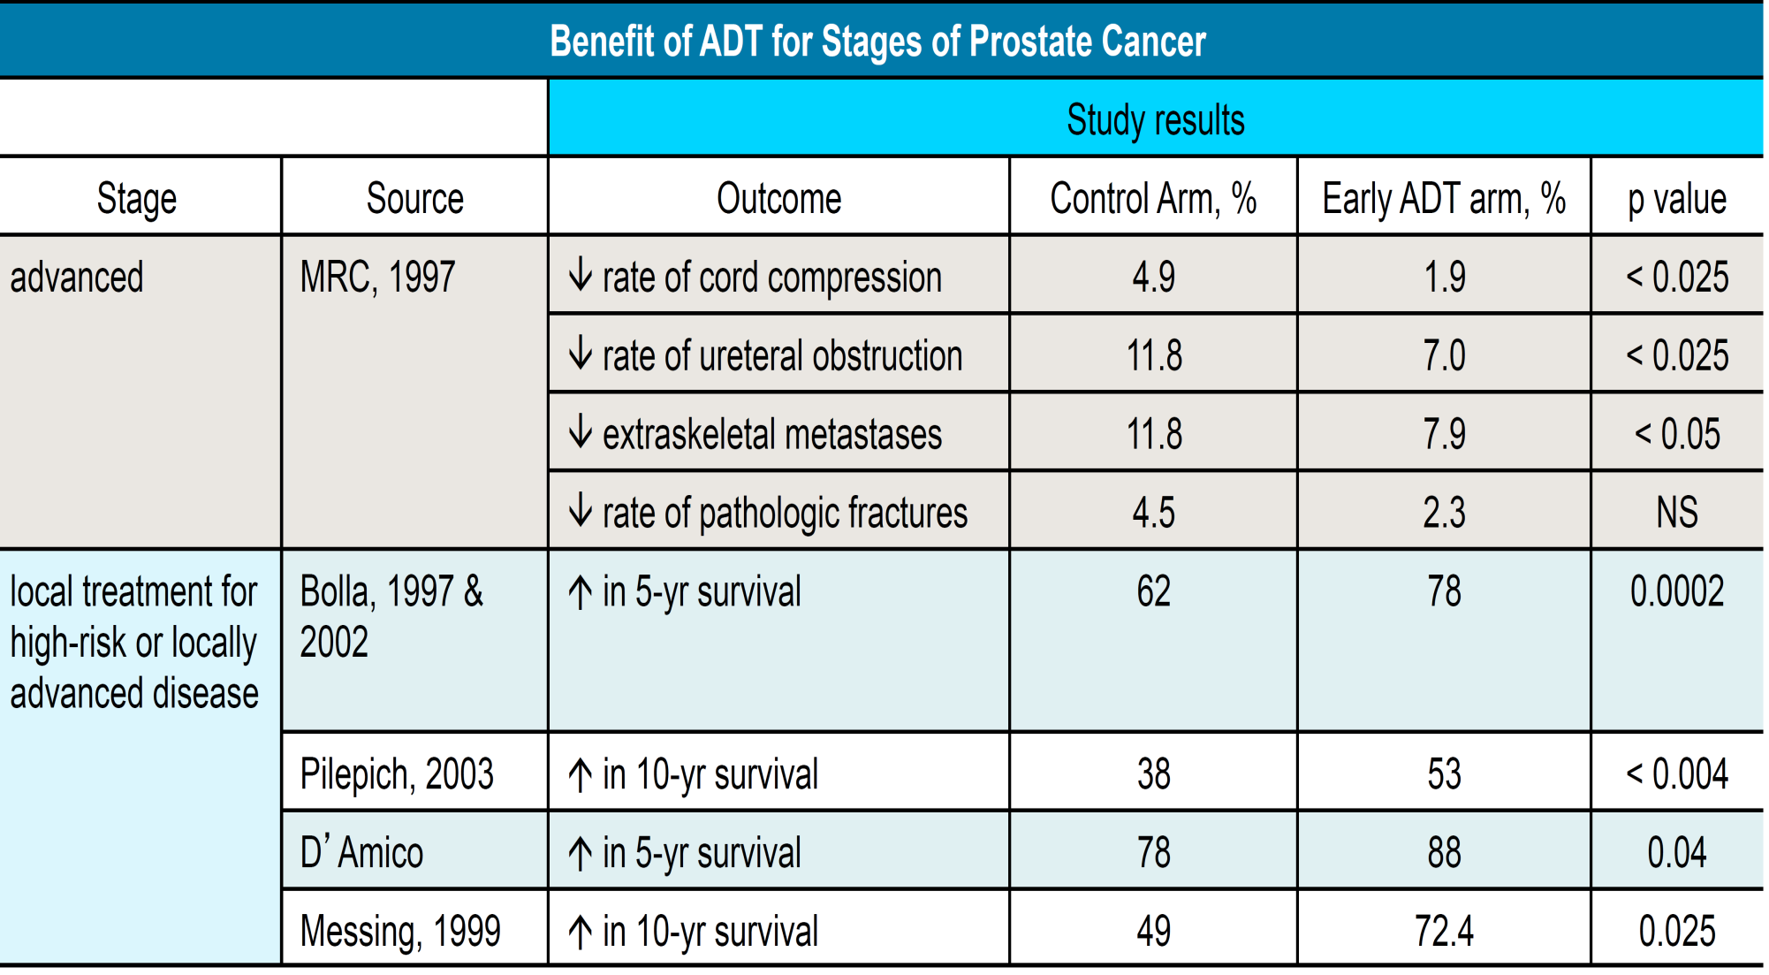
Benefit of ADT for stages of Prostate Cancer
Nima Sharifi, et al. JAMA. 2005; 294: 238-244.

Slide 16
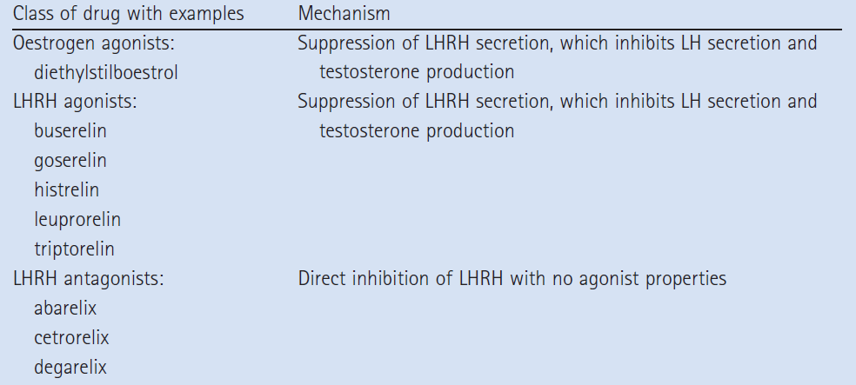
Hormonal agents: Management of prostate cancer
Hammerer P, et al. BJU International. 2012; 110 (Suppl. 1): 23-29.

Slide 17
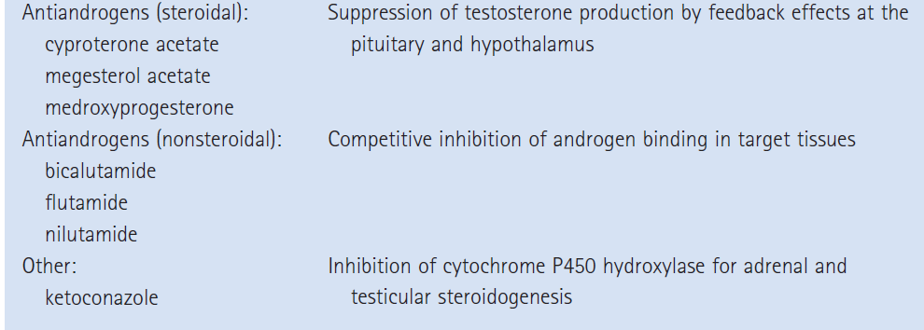
Hormonal agents: Management of prostate cancer
Hammerer P, et al. BJU International. 2012; 110 (Suppl. 1): 23-29.

Slide 18
Gonadal androgens account for up to 80% of serum androgenic steroids
Castration, therefore, does not suppress adrenal androgens
“Hormone-reduced” rather than a "hormone-free"

Slide 19
PC: Androgen-mediated progression

Slide 20
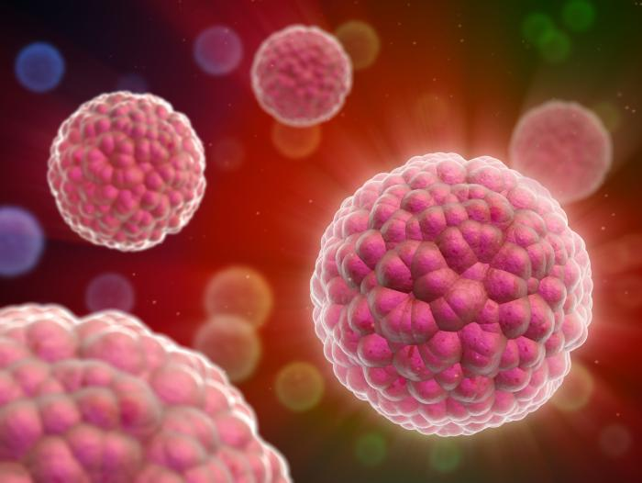
Crpc: Castration-resistant prostate cancer

Slide 21
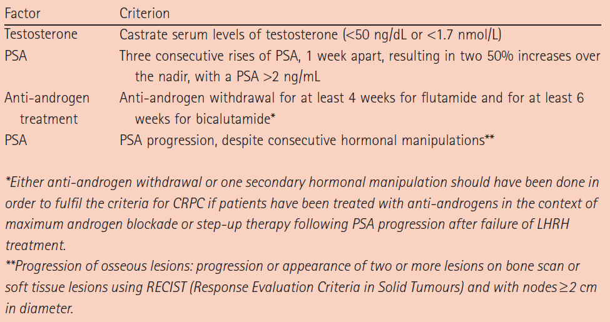
Definition of CRPC
Shore N, et al. BJU International. 2012; 109 (Suppl. 6): 22-32.

Slide 22
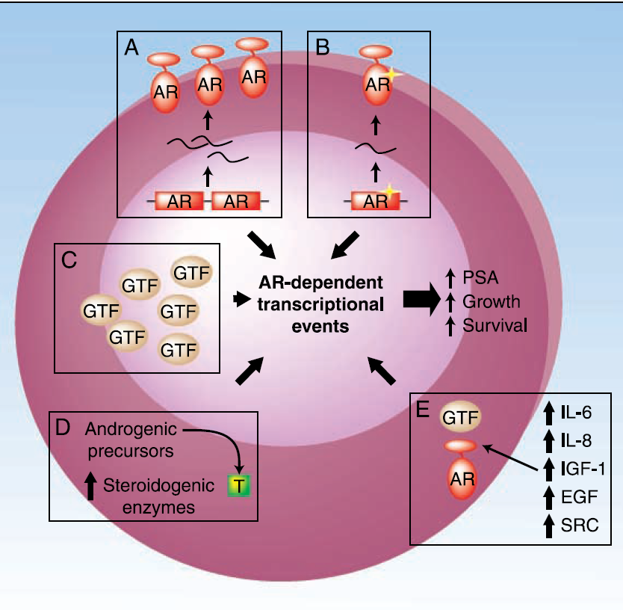
Mechanisms involved in CRPC
Several molecular mechanisms have been proposed to explain dependency of these tumors on functional AR. Those include: A, gene amplification & increased expression of AR mRNA & protein; B, selection of mutations in AR that confer broader ligand specificity; C, changes in ratios or expression between AR & its coregulators (GTF, general transcription factor); D, increased expression of steroidogenic enzymes; and E, up-regulation of cross-talk signal transduction pathways that can activate AR in ligand-independent manner
Attar RM, et al. Clin Cancer Res 2009;15(10): 3251-5.

Slide 23
Selection of therapy for CRPC
With range of newer treatment options becoming available, it is clear there will be need to more carefully define most appropriate treatment for individual patients with CRPC
As incidence of prostate cancer is disproportionately high in elderly men, consideration should be given to life expectancy issues, functional status & ability of patient to tolerate potential side effects of therapies
Sartor OA. Journal of Hematology & Oncology 2011, 4:18.

Slide 24
Selection of therapy for CRPC
Because elderly patients also may benefit from chemotherapies to same degree younger patients do, we should ensure that all treatment options that prolong survival, control symptoms, reduce pain & improve QoL are available to those patients with good clinical status
Strategies such as proteomic profiling have been used to define markers that predict docetaxel resistance in men with mCRPC & use of such biomarkers potentially could better define which patients will experience recurrence early on docetaxel therapy and direct these patients to a more appropriate therapy
Sartor OA. Journal of Hematology & Oncology 2011, 4:18.

Slide 25
Selection of therapy for CRPC
Other surrogate biomarkers for prediction of clinical benefit in mCRPC include PSA, bone turnover markers, bone pain, bone scans & circulating tumor cells
Use of these surrogate biomarkers has the potential to improve patient selection strategies & more rapidly identify agents that merit further testing in phase 3 clinical trials, as well as accelerate phase 3 testing
However, these markers will require validation for use in patients with mCRPC
Sartor OA. Journal of Hematology & Oncology 2011, 4:18.

Slide 26
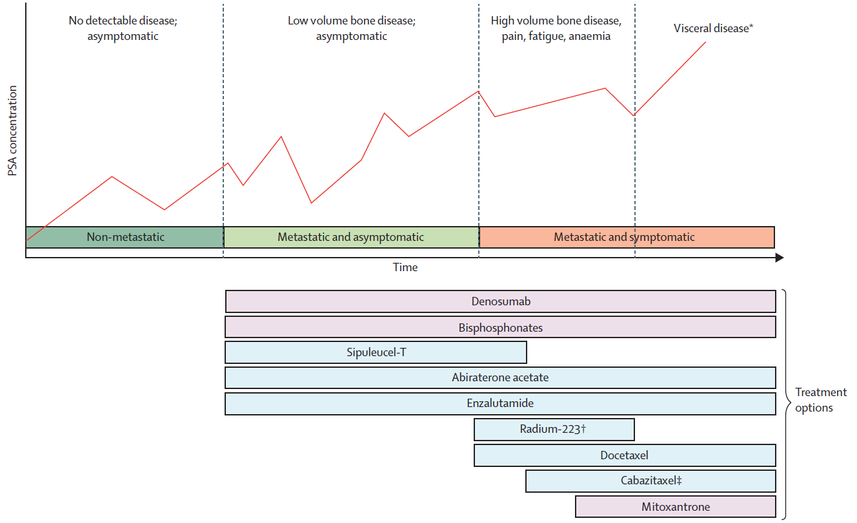
Typical progression of metastatic CRPC
Lorente D, et al. Lancet Oncology. 2015; 16: e279–92.
Notes:
The majority of patients diagnosed with prostate cancer are cured with definitive primary treatment.
In advance or metastatic disease, Anti-androgens and LHRH analogues are effective but patients progress within 2-3 years and there will be an emergence of castrate resistance. Chemotherapy is not without the side effects. Post chemotherapy there is a need for better and safe drugs in castrate resistant prostate cancer

Slide 27
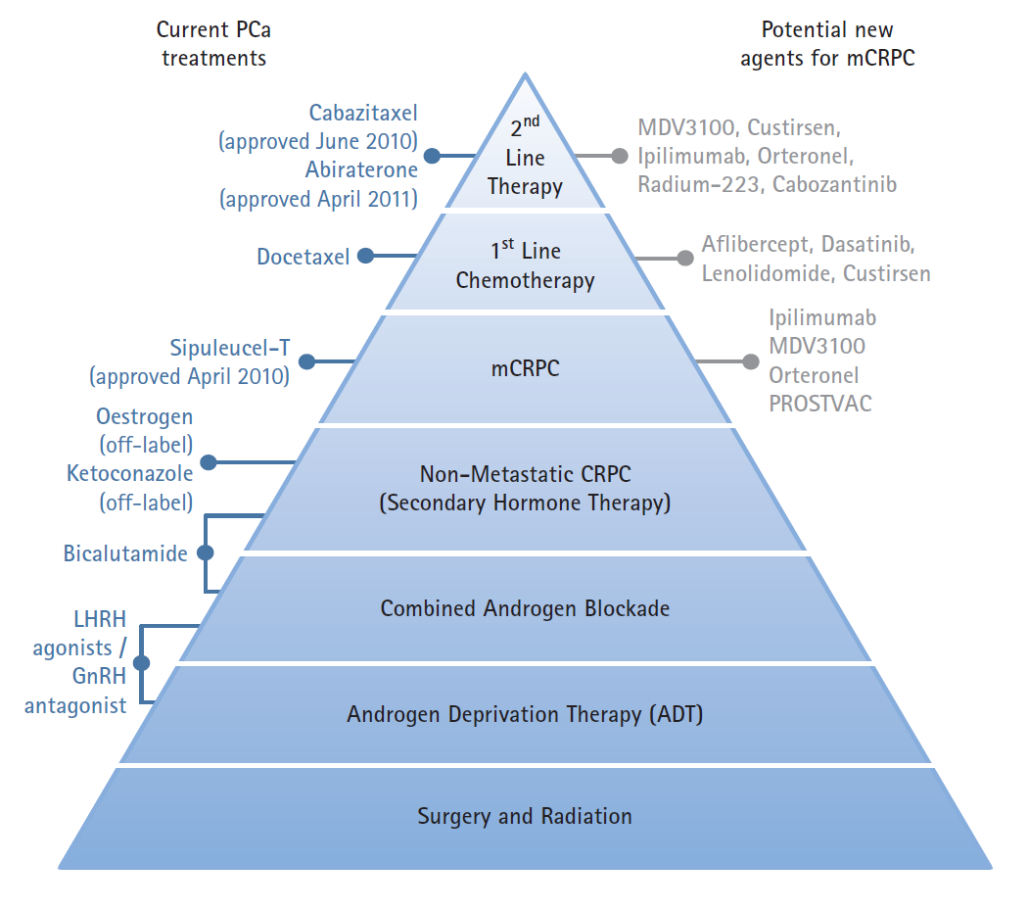
Current treatment options for PCa & potential new therapeutic agents being assessed in phase III trials for treatment of mCRPC
Shore N, et al. BJU International. 2012; 109 (Suppl. 6): 22-32.

Slide 28
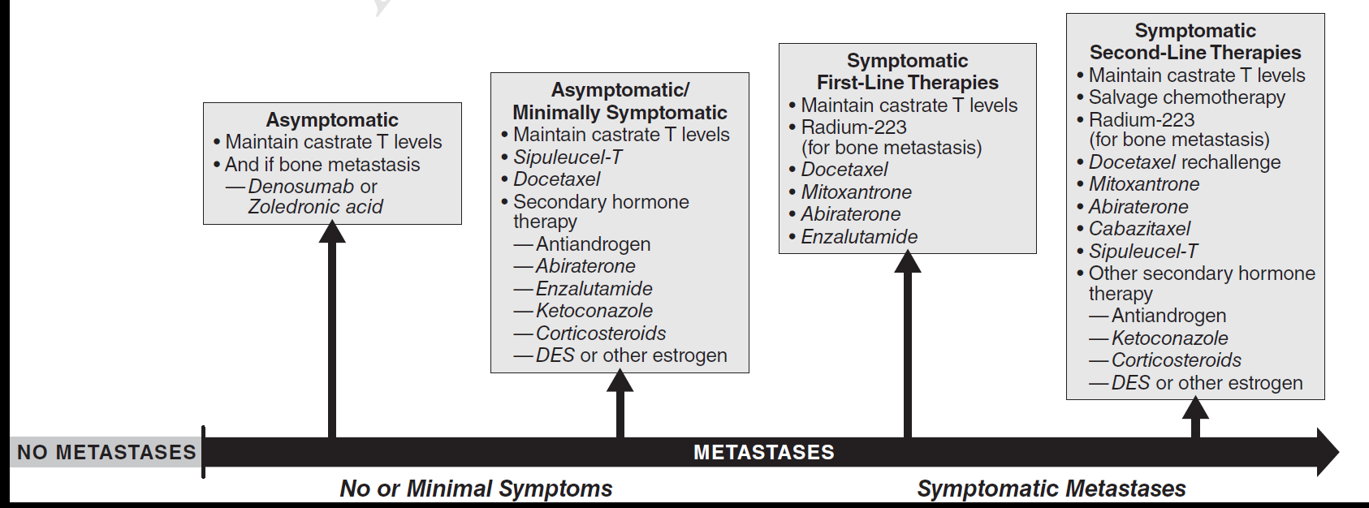
CRPC drug treatment options in addition to continued ADT
Saad F, et al. Urology. 2015 Aug 14.

Slide 29
Prospects for successful treatment of patients with CRPC have developed considerably so that these patients may soon have reasonable expectation of therapeutic efficacy & meaningful extension of their lives
Several new & emerging therapies for patients with CRPC have fundamentally altered treatment landscape. These new treatment options include, among others, a new cytotoxic agent, immunotherapy & androgen receptor-signalling inhibitors

Slide 30
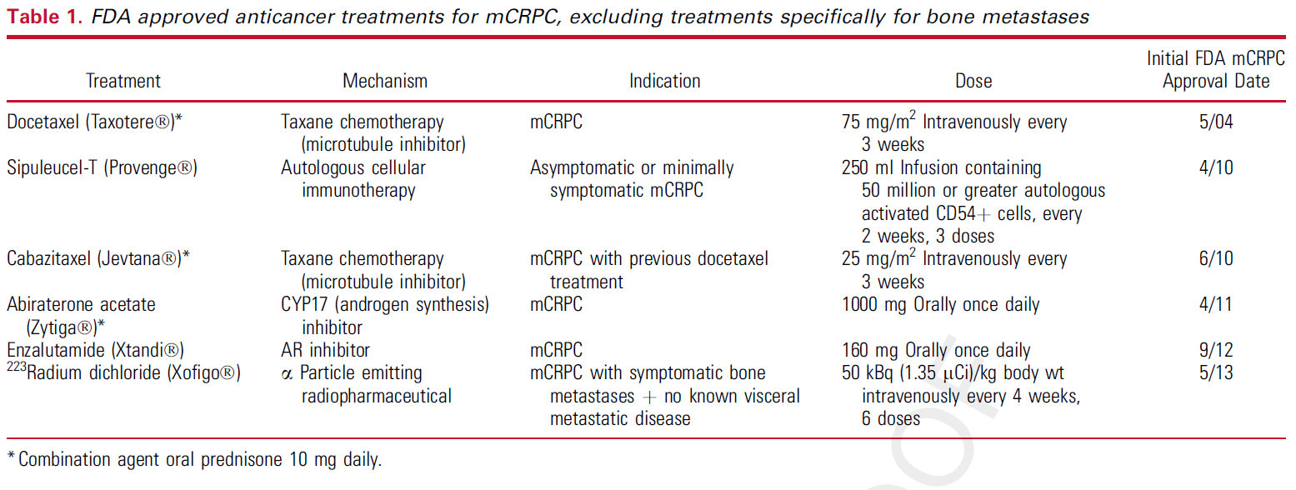
Crawford DE, et al. J Urol. 2015 July 18.

Slide 31
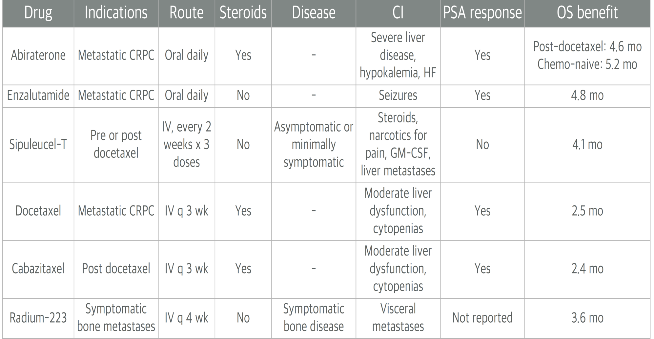
Castration-resistant disease: Management Options

Slide 32
Phase 3 trials: Approved agents in CRPC
Lorente D, et al. Lancet Oncology. 2015; 16: e279–92.

Slide 33
Phase 3 trials: Approved agents in CRPC
Lorente D, et al. Lancet Oncology. 2015; 16: e279–92.

Slide 34
Phase 3 trials: Approved agents in CRPC
Lorente D, et al. Lancet Oncology. 2015; 16: e279–92.

Slide 35
Phase 3 trials: Approved agents in CRPC
Lorente D, et al. Lancet Oncology. 2015; 16: e279–92.

Slide 36
Phase 3 trials: Approved agents in CRPC
Lorente D, et al. Lancet Oncology. 2015; 16: e279–92.

Slide 37
Phase 3 trials: Approved agents in CRPC
Lorente D, et al. Lancet Oncology. 2015; 16: e279–92.

Slide 38
Abiraterone Acetate
Pregnenolone analogue¹
Highly specific & irreversible CYP17A1 inhibitor¹
Orally administered²
Converted to its active metabolite abiraterone by liver²
Abiraterone acetate: 3β-acetoxy prodrug of abiraterone with improved bioavailability compared with abiraterone¹
1. Grist E, et al. Urologic Oncology: Seminars and Original Investigations. 2015; 33: 289–294/ 2. Han CS, et al. Expert Opin Drug Metab Toxicol. 2015; 11(6): 967-975.

Slide 39
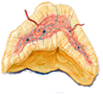
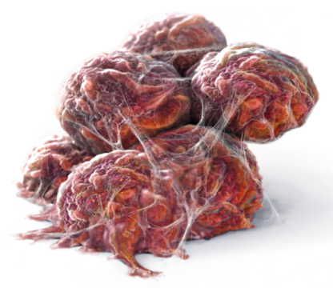
Sources of Androgen in Prostate Cancer
PC tumors produce androgen de novo:¹ Androgen biosynthesis is taking place in testes, adrenal glands & within prostate tumor²
Abiraterone inhibits androgens from all 3 sources
Adrenal gland
Testes
Dehydroepiandrostenedione
Androstenedione
Testosterone
Dihydrotestosterone
Dehydroepiandrostenedione
Androstenedione
Autocrine and paracrine signalling
Prostate cancer cells
1. Locke JA, et al. Cancer Res 2008;68:6407–6415/ 2. Denmeade SR, et al. Nature Rev Cancer 2002;2:389-396/ 3. Chen Y, et al. Lancet Oncol 2009; 10:981–991.

Slide 40
Mechanism of Action of Abiraterone acetate
Abiraterone acetate

Slide 41
Steroid Synthesis Pathway: MOA of Abiraterone & Related AEs
Cholesterol
Desmolase
Na ⁺
H₂0 retention
K⁺
CYP21
Pregnenolone
Deoxy-
corticosterone
Aldosterone
Progesterone
Corticosterone
X
CYP17
17α-hydroxylase
11β-Hydroxylase
17α-OH-
pregnenolone
17α –OH-
progesterone
CYP21
11-Deoxy-
cortisol
Cortisol
ACTH
X
CYP17
C17,20-lyase
Androstenedione
5α-reductase
DHEA
Testosterone
DHT
CYP19: aromatase
Estradiol
Attard, et al, J. Clin. Oncol. 2008.

Slide 42
Abiraterone in metastatic PC: COU-AA-302
Study COU-AA-302 evaluated abiraterone acetate (AA) + prednisone (P) vs. prednisone alone in mildly symptomatic or asymptomatic patients with progressive mCRPC without prior chemotherapy
Ryan CJ, et al. N Engl J Med. 2013; 368: 138-48.
Notes:
Multinational

Slide 43
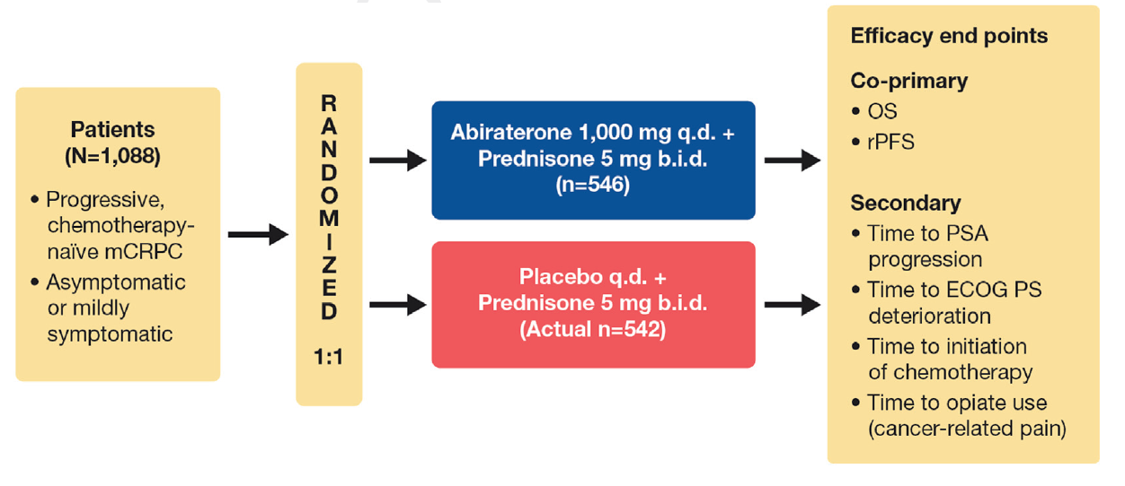
Patients and Efficacy parameters
Ryan CJ, et al. N Engl J Med. 2013; 368: 138-48.
Notes:
Asymptomatic or minimally symptomatic with absence of visceral metastasis
Had Eastern Cooperative Oncology Group (ECOG) performance status score of 1 or lower (76% ECOG 0 & 24% ECOG 1)

Slide 44
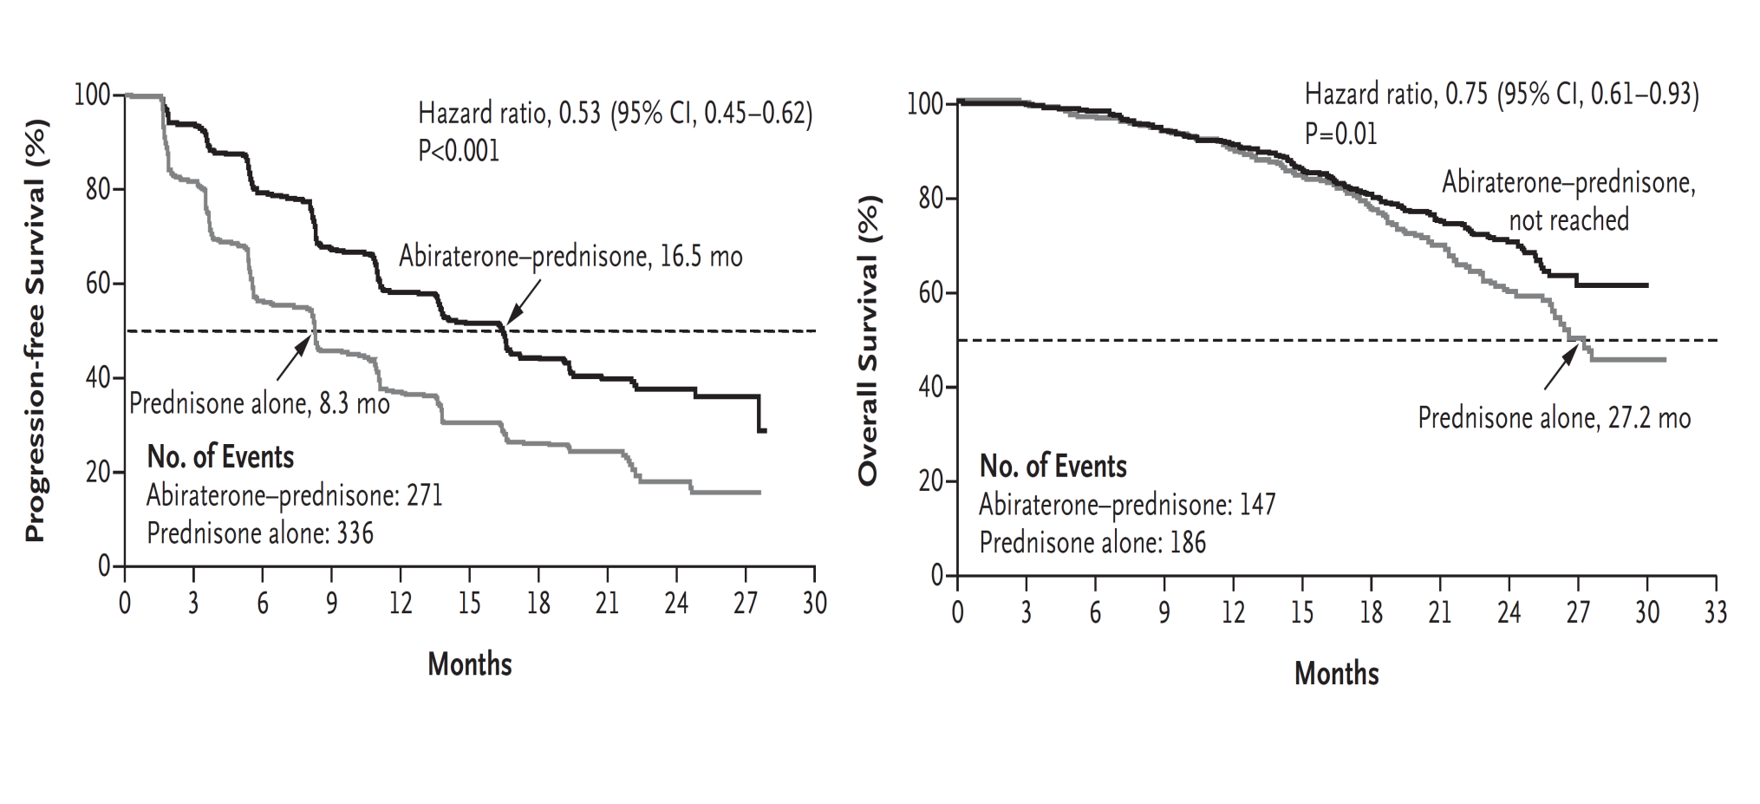
COU-AA-302 Results: r-PFS & OS (primary efficacy parameters)
Ryan CJ, et al. N Engl J Med. 2013; 368: 138-48.

Slide 45
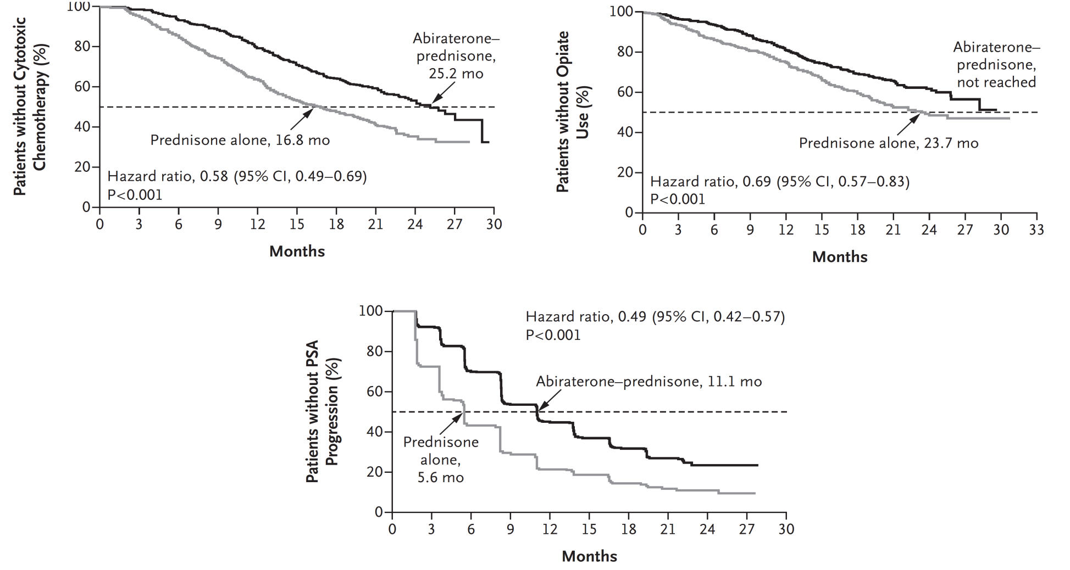
COU-AA-302: Secondary efficacy parameters
Ryan CJ, et al. N Engl J Med. 2013; 368: 138-48.

Slide 46
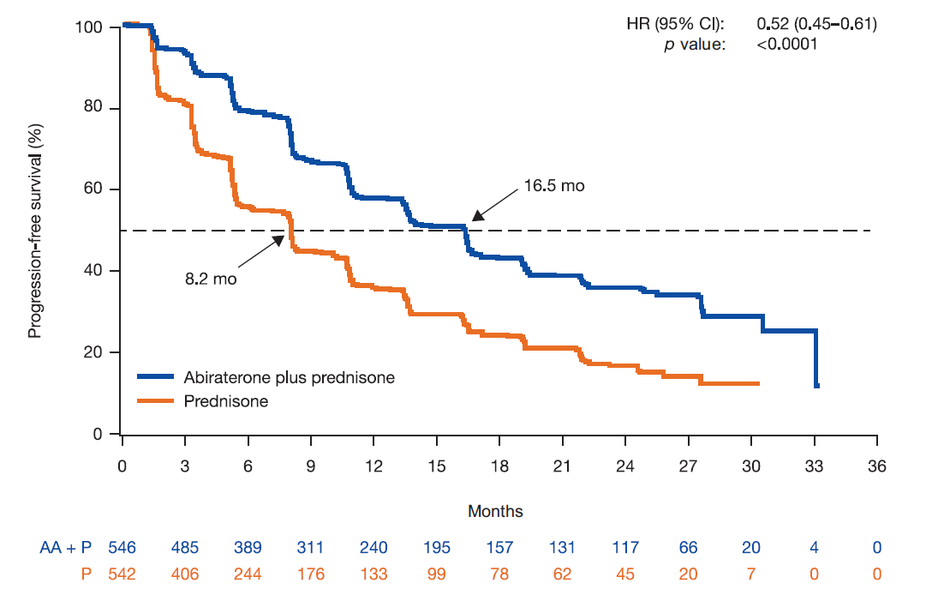
IA3 Results: rPFS
AA+P
P
Rathkopf DE, et al. Eur Urol. 2014; 66: 815-825.

Slide 47
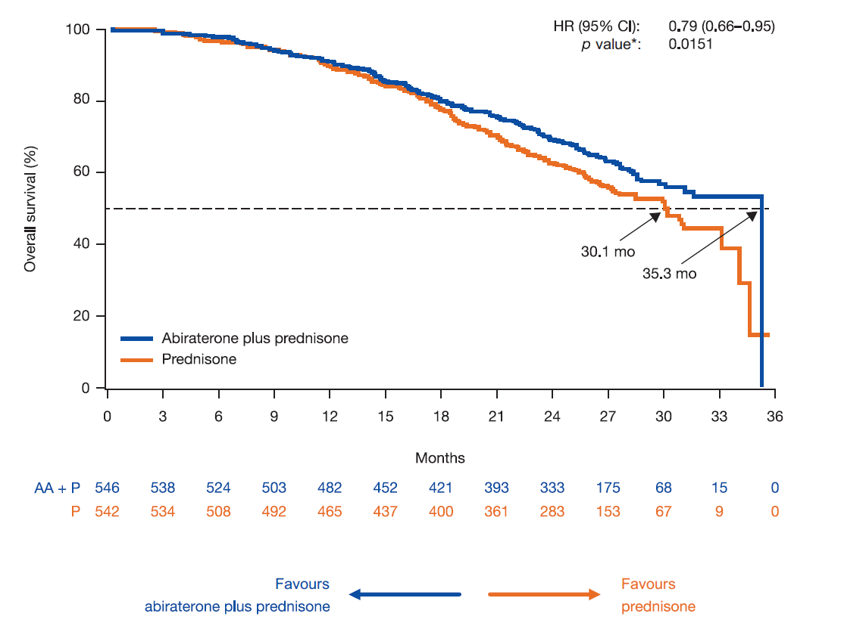
IA3 Results: OS
Rathkopf DE, et al. Eur Urol. 2014; 66: 815-825.

Slide 48
IA3 Conclusions: COU-AA-302
Confirmed clinical benefits of AA vs. P in chemotherapy-naïve patients, including significantly delayed time to disease progression (16.5 mo vs 8.2 mo)
AA therapy improved OS compared with P (median: 35.3 mo vs 30.1 mo), did not cross prespecified efficacy boundary for statistical significance
Secondary end points (time to opiate use for cancer-related pain, time to cytotoxic chemotherapy, time to ECOG-PS deterioration by at least 1 grade, time to PSA progression): Consistent with results of previous analyses & demonstrated statistically significant differences in favour of treatment with AA compared with P
Rathkopf DE, et al. Eur Urol. 2014; 66: 815-825.

Slide 49
Conclusions from the IA: COU-AA-302
Abiraterone treatment delayed pain progression & deterioration of functional status compared with prednisone, consistent with previous IA2 report
No new safety signals were observed with 24mo of treatment with abiraterone or with prednisone
In patients with asymptomatic and mildly symptomatic mCRPC without prior chemotherapy, treatment with abiraterone plus prednisone significantly delayed disease progression, time to opiate use & initiation of chemotherapy, and it was associated with increase in OS
Rathkopf DE, et al. Eur Urol. 2014; 66: 815-825.

Slide 50
Completed clinical trials of immunotherapy for patients with metastatic castration-resistant prostate cancer
Suarez C, et al. BJU Int. 2014; 113: 367–375.

Slide 51
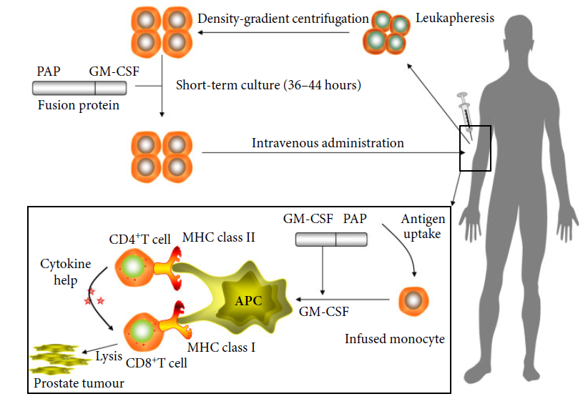
Sipuleucel-T is manufactured by culturing a patient's peripheral blood mononuclear cells, including autologous APCs, with a recombinant
protein comprising a tumour-associated antigen (PAP) & GM-CSF
Suarez C, et al. BJU Int. 2014; 113: 367–375.

Slide 52
Ongoing clinical trials of immunotherapy for patients with metastatic castration-resistant prostate cancer
Suarez C, et al. BJU Int. 2014; 113: 367–375.

Slide 53
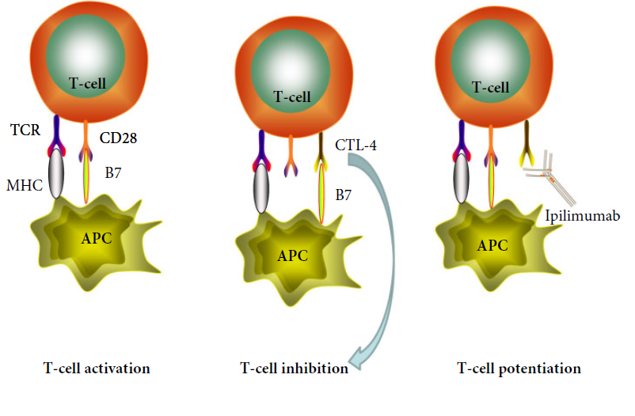
Ipilimumab mechanism of action. TCR, T-cell receptor; MHC, major
histocompatibility complex
Suarez C, et al. BJU Int. 2014; 113: 367–375.

Slide 54
Ongoing clinical trials of immunotherapy for patients with metastatic castration-resistant prostate cancer
Suarez C, et al. BJU Int. 2014; 113: 367–375.

Slide 55
Ongoing clinical trials of immunotherapy for patients with metastatic castration-resistant prostate cancer
Suarez C, et al. BJU Int. 2014; 113: 367–375.

Slide 57
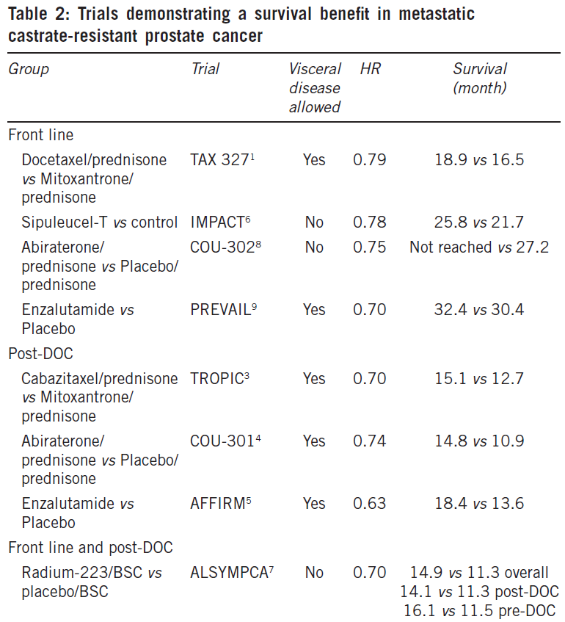
Sartor O, et al. Asian Journal of Andrology. 2014; 16: 426–431.

Slide 58
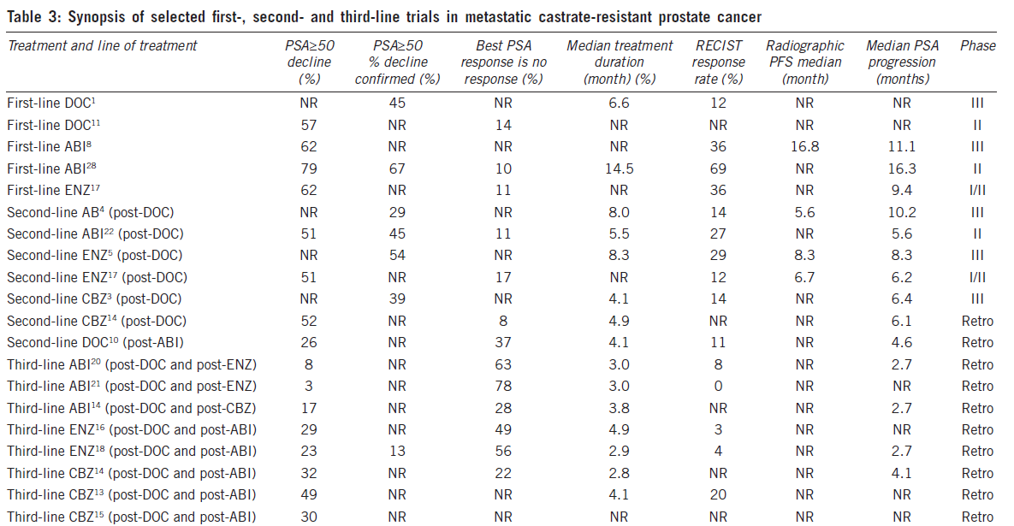

Slide 59
Dependency of prostate cancer cell growth on single defined signaling pathway mediated by the AR strongly suggests that this disease may benefit greatly from a targeted therapeutic approach
Attar RM, et al. Clin Cancer Res 2009;15(10): 3251-5.

Slide 60
As with any other cancer type, development of resistant phenotype is evolutionary response of cancer cell to selective pressure applied
Hopefully in near future, it will be possible to rapidly determine mechanism of resistance predominant in tumor as it progresses during treatment & apply that knowledge for selection of appropriate targeted therapy or therapies, with goal of turning prostate cancer into chronic disease
Attar RM, et al. Clin Cancer Res 2009;15(10): 3251-5.

Slide 61
THANK YOU!!!

