Slide 1
BPH: Patient Awareness
October 2015

Slide 2
What is the prostate gland?

Slide 3
Prostate Gland
A small organ usually the shape and size of a walnut
Lies below urinary bladder (where urine is stored) and surrounds the urethra (the tube which passes urine and semen through to outside of body)
Main job: To make some of the fluid that carries sperm, called semen (ejaculatory fluid)
Bladder
Urethra
Prostate gland
Penis

Slide 4
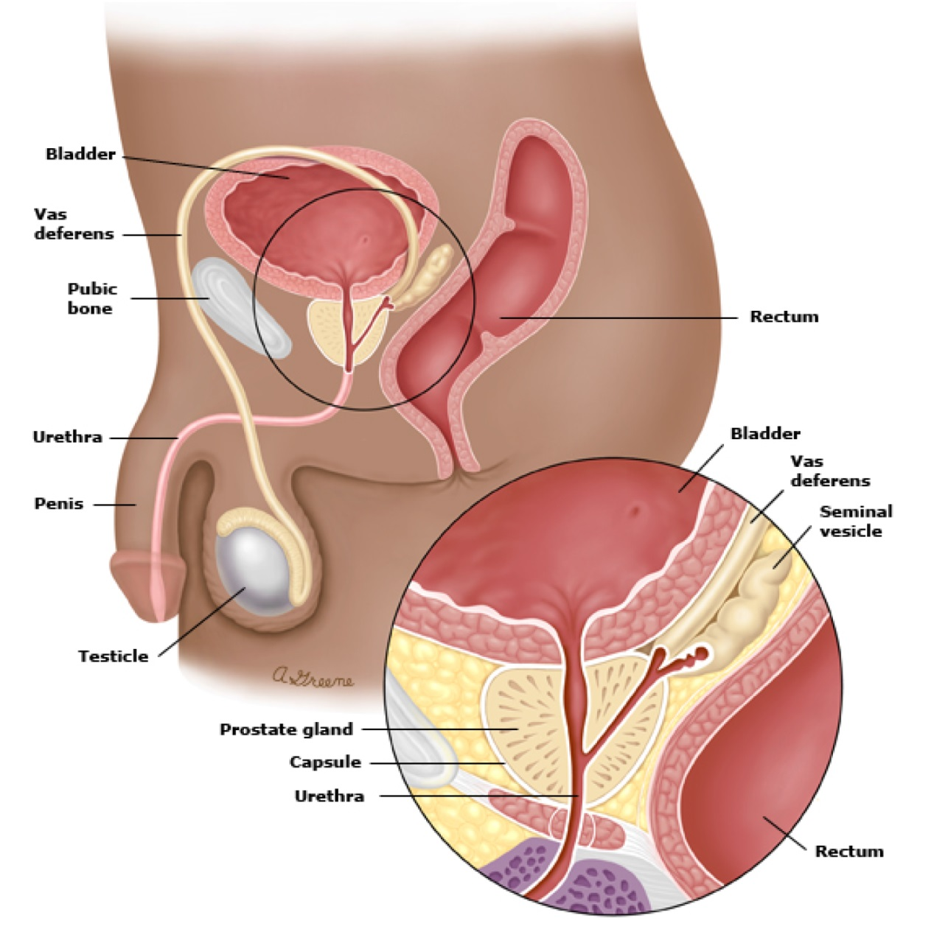

Slide 5
What is Benign Prostatic Hyperplasia (BPH)?

Slide 6
What is benign prostatic hyperplasia (BPH)?
Benign prostatic hyperplasia (BPH): Means a non-cancerous enlargement of the prostate gland
Benign: Non-cancerous
Prostatic: To do with the prostate gland
Hyperplasia: Means an increase in the number of prostatic cells
An increase in prostatic cells causes the prostate to grow

Slide 7
How common is BPH?
Common: Men after the age of about 50

Slide 8
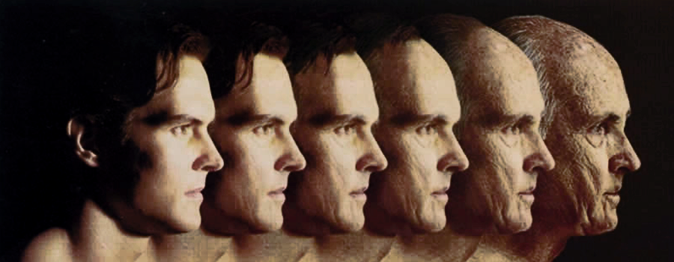
Prevalence of prostatic hyperplasia
Increases from 8% in men aged 31 to 40 to 40-50% in men aged 51 to 60 to over 80% in men older than age 80
UpToDate 2015.

Slide 9
A normal prostate gland
A enlarged prostate gland
Bladder
Narrowed Urethra
Urethra
Increase in number of cells
Prostate tissue

Slide 10
What happens in BPH?
Normal prostate
Enlarged prostate
Narrows urethral passage
Obstructs flow of urine from bladder through urethra to outside of the body
10
Notes:
10

Slide 11
Who is more likely to develop BPH?
Men with the following factors are more likely to develop benign prostatic hyperplasia:
Men after age 50 years
Family history of benign prostatic hyperplasia
Medical conditions such as obesity, heart and circulatory disease, and type 2 diabetes
Lack of physical exercise
Erectile dysfunction (a consistent inability to sustain an erection sufficient for sexual intercourse)
http://www.niddk.nih.gov/health-information/health-topics/urologic-disease/benign-prostatic-hyperplasia-bph/Pages/facts.aspx/ http://www.medicinenet.com/benign_prostatic_hyperplasia/page2.htm/ Uptodate 2015.

Slide 12
An enlarged prostate is the most common cause of urinary symptoms in men as they get older (because an enlarged prostate can cause narrowing of the urethra)

Slide 13
Major Symptoms of BPH & Enlarged prostate
http://www.niddk.nih.gov/health-information/health-topics/urologic-disease/benign-prostatic-hyperplasia-bph/Pages/facts.aspx/ UpToDate 2015.

Slide 14
Major Symptoms of BPH & Enlarged prostate
http://www.niddk.nih.gov/health-information/health-topics/urologic-disease/benign-prostatic-hyperplasia-bph/Pages/facts.aspx/ UpToDate 2015.

Slide 15
Major Symptoms of BPH & Enlarged prostate
http://www.niddk.nih.gov/health-information/health-topics/urologic-disease/benign-prostatic-hyperplasia-bph/Pages/facts.aspx/ UpToDate 2015.

Slide 16
Major Symptoms of BPH & Enlarged prostate
http://www.niddk.nih.gov/health-information/health-topics/urologic-disease/benign-prostatic-hyperplasia-bph/Pages/facts.aspx/ UpToDate 2015.

Slide 17
Symptoms of BPH & enlarged prostate?
You may have only a few of these symptoms, or you may not have any symptoms at all
Without treatment, some men find that the symptoms of an enlarged prostate slowly get worse
These symptoms can be caused by other medical problems, lifestyle factors or certain medicines and may be nothing to do with the prostate
http://www.niddk.nih.gov/health-information/health-topics/urologic-disease/benign-prostatic-hyperplasia-bph/Pages/facts.aspx/ UpToDate 2015.

Slide 18
If you have any of the symptoms mentioned, you should consult your doctor to find out what is causing them

Slide 19
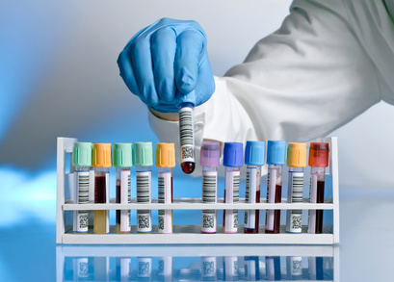
How will I know that I have BPH?

Slide 20
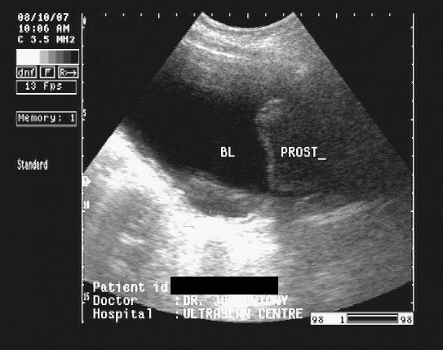
Diagnosis of BPH
To know if BPH or another problem is causing your symptoms, a doctor will ask you questions (take a medical history), perform an exam, and do blood, urine tests, ultrasound scans or other tests
UpToDate 2015.

Slide 21
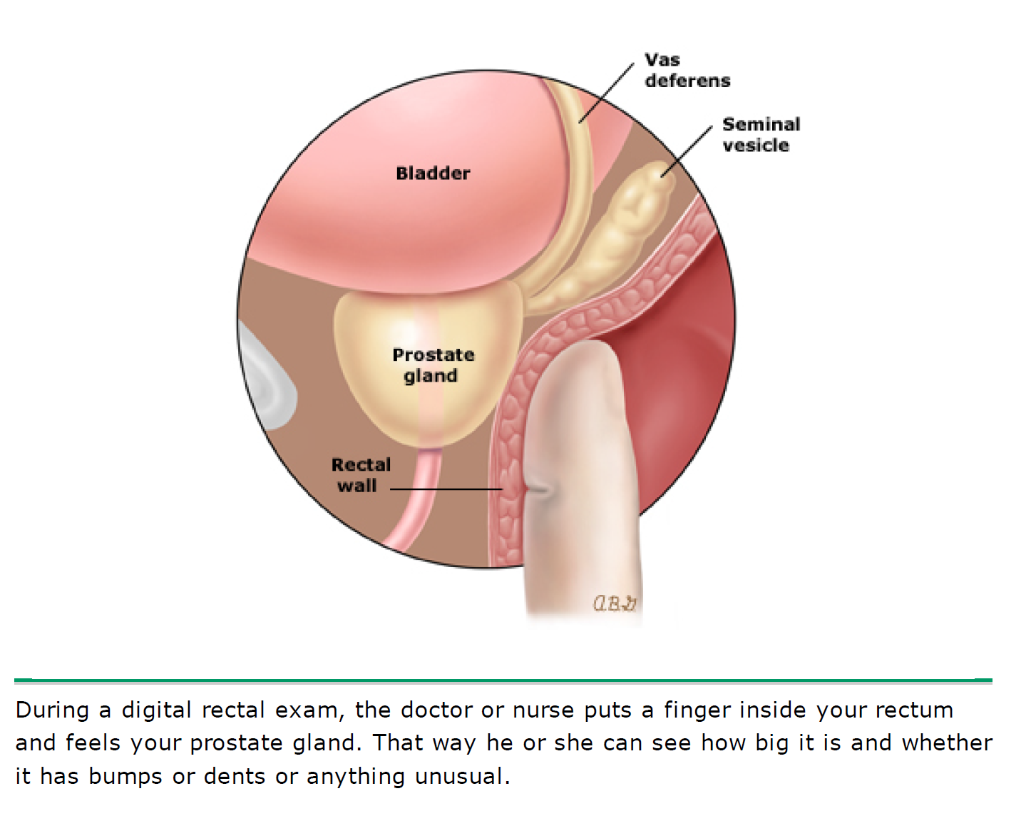
UpToDate 2015.

Slide 22
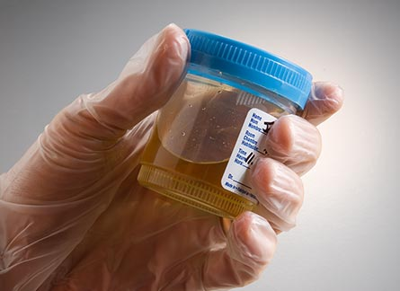
Urine examination
Urinalysis: You might be asked for a urine sample to see if you have a bladder infection
UpToDate 2015.

Slide 23
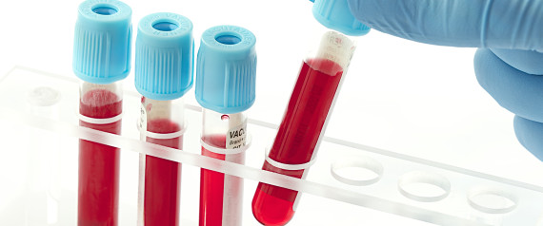
Blood tests
Blood tests: A blood test to check the prostate specific antigen (PSA) level is recommended
PSA: A protein produced by prostate cells; the PSA level may be increased in men with BPH
Men who have prostate cancer often have a highly disproportionately elevated PSA level, although prostate cancer is also found in men who do not have an elevated PSA
UpToDate 2015.

Slide 24
Urodynamic study
A bladder test, known as a urodynamic study, might be recommended for some men who have signs or symptoms of BPH
This test can give information about how well the bladder and urethra are working
UpToDate 2015.

Slide 25
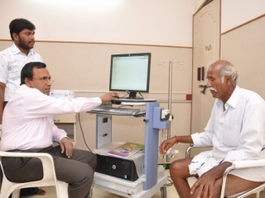

Slide 26
How will my BPH be treated?

Slide 27
Treatments for BPH can help to reduce urinary symptoms
Treatment options include medicines and surgery
UpToDate 2015.

Slide 28
Men with mild BPH might not need treatment
In this case, most doctors recommend a "wait and watch“ approach
This means that you will watch your symptoms over time
UpToDate 2015.

Slide 29
Men with moderate to severe symptoms usually require treatment
UpToDate 2015.

Slide 30
Medicines
Alpha blockers
Alpha-reductase inhibitors
Phosphodiesterase 5 Inhibitors
Most men with BPH who start taking a medicine will need to take it forever unless they have some type of prostate surgery
UpToDate 2015.

Slide 31
Alpha blockers
Alpha blockers: These medications relax the muscle of the prostate and bladder neck, which allows urine to flow more easily
Alpha blockers begin to work quickly and are usually recommended as a first-line treatment for men with mild to moderate symptoms
Examples: Terazosin, doxazosin, tamsulosin, alfuzosin, and silodosin
UpToDate 2015.

Slide 32
Alpha reductase inhibitors
Alpha reductase inhibitors: Medicines that can stop the prostate from growing further or even cause it to shrink
This type of medicine works better in men with a larger prostate
It can reduce the risk of urinary retention (not being able to empty the bladder) and the need for surgery
Most men see an improvement within six months of starting treatment
UpToDate 2015.

Slide 33
Phosphodiesterase 5 inhibitor
Example: Tadalafil 5 mg
Tadalafil will make BPH symptoms less severe and reduce the chance that prostate surgery will be needed

Slide 34
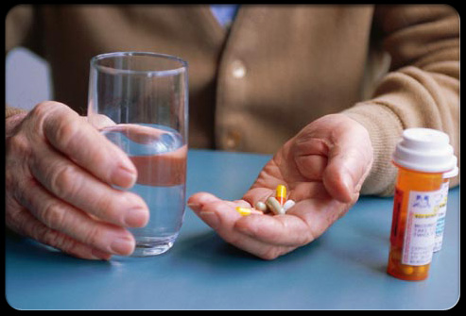
Combination treatment
With severe symptoms
With a large prostate
Sometimes, taking more than one medication is beneficial
UpToDate 2015.

Slide 35
Combination treatment
Combining a drug that slows prostate growth with one that relaxes bladder muscles may work better than the drugs given alone
Other medications that may be added include drugs to treat an overactive bladder

Slide 36
Lifestyle changes
All men with BPH should avoid medicines that can worsen symptoms or cause urinary retention
These include certain antihistamines (such as diphenhydramine and decongestants (eg, pseudoephedrine)
UpToDate 2015.

Slide 37
Lifestyle changes
Lifestyle changes are also recommended if you are bothered by having to go to the bathroom frequently
This includes:
Making a habit of going to the bathroom when you have the urge
Double void:
This means that after you empty your bladder, you wait a moment and try to go again
Do not strain or push to empty
UpToDate 2015.

Slide 38
Lifestyle changes
Stop drinking fluids a few hours before bedtime or going out
UpToDate 2015.

Slide 39
Lifestyle changes
Avoid or drink less fluids that can make you go more often, like caffeine and alcohol
UpToDate 2015.

Slide 40
Lifestyle changes
Try to do some form of exercise, for 30 minutes a day
Nursing times. 2012.

Slide 41
Surgery
Transurethral procedures: If medicines do not relieve your symptoms of BPH, a treatment to remove or destroy some of the prostate tissue around the urethra may be recommended

Slide 42
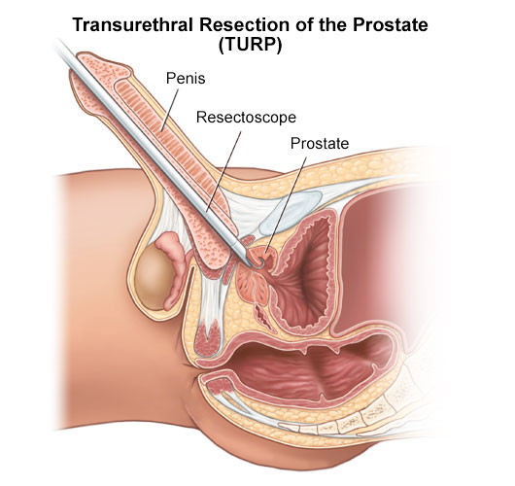
After the patient is given anaesthesia, the doctor inserts a special instrument into the urethra through the penis
With the instrument, the doctor then remove or destroy some of the prostate tissue around the urethra to relieve the outflow of urine from the bladder

Slide 43
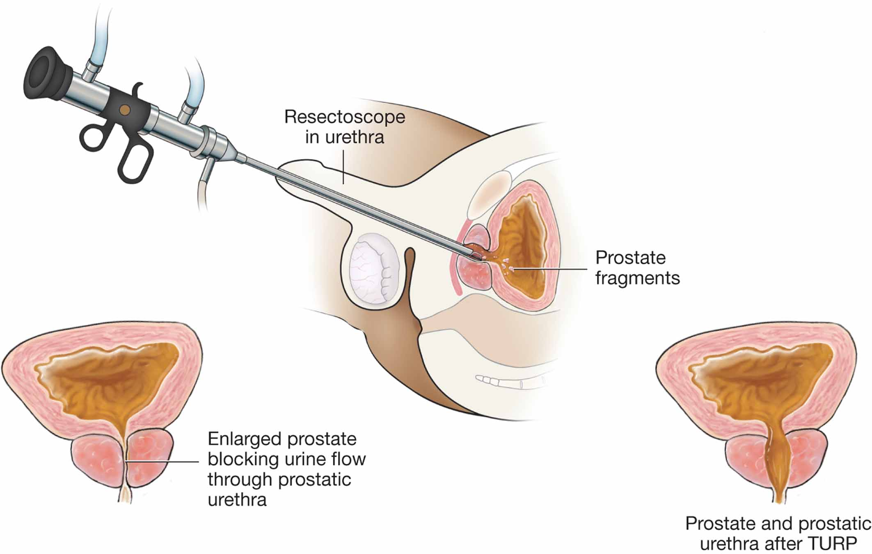

Slide 44
Laser procedures
A number of laser procedures are available, some of which can be performed in the doctor's office with minimal anaesthesia
These procedures also involve removal of obstructing prostate tissue with the help of laser technology
They are generally associated with less bleeding and quicker recovery than TURP

Slide 45
THANK YOU!

