Slide 1
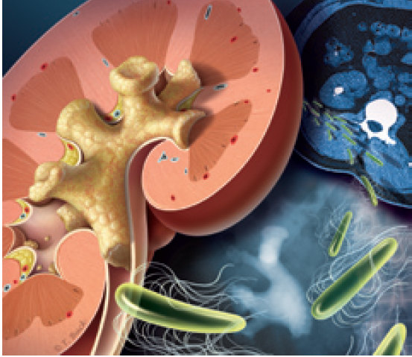
Endourological procedures in stone disease
December 2015

Slide 2
Urolithiasis: iNTRODUCTION
Urolithiasis: A problem that has confronted clinicians since the time of Hippocrates & many family physicians have extensive experience in its clinical management
In recent years, technological advancements have greatly facilitated diagnosis of stone disease
Management of urolithiasis is also becoming increasingly well defined
Portis AJ, et al. Am Fam Physician 2001;63:1329-38.

Slide 3
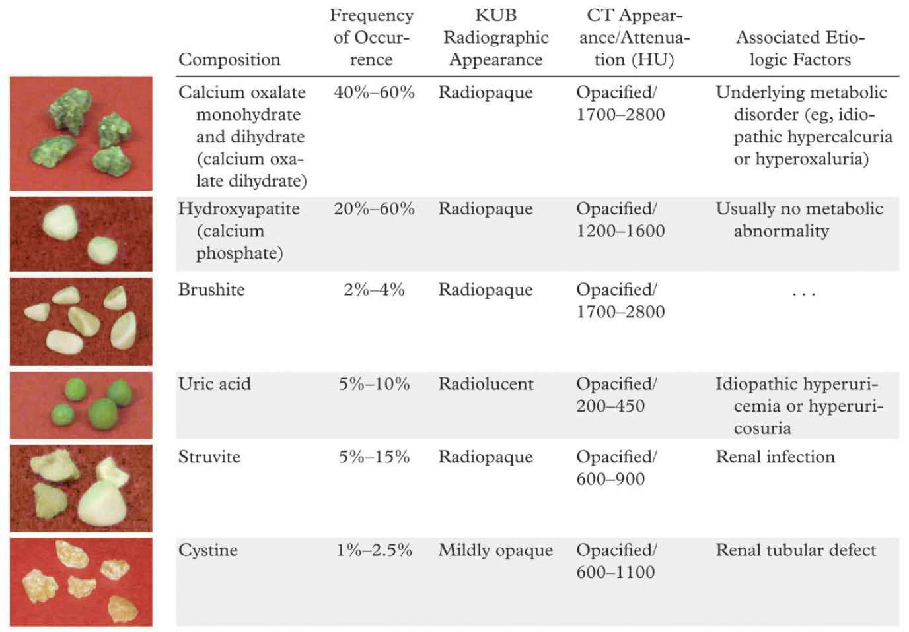
commonly occurring urinary tract stones and their salient features
Kambadakone AR, et al. RadioGraphics 2010; 30:603–623.

Slide 4
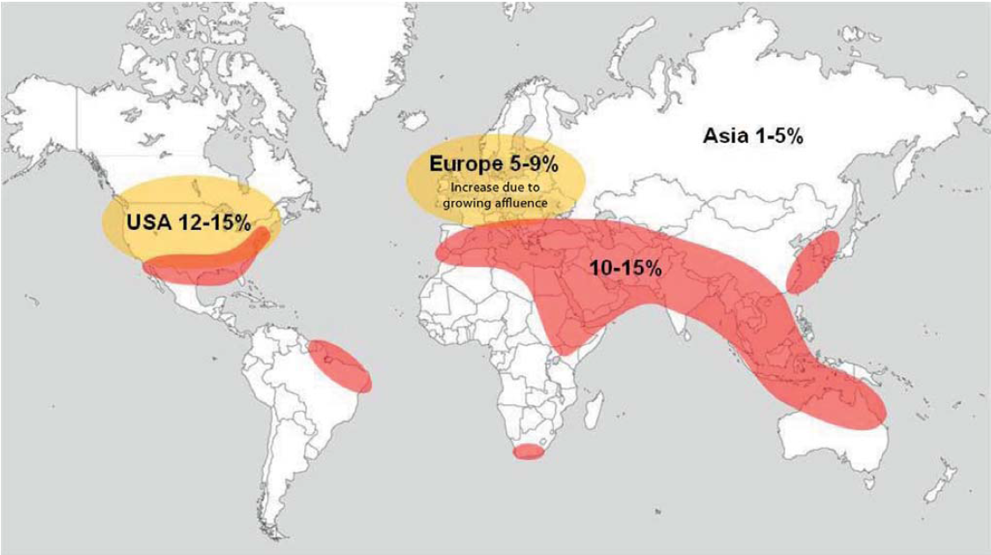
Urolithiasis: Epidemiology
So-called stone belt (red) extends all the way around world & characterized by urinary stone prevalence of 10-15%
Fisang C, et al. Dtsch Arztebl Int 2015; 112: 83–91.

Slide 5
Urolithiasis: Epidemiology
≈ 50% patients with previous urinary calculi: recurrence within 10 yrs
2-3 times more common in males than in females
Occurs more often in adults than in elderly persons & more often in elderly persons than in children
Whites are affected more often than persons of Asian ethnicity, who are affected more often than blacks
Portis AJ, et al. Am Fam Physician 2001;63:1329-38.

Slide 6
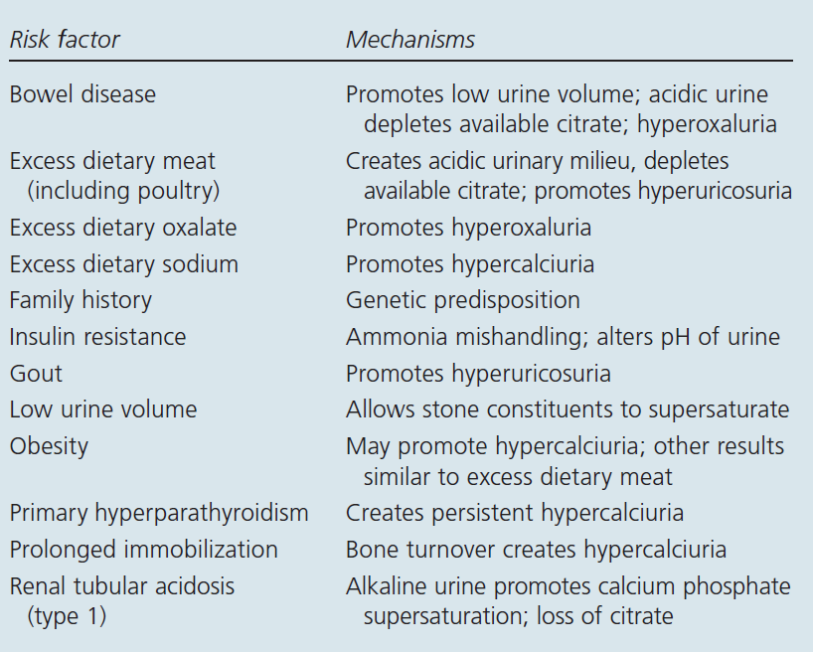
Development of Urinary Calculi: RISK FACTORS
Pietrow PK, et al. Am Fam Physician. 2006;74:86-94, 99-100.

Slide 7
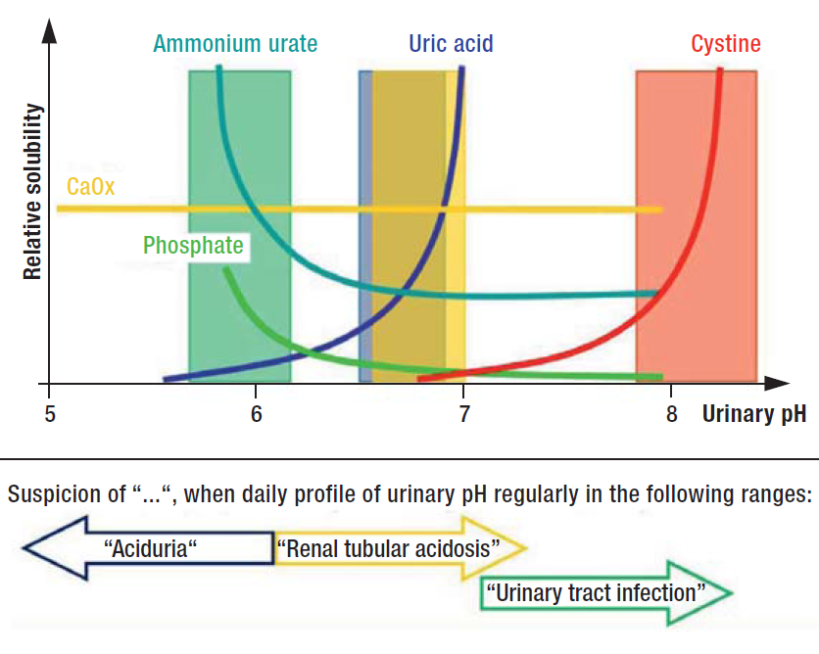
Dependence of lithogenesis on urinary pH
Fisang C, et al. Dtsch Arztebl Int 2015; 112: 83–91.

Slide 8
Relationship of Stone Location to Symptoms
Stone Location | Common Symptoms
Kidney | Vague flank pain, hematuria
Proximal ureter | Renal colic, flank pain, upper abdominal pain
Middle section of ureter | Renal colic, anterior abdominal pain, flank pain
Distal ureter | Renal colic, dysuria, urinary frequency, anterior abdominal pain, flank pain
Portis AJ, et al. Am Fam Physician 2001;63:1329-38.

Slide 9
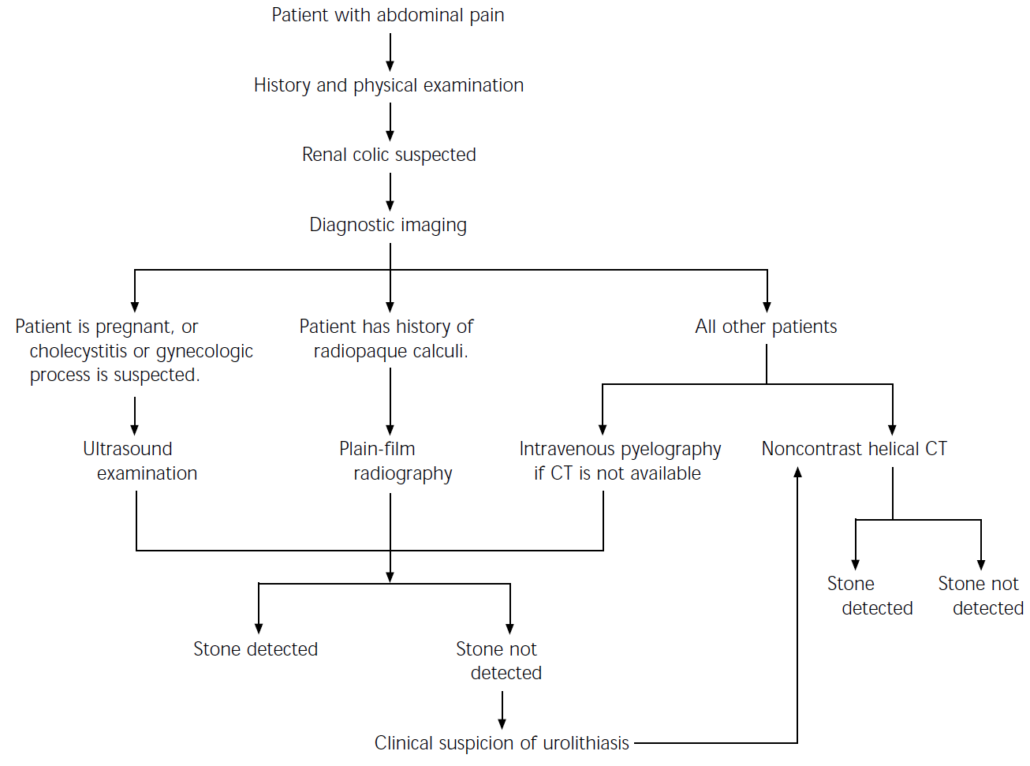
Diagnostic approach: Suspected renal colic

Slide 10
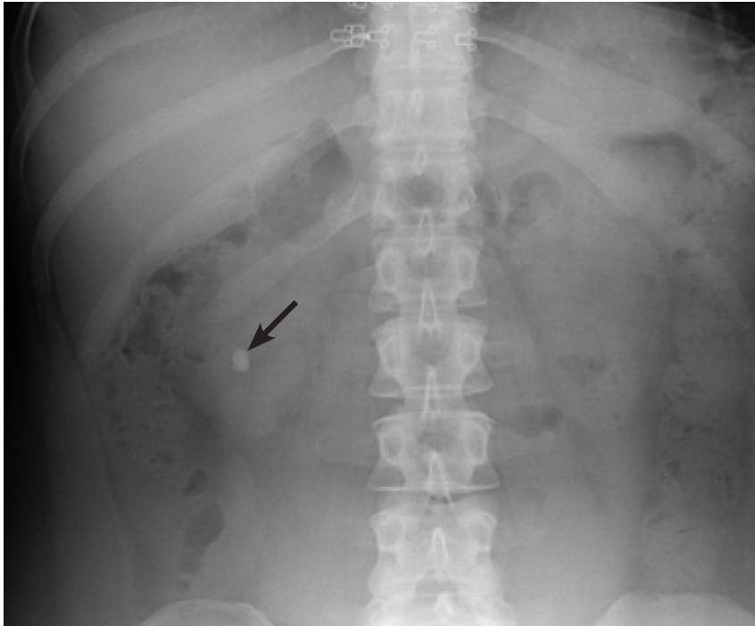
Plain film radiograph: calcium oxalate stone (arrow) in lower pole of rt kidney
Pietrow PK, et al. Am Fam Physician. 2006;74:86-94, 99-100.

Slide 11
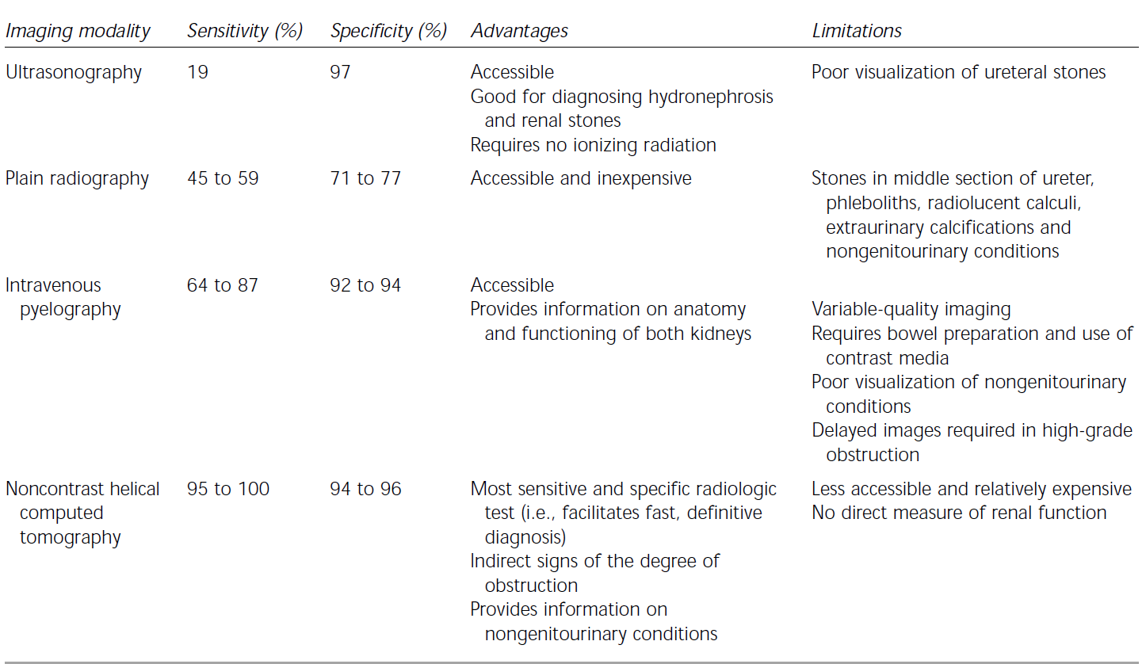
Imaging Modalities: Diagnosis of Ureteral Calculi

Slide 12
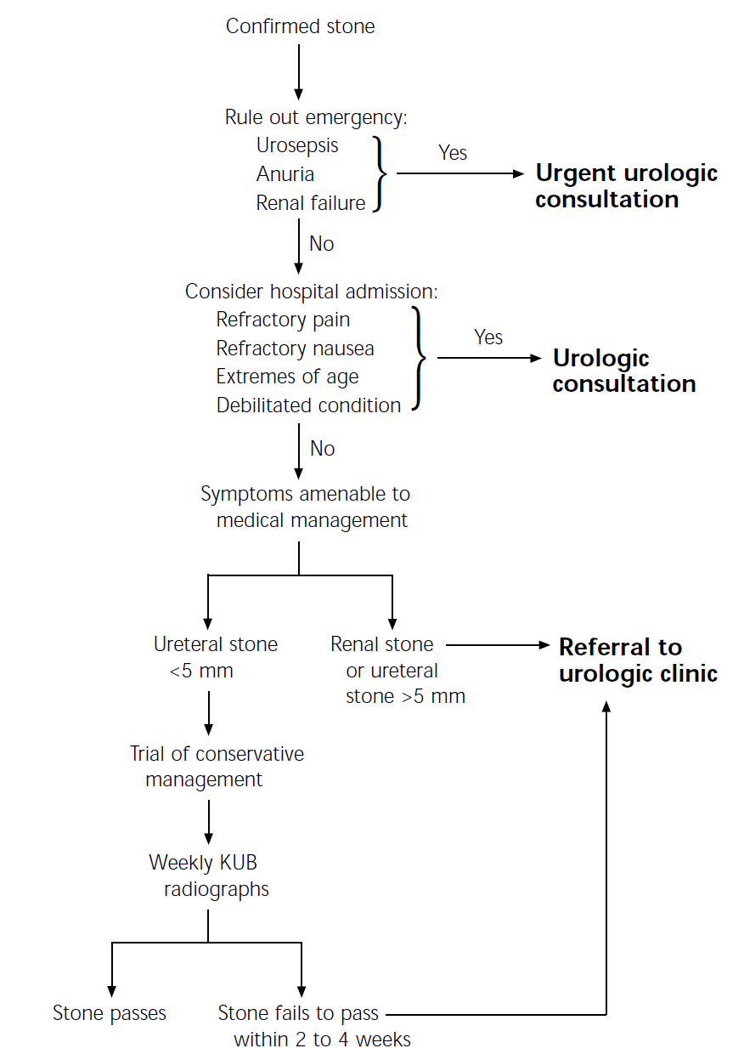
Initial management of radiologically confirmed urolithiasis
(KUB = kidney, ureters and bladder)

Slide 13
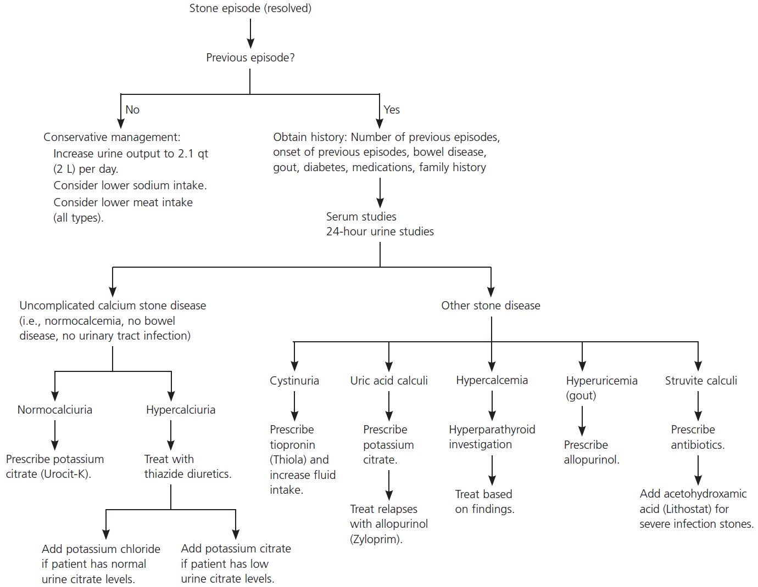
Medical Management of Nephrolithiasis
Pietrow PK, et al. Am Fam Physician. 2006;74:86-94, 99-100.

Slide 14
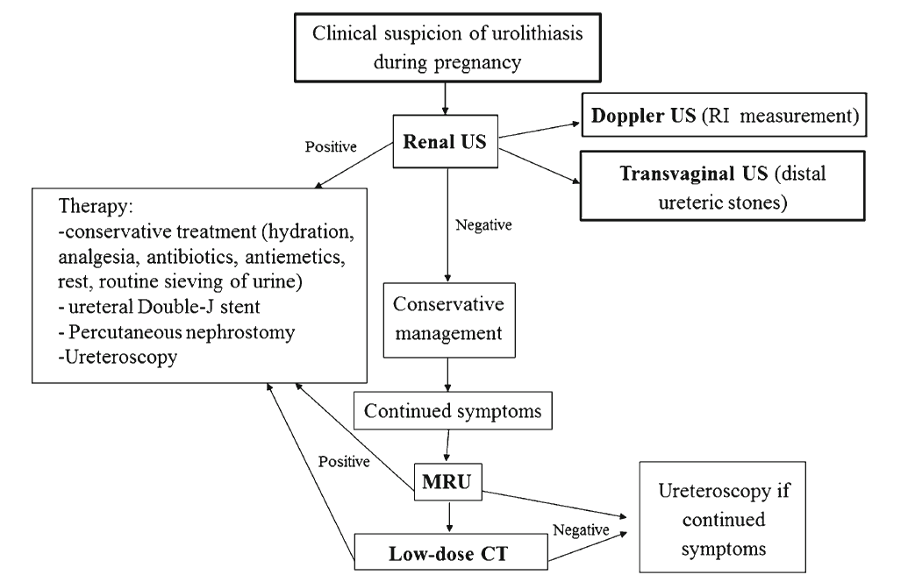
Algorithm: management of urolithiasis during pregnancy
Masselli G, et al. Insights Imaging. 2014; 5: 691–696.

Slide 15
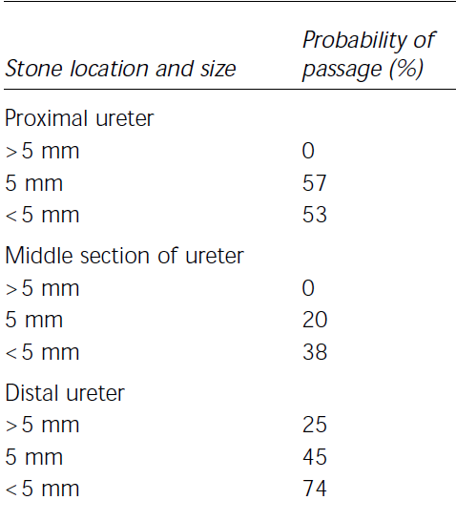
Probability of Stone Passage*
Portis AJ, et al. Am Fam Physician 2001;63:1329-38.

Slide 16
COMPLICATIONS OF UROLITHIASIS
Renal failure
Ureteral stricture
Infection, sepsis
Urine extravasation
Perinephric abscess
Xanthogranulomatous pyelonephritis
Portis AJ, et al. Am Fam Physician 2001;63:1329-38.

Slide 17
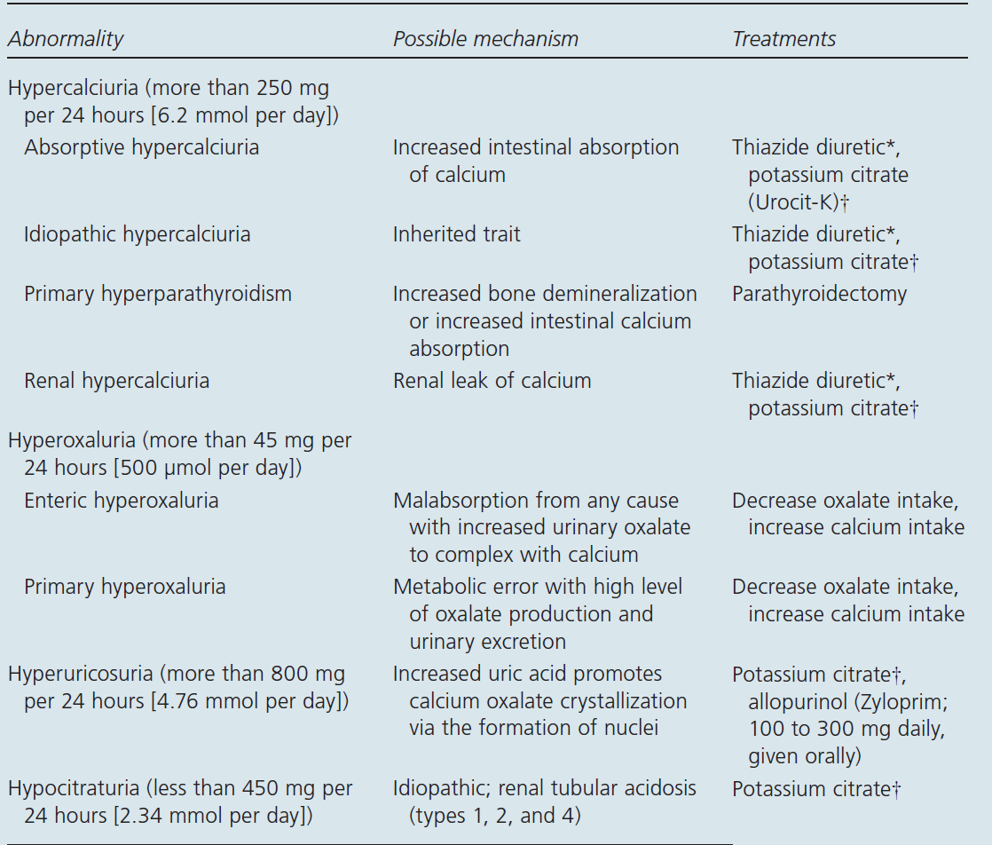
Pietrow PK, et al. Am Fam Physician. 2006;74:86-94, 99-100.

Slide 18
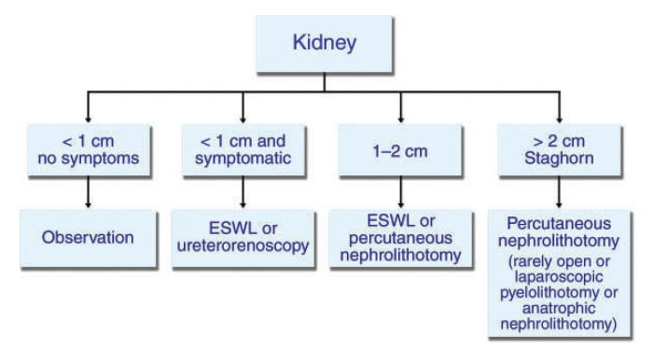
TREATMENT DECISION BASED ON STONE LOCATION: KIDNEY
Kambadakone AR, et al. RadioGraphics 2010; 30:603–623.

Slide 19
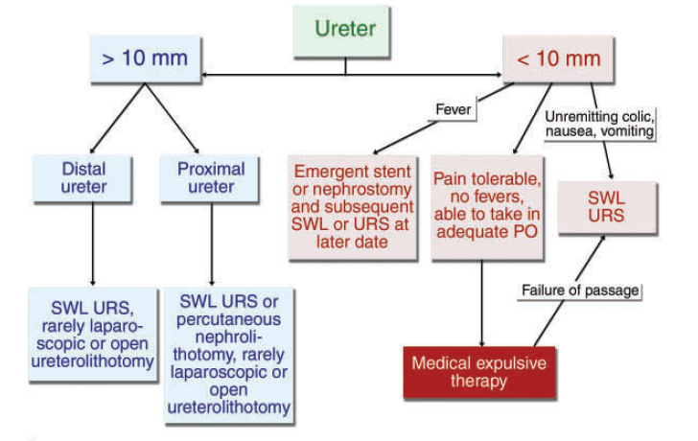
TREATMENT DECISION BASED ON STONE LOCATION: URETER
Kambadakone AR, et al. RadioGraphics 2010; 30:603–623.

Slide 20
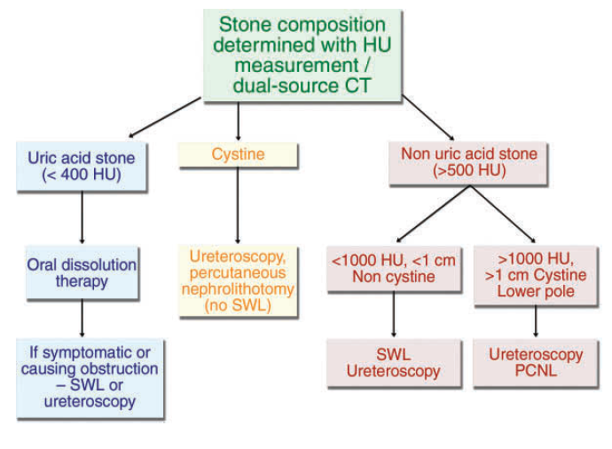
TREATMENT DECISION BASED ON STONE COMPOSITION
Kambadakone AR, et al. RadioGraphics 2010; 30:603–623.

Slide 21
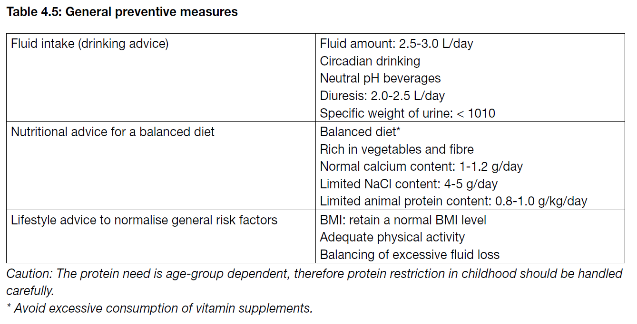

Slide 22
PROPHYLACTIC MEDICATIONS: Potassium citrate
Potassium citrate has several features
It maintains urine pH above pK_{a} for uric acid thus promoting dissolution of uric acid crystals. This ↓ uric acid & calcium stone formation by ↓ formation of a nidus
Citrate also directly prevents complexation of calcium
In patients with either hypocitraturia or acidic urine pH, treatment with this medication ↑ urinary citrate levels, pH and potassium. This is associated with remission rate of stone disease of up to 91%
Spernat D, et al. BJU International. 2011; 108: 9-13.

Slide 23
DISSOLUTION THERAPY
Oral Medications:
Sodium bicarbonate
Potassium citrate
Percutaneous Instillation:
Calcium oxalate stones are resistant to dissolution therapy. However, struvite calculi have been associated with (limited) successful dissolution therapies since 1943 (Suby’s solution G). The following two solutions are still used in limited cases:
Hemiacidrin/renacidrin
Tham E
Spernat D, et al. BJU International. 2011; 108: 9-13.

Slide 24
MEDICAL EXPULSION THERAPY
Medical expulsion therapy (MET): Beneficial for distal ureteric calculi
No evidence that MET improves spontaneous stone passage rate of proximal ureteric calculi
However, tamsulosin has been shown to significantly ↑ passage of stones between 5 & 10 mm from proximal to distal ureter
Spernat D, et al. BJU International. 2011; 108: 9-13.

Slide 25
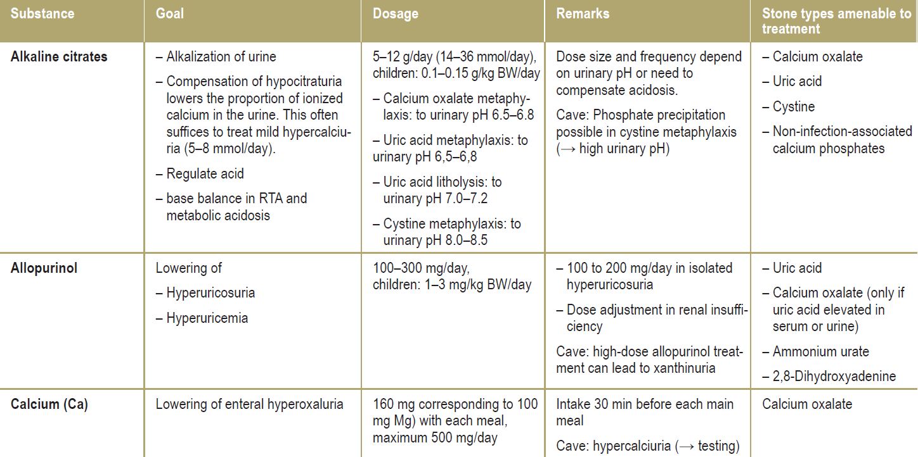
Principal substances used in medicinal prophylaxis of urinary stones
Fisang C, et al. Dtsch Arztebl Int 2015; 112: 83–91.

Slide 26
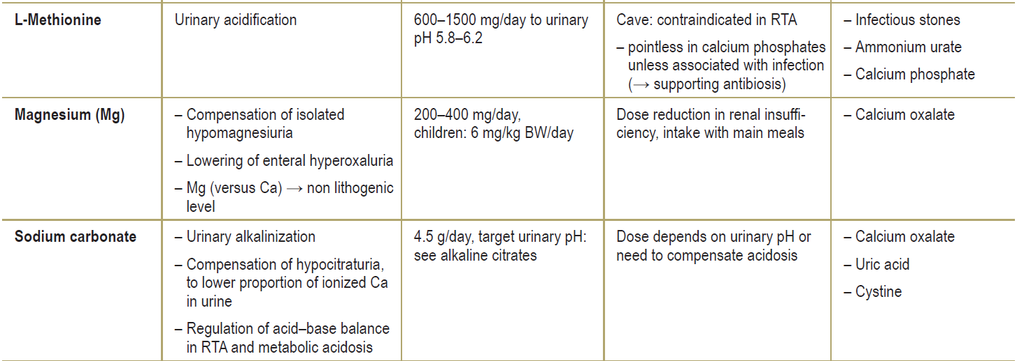
Principal substances used in medicinal prophylaxis of urinary stones
Fisang C, et al. Dtsch Arztebl Int 2015; 112: 83–91.

Slide 27
Principal substances used in medicinal prophylaxis of urinary stones
Fisang C, et al. Dtsch Arztebl Int 2015; 112: 83–91.

Slide 28
Advances in Endourology
Field of Endourology has simply exploded in past 3 decades since 1979, when Smith & Flang described closed manipulation of urinary tract as “ ENDO-UROLOGY”
Interesting that > 100 years have passed from work of Nitze in 1877, when endoscopic light sources were coupled with instrumentation that allowed visualization of lower urinary tract to break through techniques
Varshney A. JIMSA July-September 2011 Vol. 24 No. 3.

Slide 29
Advances in Endourology
One of more interesting concepts of endourology
This developing speciality has been eclectic & all inclusive and therefore encompasses not only visualization of bladder, ureter and kidney, but also modern management of prostate disease as well as evolving field of Laparoscopy and Robotic Urology
Varshney A. JIMSA July-September 2011 Vol. 24 No. 3.

Slide 31
Extracorporeal shock wave lithotripsy (SWL)
Success depends on efficacy of lithotripter & following factors:
Size, location (ureteral, pelvic or calyceal) & composition (hardness) of stones
Patient’s habitus
Performance of SWL
Each of these factors has important influence on retreatment rate & final outcome of SWL
EAU Guidelines 2015.

Slide 32
Extracorporeal shock wave lithotripsy (SWL)
Contraindications of extracorporeal shock wave lithotripsy:
Pregnancy, due to potential effects on foetus
Bleeding diatheses, which should be compensated for at least 24 h before & 48 h after treatment
Uncontrolled UTIs
Severe skeletal malformations & severe obesity, which prevent targeting of stone
Arterial aneurysm in vicinity of stone
Anatomical obstruction distal to stone
EAU Guidelines 2015.

Slide 34
PCNL
PNL remains standard procedure for large renal calculi
Different rigid & flexible endoscopes are available and selection is mainly based on surgeon’s own preference
Standard access tracts are 24-30 F
Smaller access sheaths, < 18 French, were initially introduced for paediatric use, but are now increasingly popular in adults
EAU Guidelines 2015.

Slide 35
PCNL
Efficacy of miniaturized systems seems to be high, but longer OR times apply & benefit compared to standard PCNL for selected patients has yet to be demonstrated
There is some evidence that smaller tracts cause less bleeding complications, but further studies need to evaluate this issue
Contraindications:
Patients receiving anticoagulant therapy must be monitored carefully pre- & postoperatively. Anticoagulant therapy must be discontinued before PCNL
Untreated UTI
Tumour in presumptive access tract area
Potential malignant kidney tumour
Pregnancy
EAU Guidelines 2015.

Slide 36
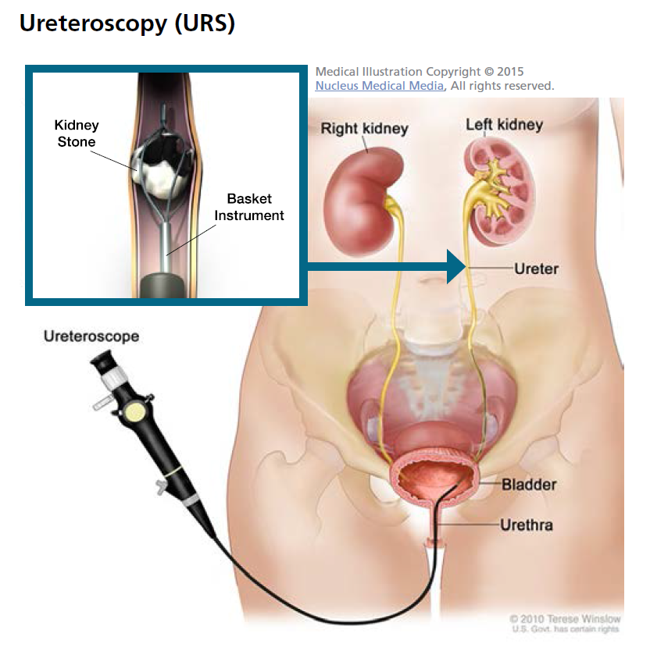

Slide 37
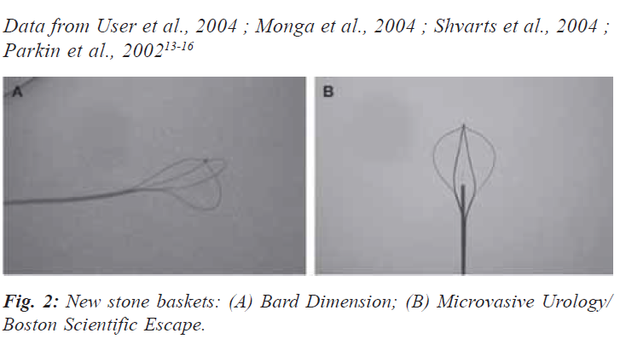
Rirs: Retrograde Intra Renal Surgery
Sharma DK, Varshney A. JIMSA July-September 2011 Vol. 24 No. 3.

Slide 38
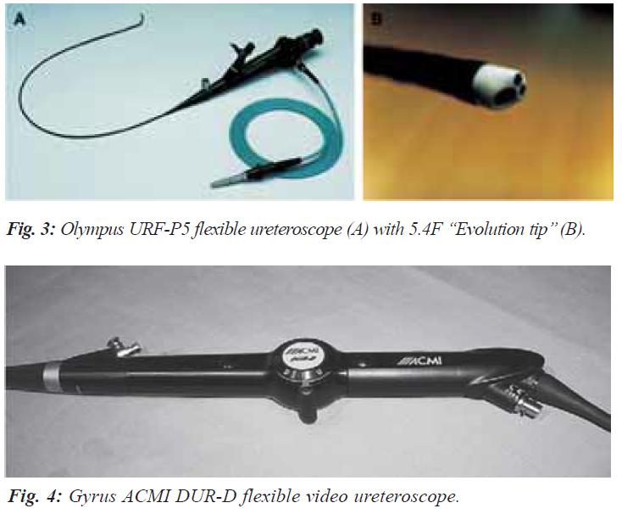
Rirs: Retrograde Intra Renal Surgery
Sharma DK, Varshney A. JIMSA July-September 2011 Vol. 24 No. 3.

Slide 39
Rirs: Retrograde Intra Renal Surgery
Indications for ureteroscopy fall into 2 categories: Diagnostic & therapeutic
Diagnostic indications:
Evaluating a patient with radiological filling defect, undiagnosed gross haematuria, or positive cytology of upper tract, or surveillance of patients with upper tract malignancies that have been treated endoscopically
Sharma DK, Varshney A. JIMSA July-September 2011 Vol. 24 No. 3.

Slide 40
Rirs: Retrograde Intra Renal Surgery
Therapeutic indications:
Removing upper tract stones or other foreign bodies, treating upper tract malignancies, treating strictures or areas of obstruction
Flexible ureteroscopy is emerging as 1st line procedure for increasingly challenging stone cases
Sharma DK, Varshney A. JIMSA July-September 2011 Vol. 24 No. 3.

Slide 41
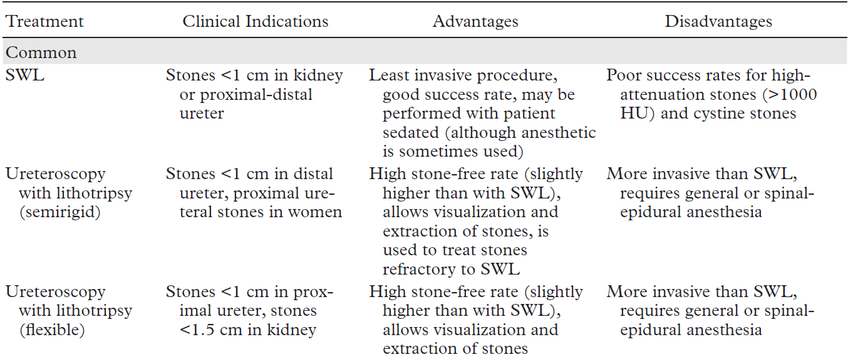
Salient Features of Various Urologic Interventional Procedures for Urolithiasis
Kambadakone AR, et al. RadioGraphics 2010; 30:603–623.

Slide 42
Salient Features of Various Urologic Interventional Procedures for Urolithiasis
Kambadakone AR, et al. RadioGraphics 2010; 30:603–623.

Slide 43
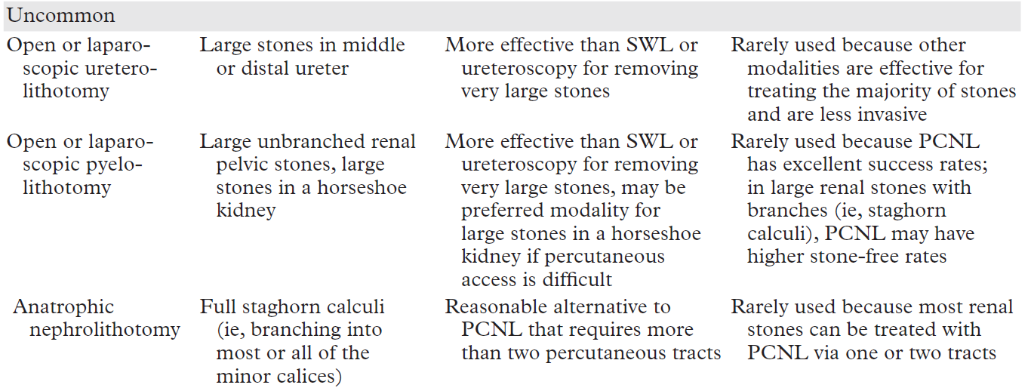
Salient Features of Various Urologic Interventional Procedures for Urolithiasis
Kambadakone AR, et al. RadioGraphics 2010; 30:603–623.

Slide 44
Ureterorenoscopy for large renal stones in modern era has good SFR with small risk of major complications

Slide 45
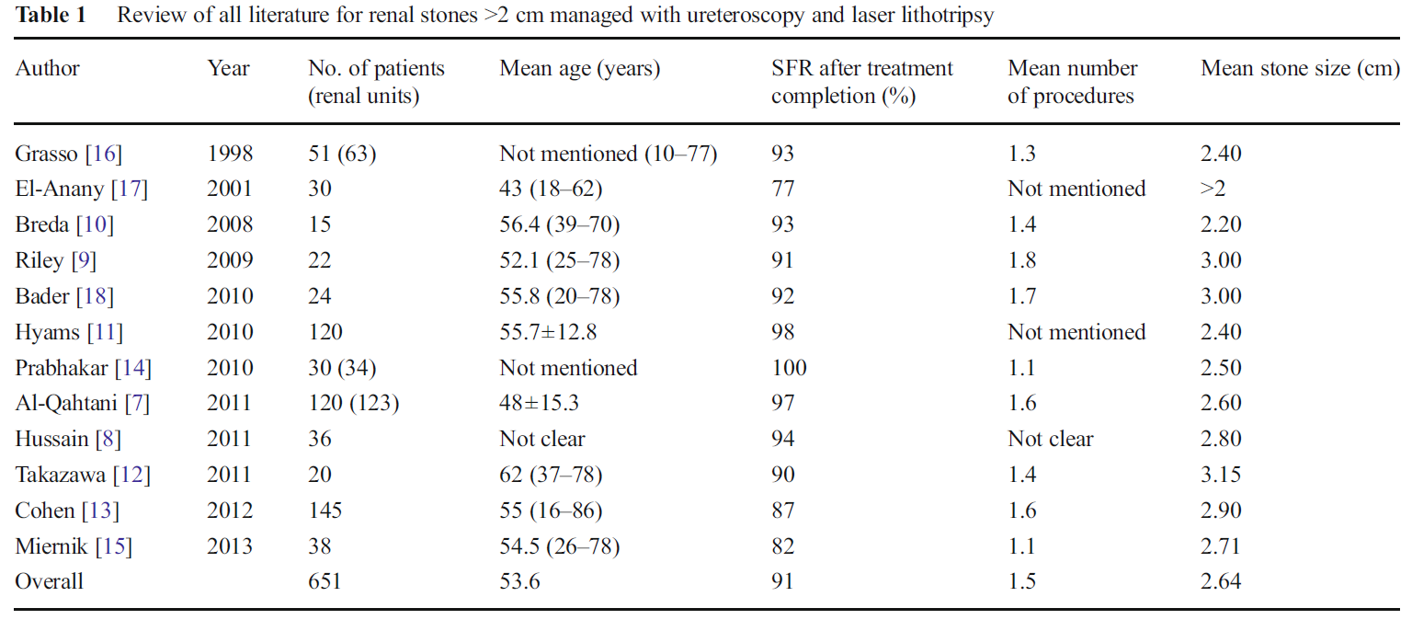
SFR: Stone-Free Rate

Slide 46
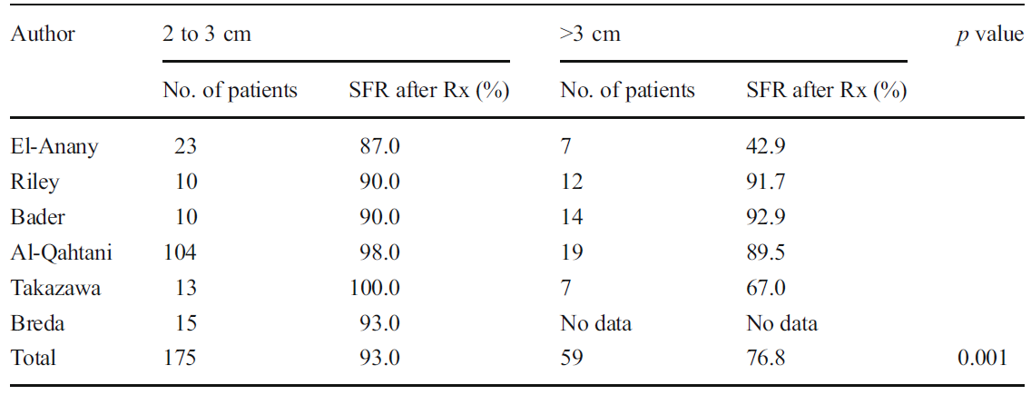
Subgroup analysis of SFR for stones 2–3 and >3 cm SFR was significantly higher in 2–3-cm group
SFR: Stone-Free Rate

Slide 47
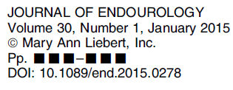
Factors believed to be important in determining likelihood of achieving stone clearance from percutaneous nephrolithotomy (PCNL) are frequently summarized as ‘‘stone complexity’’

Slide 48
Stone complexity: Refer specifically to ‘‘stone-related factors’’ & in broader sense that encompasses other factors that influence difficulty of access, for eg., spinal pathology & urinary diversion
Stone complexity may also influence complication rates following PCNL

Slide 49
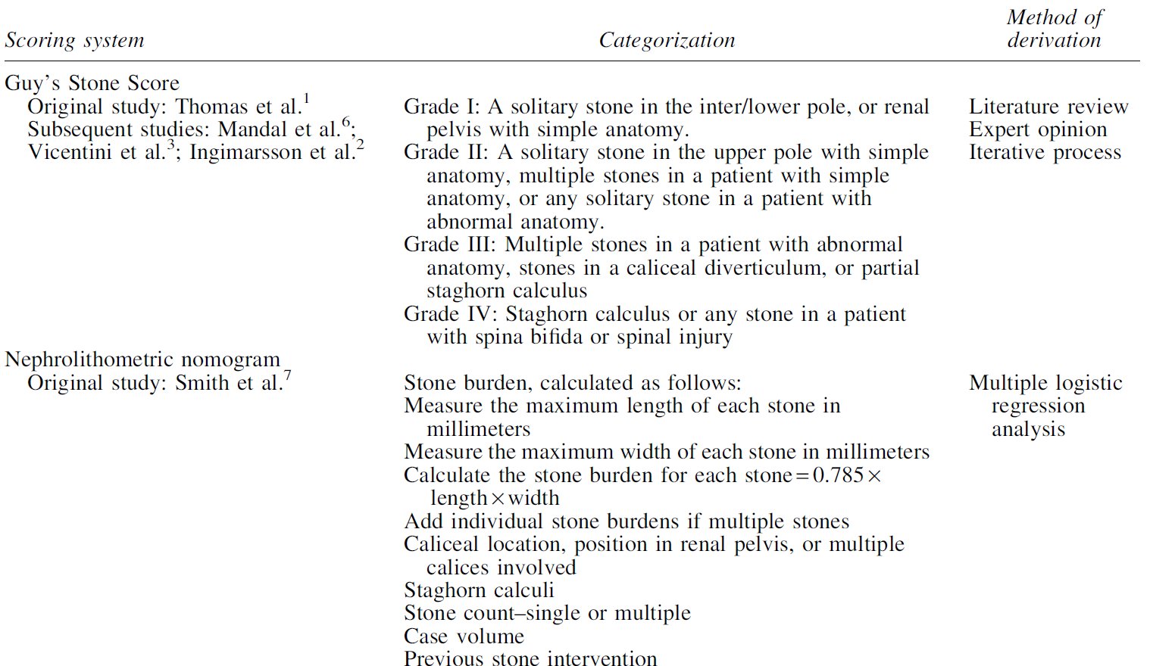
Summary of Stone Complexity Scoring Systems
Withington J, et al. J Endourology. 2015; 30(1).

Slide 50
Summary of Stone Complexity Scoring Systems
Withington J, et al. J Endourology. 2015; 30(1).

Slide 51
Conclusion
This review does not allow us to firmly recommend 1 scoring system over the other
However, quality of evidence supporting validation of Guy’s Stone Score is marginally superior, according to criteria applied in this study
Withington J, et al. J Endourology. 2015; 30(1).

Slide 52
efficacy & safety of pcnl: GA vs. regional anaesthesia
PCNL under RA offers several potential advantages over GA:
Surgical duration, hospitalization period, fluoroscopy time, blood transfusion, postoperative pain & analgesic requirements, but both anesthetic techniques appear to be equivalent with regard to SFR and complication rate
Along with suggested favourable hemodynamic profile & lower cost, RA may prove better alternative than GA
Pu C, et al. Urolithiasis (2015) 43:455–466.

Slide 53
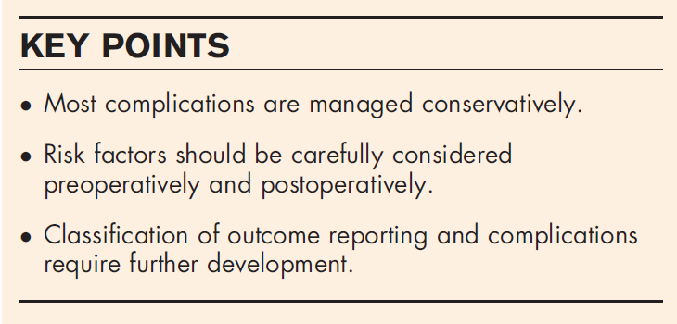

Slide 54
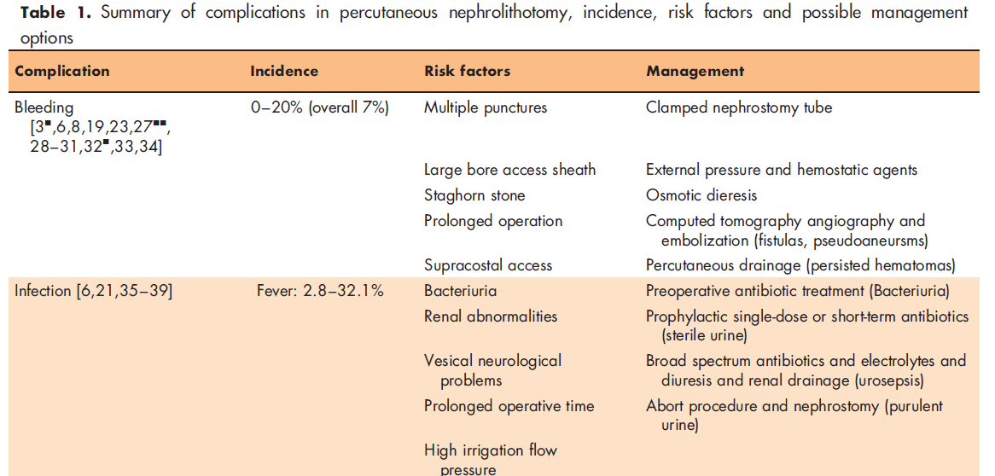
Kallidonis P, et al. Curr Opin Urol 2016, 26:88–94.

Slide 55
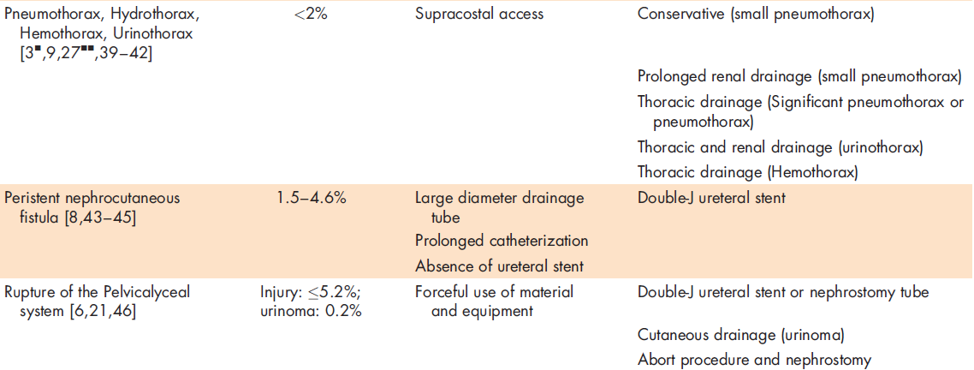
Kallidonis P, et al. Curr Opin Urol 2016, 26:88–94.

Slide 56
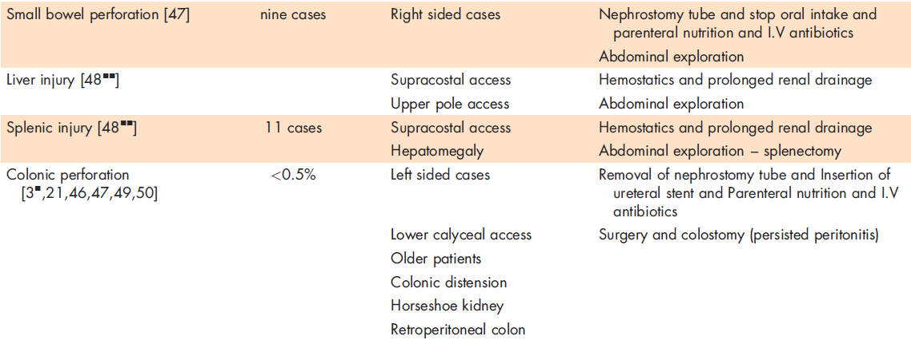
Kallidonis P, et al. Curr Opin Urol 2016, 26:88–94.

Slide 59
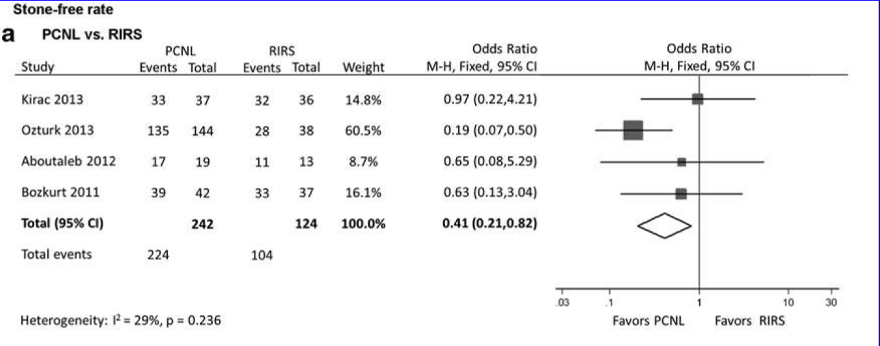

Slide 60
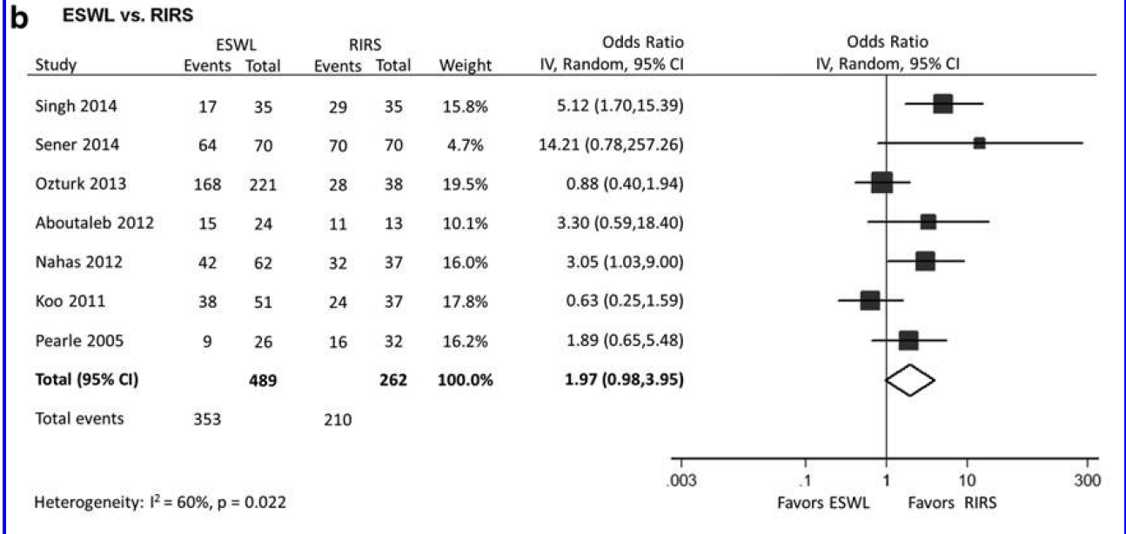

Slide 61
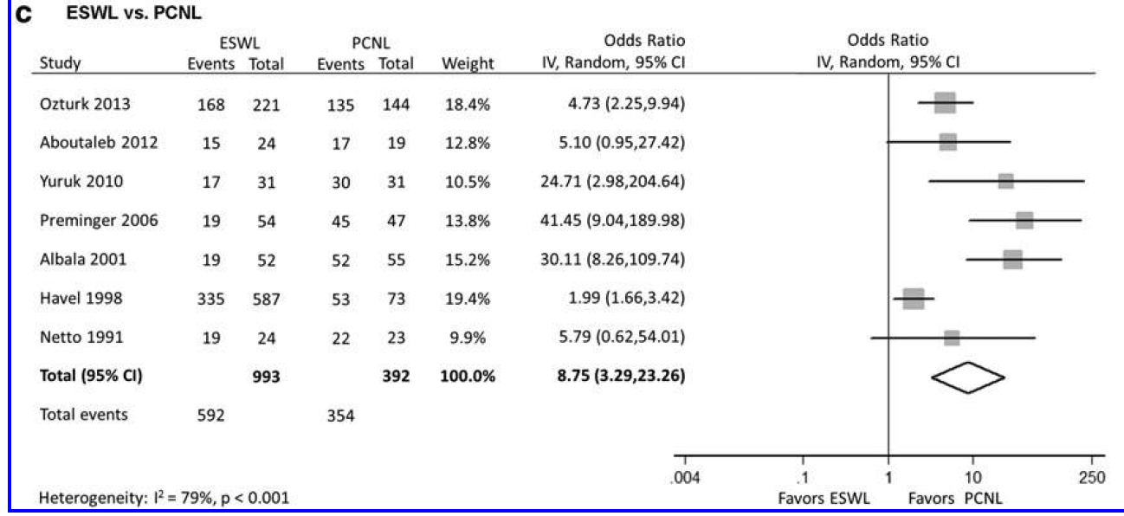

Slide 62
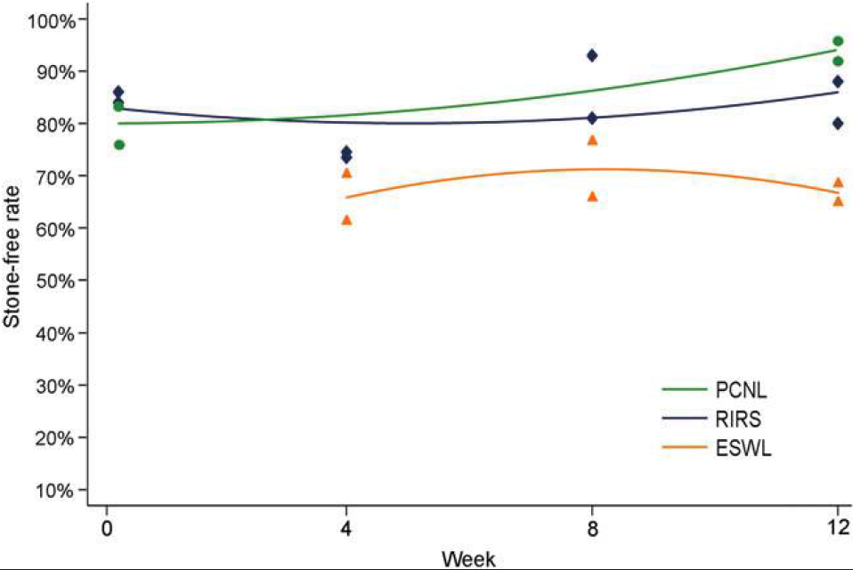
Meta-analysis of SFR:
PCNL, RIRS & SWL at all time points

Slide 63
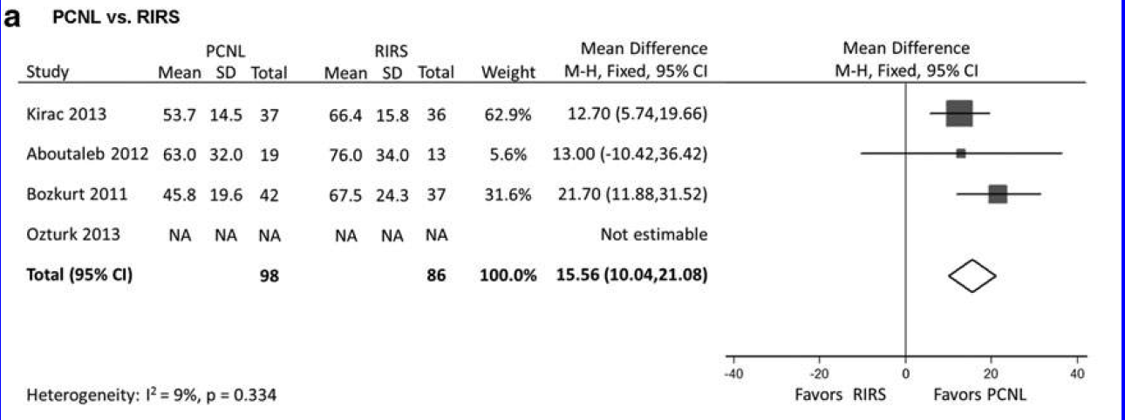

Slide 64
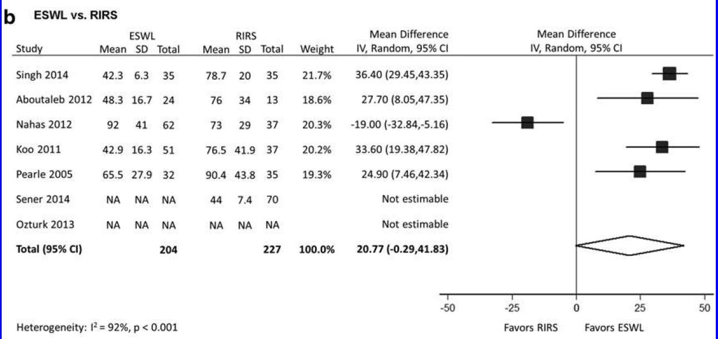

Slide 65
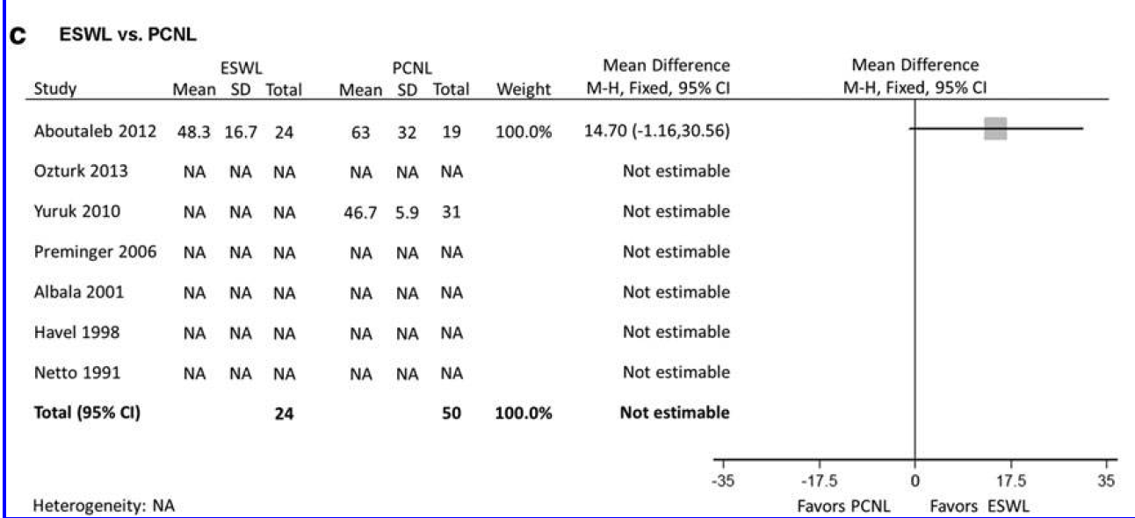

Slide 66
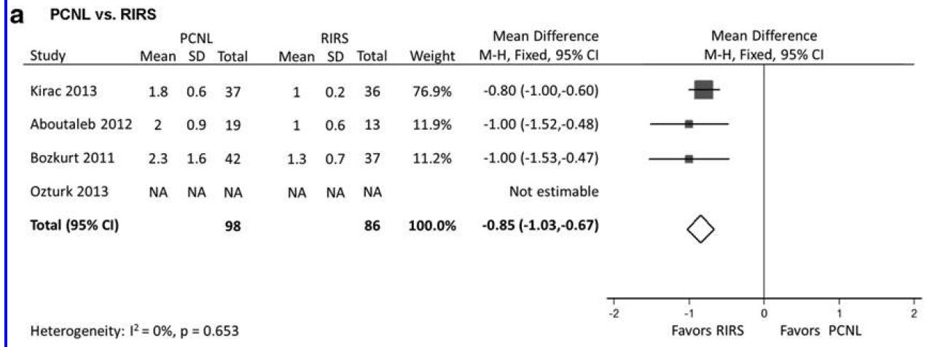

Slide 67
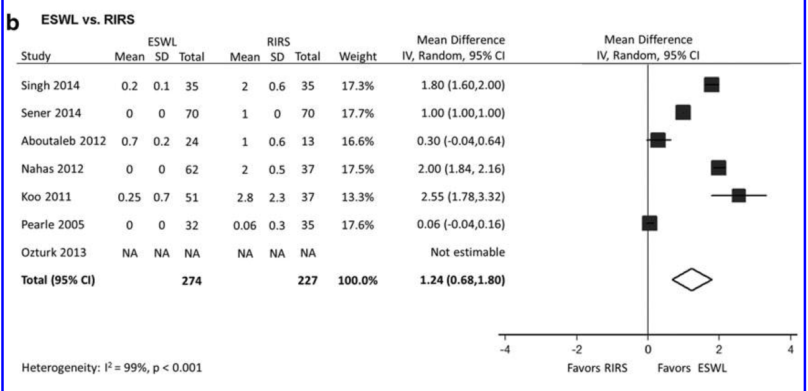

Slide 68
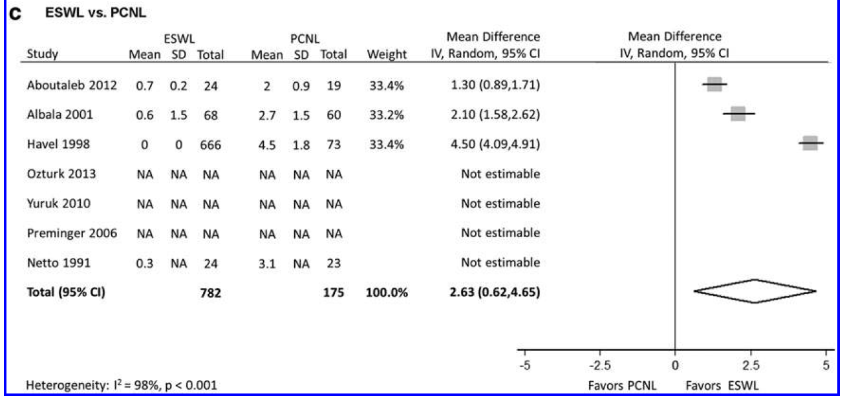

Slide 69
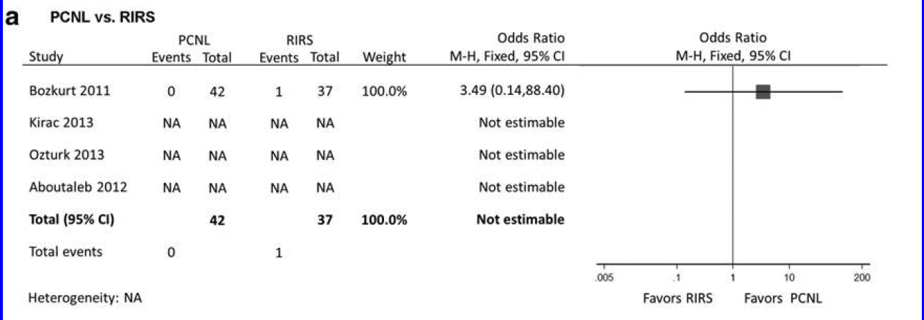

Slide 70
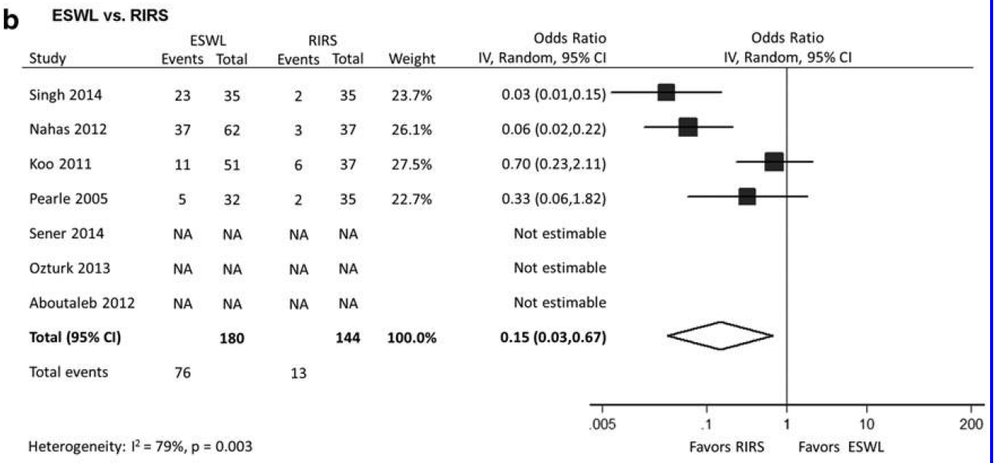

Slide 71
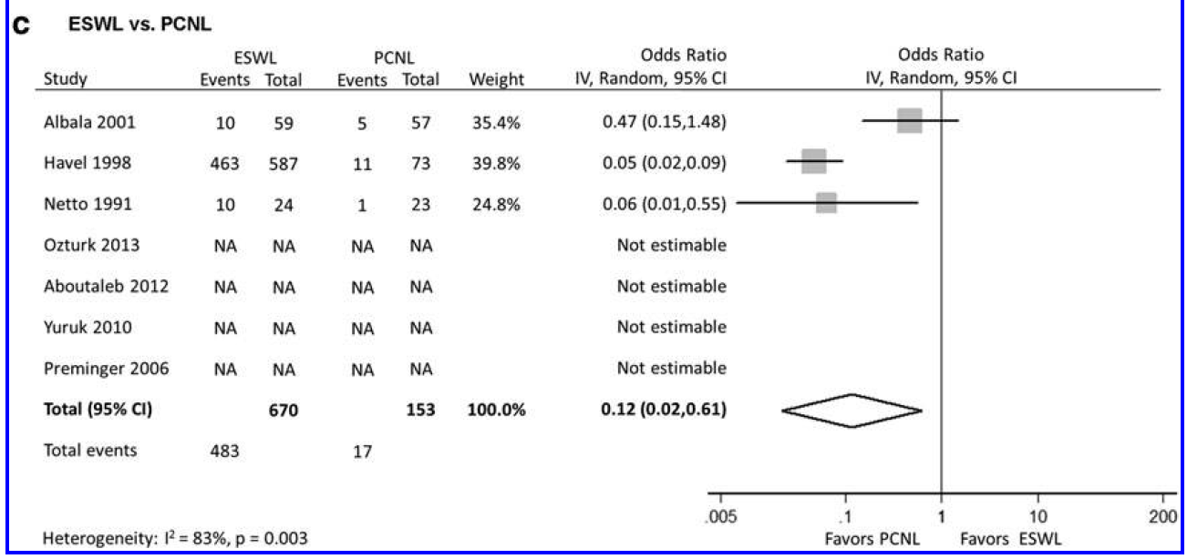

Slide 72
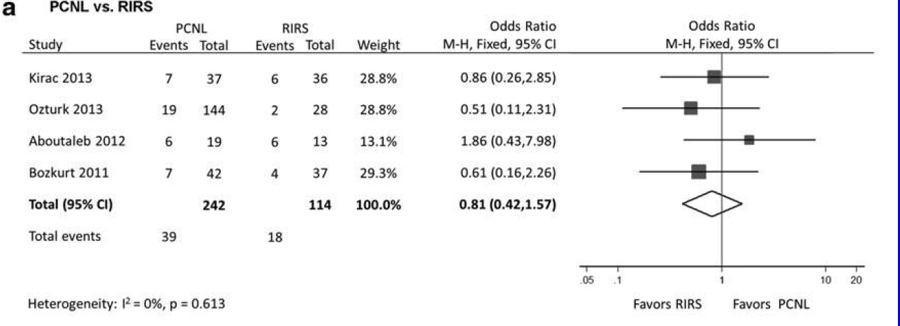

Slide 73
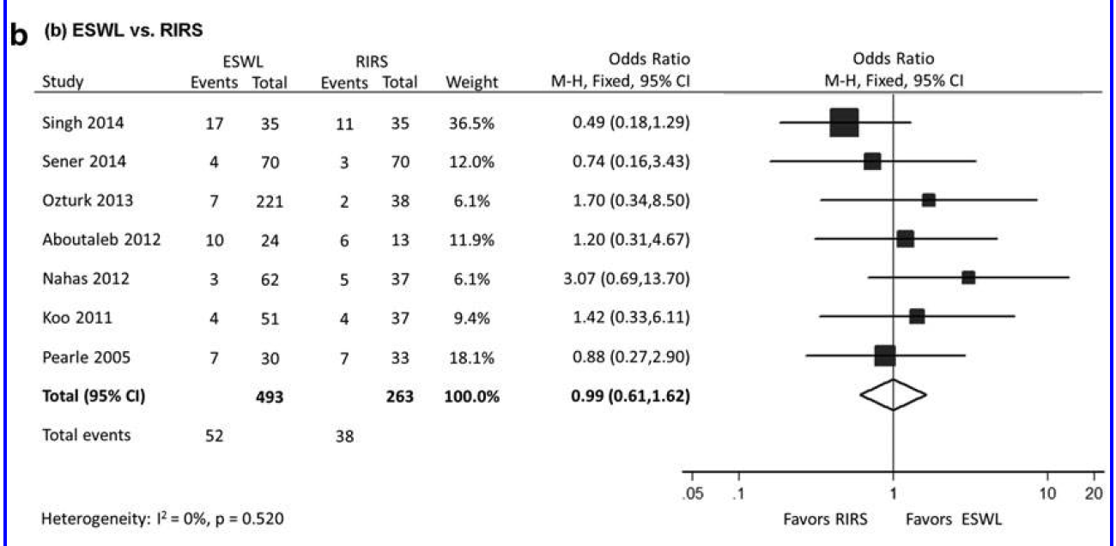

Slide 74
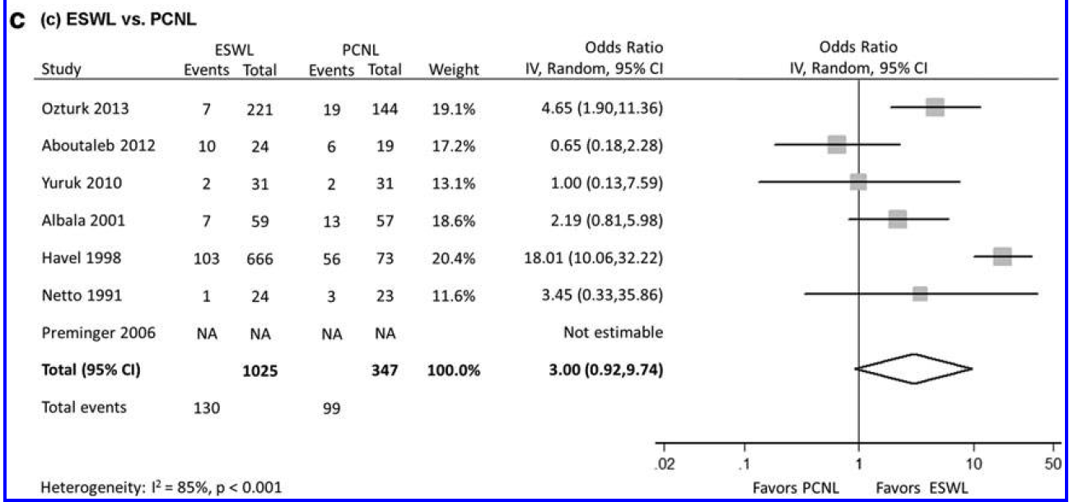

Slide 75
RIRS offers a relative higher SFR while it has a longer operative time
PCNL is associated with highest SFR at expense of longest hospital stay
SWL is performed as outpatient procedure with relative shorter operative time; however, it has lower SFR & higher re-treatment rate

Slide 76
SWL is performed as outpatient procedure with relative shorter operative time; however, it has lower SFR & higher re-treatment rate

Slide 83
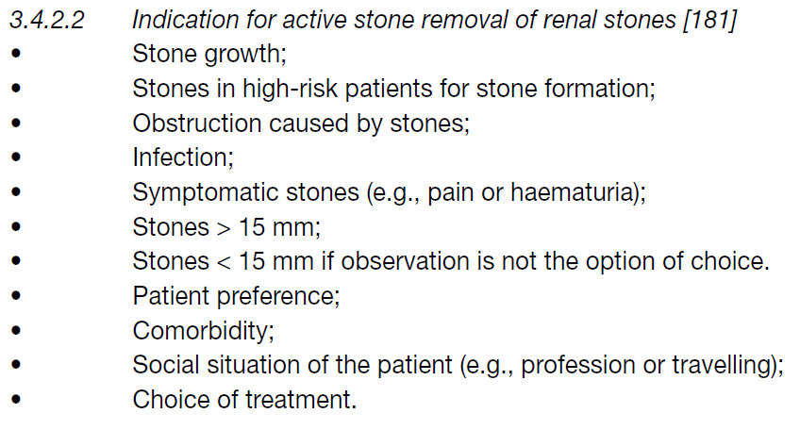

Slide 84
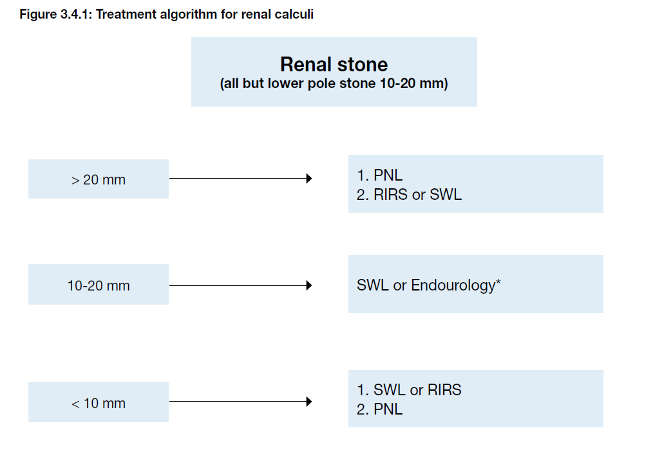

Slide 91
THANK YOU!!!

