Slide 1
Hemorrhagic Cystitis
October 2015

Slide 2
Hemorrhagic cystitis
Hemorrhagic cystitis defined:
Diffuse inflammatory condition of urinary bladder due to infectious or non-infectious aetiology resulting in bleeding from bladder mucous
Most common cause:
Bacterial infection that usually responds promptly to treatment
R. Manikandan, et al. Indian J Urol. 2010 AprJun; 26(2): 159–166.

Slide 3
Epidemiology
Hemorrhagic cystitis occurs in up to 70% of patients exposed to high doses of cyclophosphamide or ifosfamide chemotherapy & in up to 15% of patients who undergo pelvic irradiation to treat malignancy
In recent years, however, newer irradiation techniques have decreased incidence of hemorrhagic cystitis to ≈ 10% of treated patients
Incidence in pediatric population is less than that in adults
Basler J, et al. Medscape 2014.

Slide 4
Epidemiology
A study in patients undergoing allogeneic hematopoietic stem cell transplantation found 2 year cumulative incidence of 24% for BK polyomavirus–associated hemorrhagic cystitis
These researchers identified 3 clinical factors associated with hemorrhagic cystitis in these patients:
Myeloablative conditioning, cytomegalovirus viremia & severe acute graft versus host disease (Uhm J, et al. Bone Marrow Transplant. 2014 Aug 11)
Basler J, et al. Medscape 2014.

Slide 5
Epidemiology
A review of consecutive pediatric patients treated at the Memorial Sloan-Kettering Cancer Center from 1986 to 2010 found that hemorrhagic cystitis was observed in 97 of 6,119 children (1.6%). On univariate analysis, following factors were significantly associated with increased risk of hemorrhagic cystitis (Riachy E, et al. J Urol. 2014. 191(1); 186-92.):
Age > 5 years
Male gender
Cyclophosphamide or busulfan chemotherapy
Bone marrow or peripheral blood stem cell transplantation
Pelvic radiotherapy
Underlying diagnoses of rhabdomyosarcoma, acute leukemia, or aplastic anemia
Basler J, et al. Medscape 2014.

Slide 6
Factors associated with greater severity of cystitis
Older age
Late-onset hemorrhagic cystitis
Positive urine culture for BK virus
Bone marrow or peripheral blood stem cell transplantation
Basler J, et al. Medscape 2014/ Riachy E, et al. J Urol. 2014. 191(1); 186-92..

Slide 7
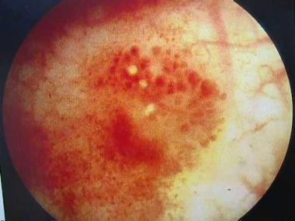
Changes associated with irradiation cystitis, which developed after 7200cGy external beam radiation for localized prostate cancer
Basler J, et al. Medscape 2014.

Slide 8
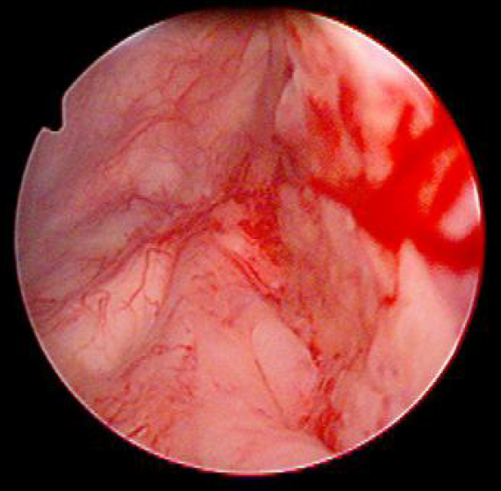
Neovascularity associated with irradiation cystitis. When distended, these weak walled
Vessels often rupture, resulting in submucosal hemorrhage & gross hematuria
Basler J, et al. Medscape 2014.

Slide 9
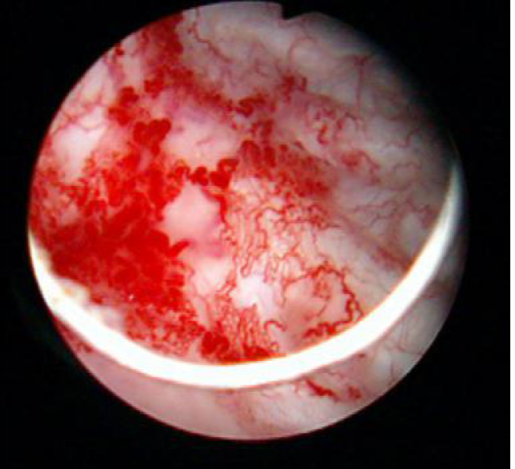
Bladder neck neovascularity after radiation therapy (IMRT) for prostate cancer
Basler J, et al. Medscape 2014.

Slide 10
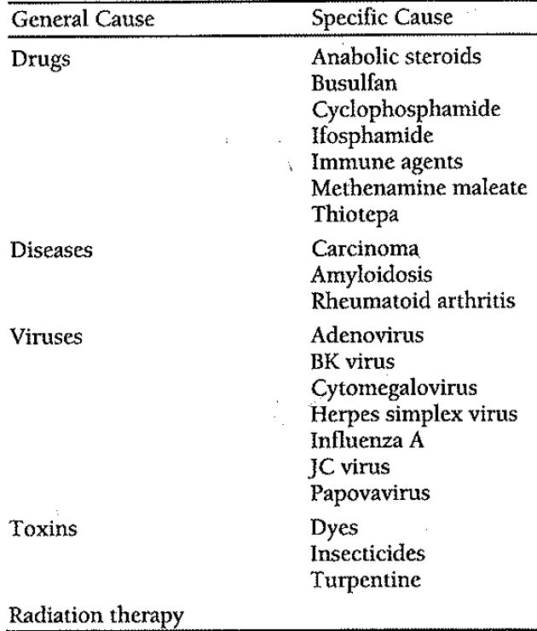
Hemorrhagic cystitis: Causes
Chronic & recurrent hemorrhagic cystitis often arises from anticancer chemotherapy or radiotherapy for treatment of pelvic malignancies
R. Manikandan, et al. Indian J Urol. 2010 AprJun; 26(2): 159–166/ West NJ. Pharmacotherapy. 1997; 4: 696-706.

Slide 11
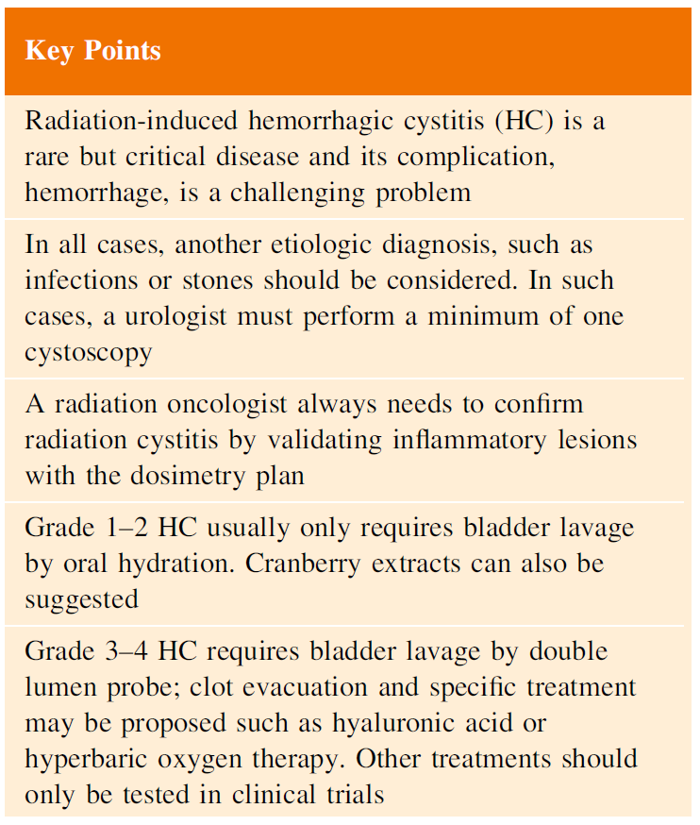

Slide 12
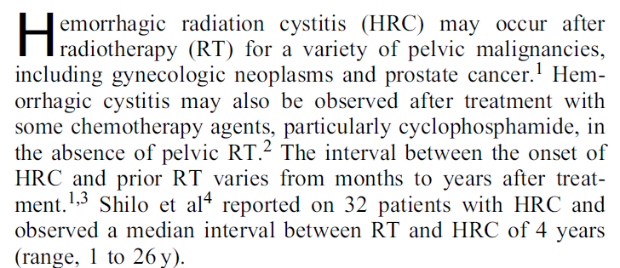

Slide 14
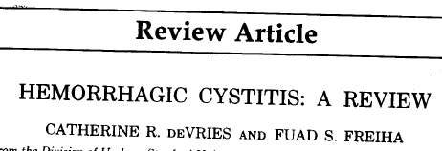
DeVries CR, et al. J Urol. 1990; 143(1): 1-9.

Slide 15
General Principles of managing Hemorrhagic Cystitis
A thorough evaluation should be done to determine cause
If etiology is not obvious, patient should undergo hematuria workup including urine cytology, upper tract imaging & cystoscopy
Patient’s current medications must be reviewed & anticoagulants must be stopped
Patients on chemotherapy may have thrombocytopenia & other coagulation abnormalities which must be corrected
R. Manikandan, et al. Indian J Urol. 2010 AprJun; 26(2): 159–166.

Slide 16
General Principles of managing Hemorrhagic Cystitis
Lab evaluation: Hb, CBC, blood urea, S. creatinine and coagulation profile & urine culture
Patient should be hemodynamically stabilized with IV fluids & blood transfusion
Antibiotics are given until sterile cultures are obtained
Symptomatic treatment with drugs like oxybutynin & analgesics helps in alleviating symptoms
R. Manikandan, et al. Indian J Urol. 2010 AprJun; 26(2): 159–166.

Slide 17
Treatment of intractable bladder hemorrhage
1st step: A large bore 3-way Foley urethral catheter is inserted to decompress bladder & start saline irrigation
This simple maneuver may slow or stop bleeding altogether
In some instance cystoscopic clot evacuation may be necessary
R. Manikandan, et al. Indian J Urol. 2010 AprJun; 26(2): 159–166.

Slide 18
Treatment of intractable bladder hemorrhage
During cystoscopy, bladder should be carefully evaluated for source of bleeding & biopsy of suspicious malignant lesions or fulguration of bleeding spots can be done at same time
Patients not responding to clot evacuation & those with diffuse bleeding, require supplemental therapeutic techniques with systemic or intravesical agents
R. Manikandan, et al. Indian J Urol. 2010 AprJun; 26(2): 159–166.

Slide 19
Medical management: Estrogen
Conjugated estrogens have been employed: Treatment of viral & radiation-induced hemorrhagic cystitis
Estrogens are believed to act by stabilization of microvasculature
Some series have described oral & intravenous administration of conjugated estrogens with success rates ranging from 60% to 86%
R. Manikandan, et al. Indian J Urol. 2010 AprJun; 26(2): 159–166.

Slide 20
Medical management: Sodium pentosan polysulfate
Sodium pentosan polysulfates have been proposed due to its uroprotective qualities that help reduce inflammatory response of urothelium
This compound replaces surface glycosaminoglycans that have been depleted by inciting agents & thereby decrease bacterial adherence
Reduces risk of infection which is often a trigger factor for hematuria
Initial dosage is 100 mg orally thrice daily which is gradually reduced to maintenance dose of 100 mg daily
Requires 1-8 weeks to reduce degree of hematuria & no side effects have been reported
R. Manikandan, et al. Indian J Urol. 2010 AprJun; 26(2): 159–166.

Slide 21
Medical management: Hyperbaric oxygen
Hyperbaric oxygen (HBO) has also been used: To control hemorrhagic cystitis arising out of several causes especially radiation or cyclophosphamide-induced hemorrhagic cystitis but most of these are single case reports or small retrospective case series
Recently a case of successful use of HBO in BKV-associated hemorrhagic cystitis refractory to cidofovir has been reported
R. Manikandan, et al. Indian J Urol. 2010 AprJun; 26(2): 159–166.

Slide 22
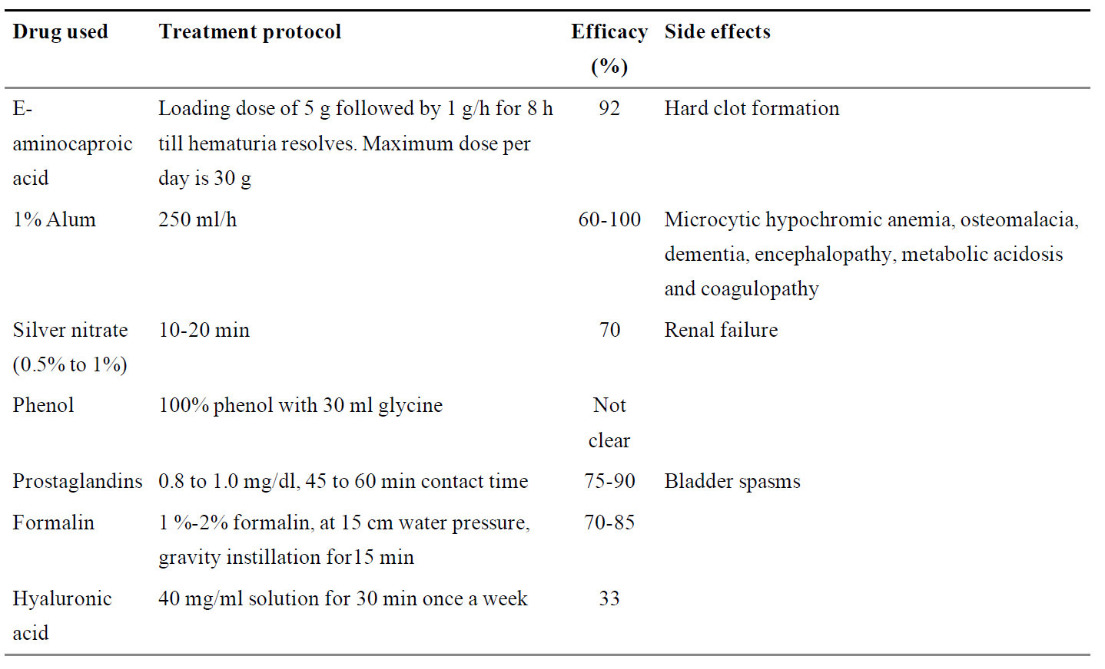
Instillation therapies used in treatment of hemorrhagic cystitis
R. Manikandan, et al. Indian J Urol. 2010; 26(2): 159–166.

Slide 23
Instillation therapies used in treatment of hemorrhagic cystitis
R. Manikandan, et al. Indian J Urol. 2010; 26(2): 159–166.

Slide 24
Instillation therapy: E-aminocaproic acid
E-aminocaproic acid inhibits fibrinolysis by preventing activation of plasminogen to plasmin
Can be given orally, parenterally or intravesically by continuous bladder irrigation
Administration involves loading dose of 5 g followed by 1 g/h for 8 h until bleeding stops
Maximum recommended dosage in 24 h: 30 gm
R. Manikandan, et al. Indian J Urol. 2010 AprJun; 26(2): 159–166.

Slide 25
Instillation therapy: E-aminocaproic acid
Major disadvantage of this treatment: Formation of hard clots that are not easily flushed from bladder
Patient should be clot-free before starting this drug & should be used in conjunction with continuous bladder irrigation
Singh et al. reported response rate of 92% in 37 cases by this treatment (Singh I, et al. Urology. 1992;40:227–9.)
Upper tract hemorrhage is a contraindication to its use since clot formation within ureter can lead to obstruction & acute renal failure
R. Manikandan, et al. Indian J Urol. 2010 AprJun; 26(2): 159–166.

Slide 26
Instillation therapy: Alum
Alum (aluminum ammonium sulphate or aluminum potassium sulphate) irrigation acts as an astringent that causes protein precipitation, vasoconstriction & decreased capillary permeability without damaging normal urothelium
It is commonly delivered as 1% solution (50 g alum in 5 liter sterile water) via CBI at a rate of 250 ml/h
It leads to complete resolution of hematuria in 60% to 100% of patients
Median time to resolution of hematuria ranges from 3-4 days, but therapy may be required for as long as 7 days
R. Manikandan, et al. Indian J Urol. 2010 AprJun; 26(2): 159–166.

Slide 27
Instillation therapy: Alum
Systemic toxicity is low as urothelial permeability to aluminum is minimal
However, aluminum toxicity due to its absorption has been reported such as microcyctic hypochromic anemia, osteomalacia, dementia, encephalopathy, metabolic acidosis and coagulopathy, particularly in renal failure patients and in children
R. Manikandan, et al. Indian J Urol. 2010 AprJun; 26(2): 159–166.

Slide 28
Instillation therapy: Silver nitrate
Silver nitrate bladder instillations cause chemical coagulation & eschar at bleeding sites
Solution is used in concentration range of 0.5% to 1% and is instilled for 10 - 20 minutes in duration
Reflux should be ruled out before instillation as renal failure has been reported due to precipitation & obstruction of upper tracts
R. Manikandan, et al. Indian J Urol. 2010 AprJun; 26(2): 159–166.

Slide 29
Instillation therapy: Prostaglandins
Prostaglandin E1, prostaglandin E2 & prostaglandin F2 alpha or its synthetic analogue carboprost tromethamine have been found to be useful in management of cyclophosphamide-induced hemorrhagic cystitis as well as BK viruria-associated hemorrhagic cystitis developing in patients after allogeneic bone marrow transplantation
They have a cytoprotective effect by regulating mucus production
They are also postulated to cause smooth muscle contraction of blood vessels in mucosa & submucosa via membrane stabilization
R. Manikandan, et al. Indian J Urol. 2010 AprJun; 26(2): 159–166.

Slide 30
Instillation therapy: Prostaglandins
They can also induce hemostasis by platelet aggregation
Bladder spasms are only known side effect reported in 78% of patients
Recommended starting dosage: 0.8 to 1.0 mg/dl
R. Manikandan, et al. Indian J Urol. 2010 AprJun; 26(2): 159–166.

Slide 31
Instillation therapy: Hyaluronic acid
Miodosky et al., have reported successful treatment of post-hematopoietic stem cell transplantation hemorrhagic cystitis with intravesical sodium hyaluronate with 5 out of 7 patients achieving complete responses (Miodosky M, et al. Bone Marrow Transplant. 2006; 38: 507–11.)
However, in recent analysis of published literature on use of hyaluronic acid in treatment of hemorrhagic cystitis & other bladder conditions, Iavazzo et al., concluded that this modality of treatment has only limited effectiveness (Iavazzo C, et al. Eur Urol. 2007;51:1534–40.)
R. Manikandan, et al. Indian J Urol. 2010 AprJun; 26(2): 159–166.

Slide 32
Instillation therapy: Formalin
Formalin (40% formaldehyde) is best known & most effective intravesical hemostatic agent
When administered intravesically, formalin rapidly fixes bladder mucosa through a process involving protein crosslinking
This prevents further necrosis & blood loss
In view of potential for significant treatment related morbidity, formalin instillation is reserved for intractable hemorrhage refractory to conservative treatment
R. Manikandan, et al. Indian J Urol. 2010 AprJun; 26(2): 159–166.

Slide 33
Instillation therapy: Formalin
Cystogram must be done to rule out vesicoureteric reflux & bladder perforation
Formalin must be instilled under spinal or general anesthesia since it is caustic to sensory nerves of bladder
Preliminary cystoscopy is performed for clot evacuation & fulguration of bleeding vessels
Entire perineum should be painted with petroleum jelly &, in women; vagina is packed with petroleum jelly gauze to protect exposed skin and mucosa from caustic effect of formalin
R. Manikandan, et al. Indian J Urol. 2010 AprJun; 26(2): 159–166.

Slide 34
Instillation therapy: Formalin
Through an 18F Foley catheter, bladder is filled to capacity with 1-2% formalin under gravity at a pressure kept below 15 cm of water
Treatment session is generally limited to 15 min
Formalin can be administered intravesically in concentrations ranging from 1-10%
Approximately 10-30% of patients may not respond to low dose of 1-2% and may require 2nd instillation using high dose formalin (4-10%)
R. Manikandan, et al. Indian J Urol. 2010 AprJun; 26(2): 159–166.

Slide 35
Instillation therapy: Fibrin glue
Fibrin glue has been used by Ouwenga et al. in a patient with persistent hematuria refractory to all recommended measures (Ouwenga MK, et al. J Urol. 2004; 172: 1348.)
After cystoscopy & clot evacuation, 5 cc aliquots of fibrin sealant were applied through a 7F open ended catheter via air distension to entire surface of the bladder
Some degree of hematuria resolution occurred
R. Manikandan, et al. Indian J Urol. 2010 AprJun; 26(2): 159–166.

Slide 36
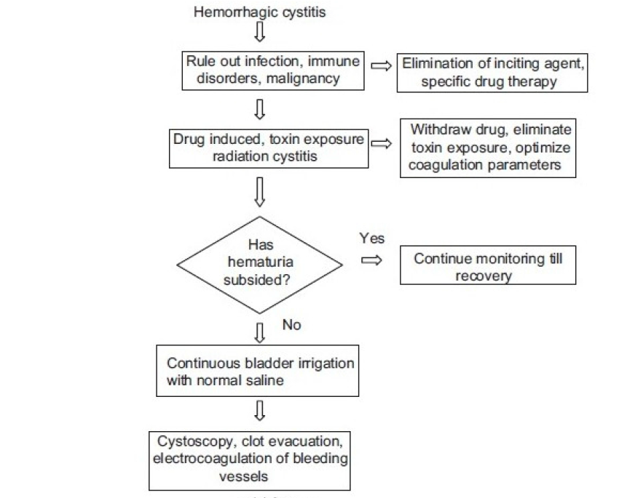
Management algorithm for hemorrhagic cystitis
Contd…
R. Manikandan, et al. Indian J Urol. 2010; 26(2): 159–166.

Slide 37
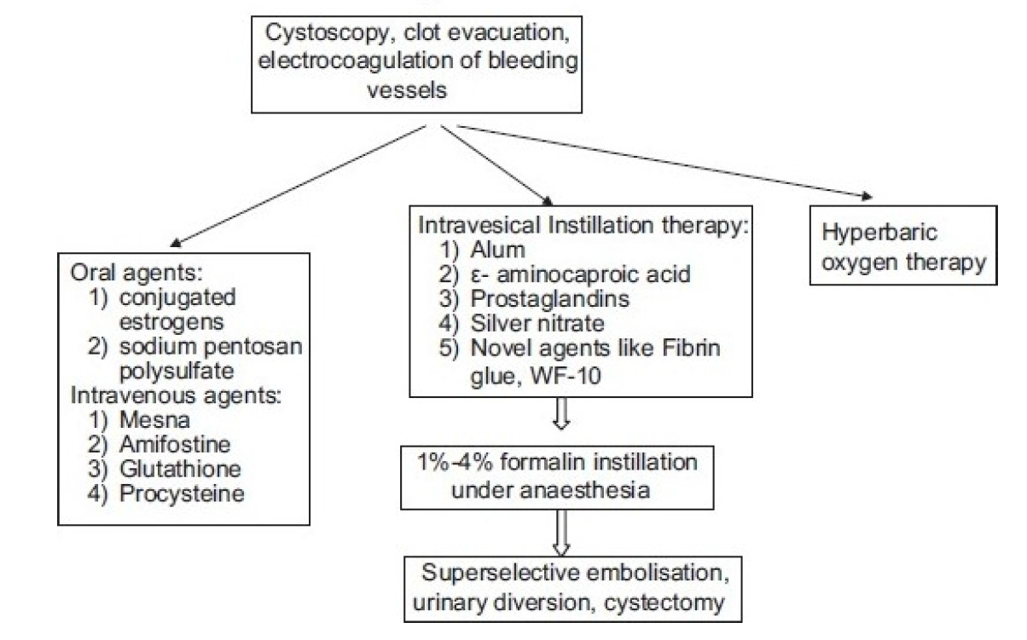
R. Manikandan, et al. Indian J Urol. 2010; 26(2): 159–166.

Slide 38
Embolization
Super selective embolization has been described as treatment option for hemorrhagic cystitis refractory to conventional treatments
McIvor et al., reported successful control of severe hematuria in 22 of 25% patients (92%) (McIvor J, et al. Clin Radiol. 1982; 33: 561–7.)
Gluteal pain, secondary to occlusion of the superior gluteal artery, is most common complication due to pelvic embolization. This complication is minimal nowadays with advent of superselective embolization using microcatheters & newer embolization particles
R. Manikandan, et al. Indian J Urol. 2010; 26(2): 159–166.

Slide 39
Surgery
Surgery is last resort in patients of intractable massive hematuria
Various surgical procedures have been described such as:
Urinary diversion including nephrostomy tube placement with occlusion of ureteral orifices (balloons or glutaraldehyde cross-linked collagen)
Cystostomy with ureteral catheters
Ileal loop diversion
Ureterosigmoidostomy & cutaneous ureterostomy
Open packing of bladder
Ligation of hypogastric arteries &
Cystectomy & urinary diversion
R. Manikandan, et al. Indian J Urol. 2010; 26(2): 159–166.

Slide 40
Surgery
Goal of supravesical diversion: To decrease exposure of hemorrhagic areas to urokinase to allow for hemostasis.
Stillwell et al., reported need for cystectomy for bleeding control in 5 of 100 (5%) patients with severe cyclophosphamide induced hemorrhagic cystitis
R. Manikandan, et al. Indian J Urol. 2010; 26(2): 159–166.

Slide 41
Purpose: To evaluate clinical presentation, management & outcomes of patients undergoing cystectomy for refractory hemorrhagic cystitis
Materials and Methods: 21 patients with refractory hematuria treated with cystectomy between 2000 & 2012
Clot evacuation, bladder fulguration & bladder irrigation had failed in all patients before cystectomy
In addition, 45% of patients had received prior intravesical therapy (aminocaproic acid, alum or formalin), hyperbaric oxygen therapy (25%), nephrostomy tube placement for attempted urinary diversion (15%) and/or selective bladder angioembolization (5%)

Slide 42
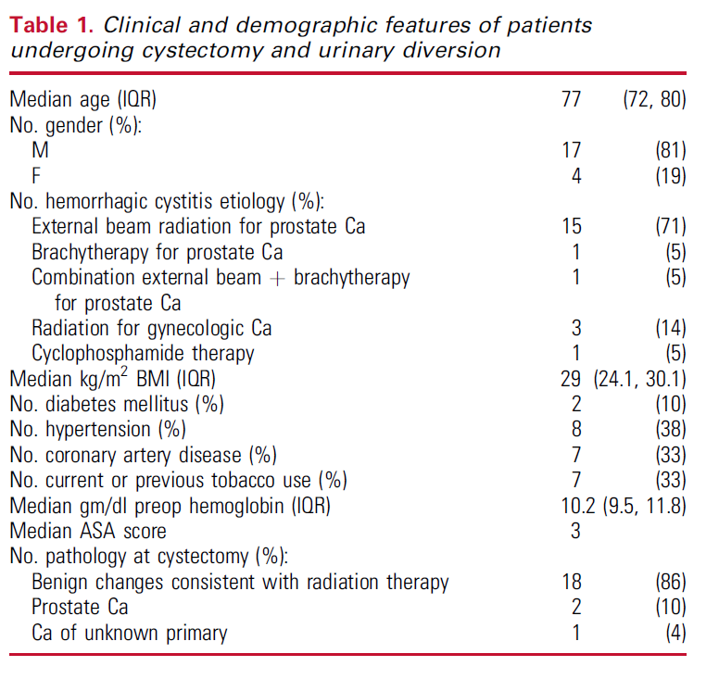

Slide 43
Results:
Median time from receipt of radiation to cystectomy in these patients was 91 months (IQR 73, 125)
Median ASA (American Society of Anesthesiologists) score at cystectomy was 3 & median preoperative hemoglobin was 10.2 gm/dl
Median length of stay after cystectomy: 10 days (IQR 7, 19)
Severe (Clavien grade III to V) complications were noted in 42% of patients (8 of 19) & 90-day mortality rate in this cohort was 16% (3 of 19)
With median postoperative follow-up of 13 months (IQR 4, 21), 1 & 3-year overall survival was 84% and 52%, respectively

Slide 44
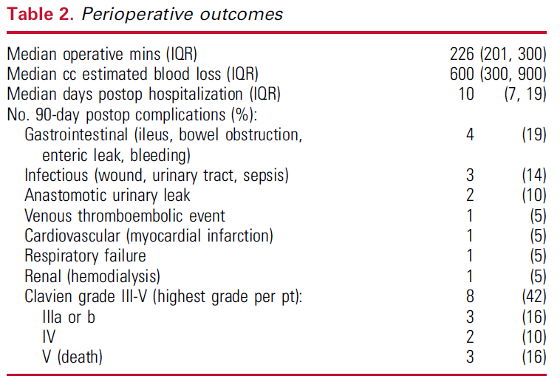

Slide 45
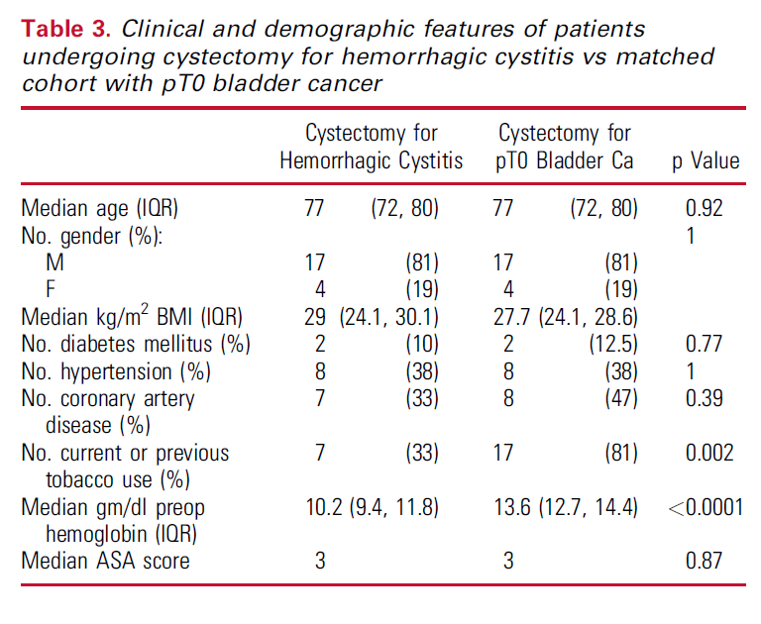

Slide 47
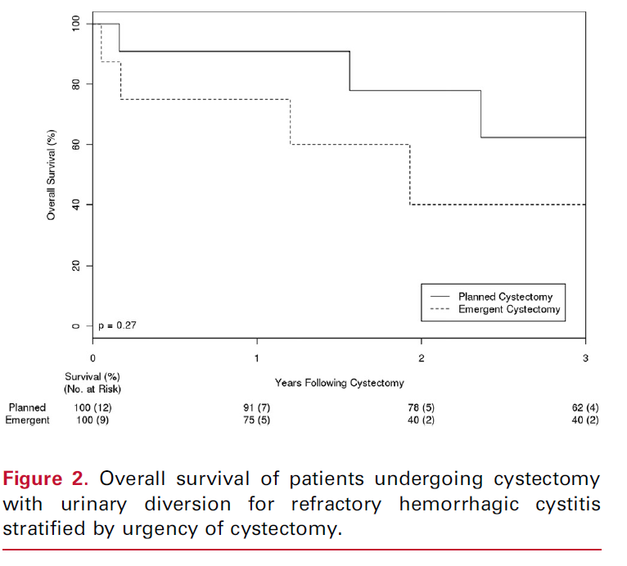

Slide 49
Conclusions:
Cystectomy for hemorrhagic cystitis is associated with high risk of perioperative complications & mortality, consistent with baseline clinical status of this patient cohort and, as such, should remain a last resort to control bleeding after failure of conservative measures

Slide 50
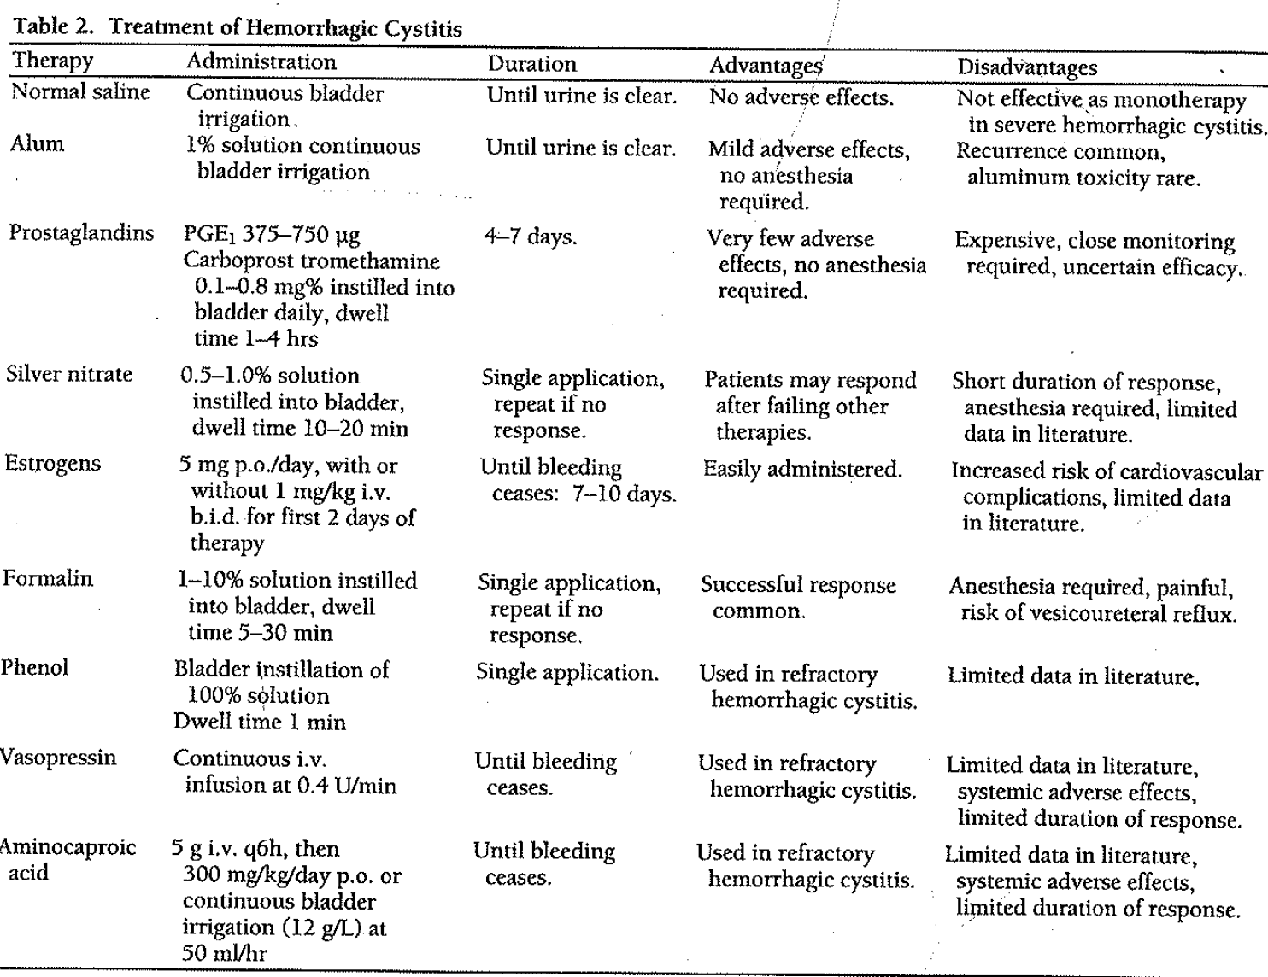
West NJ. Pharmacotherapy. 1997; 4: 696-706.

Slide 51
West NJ. Pharmacotherapy. 1997; 4: 696-706.

Slide 52
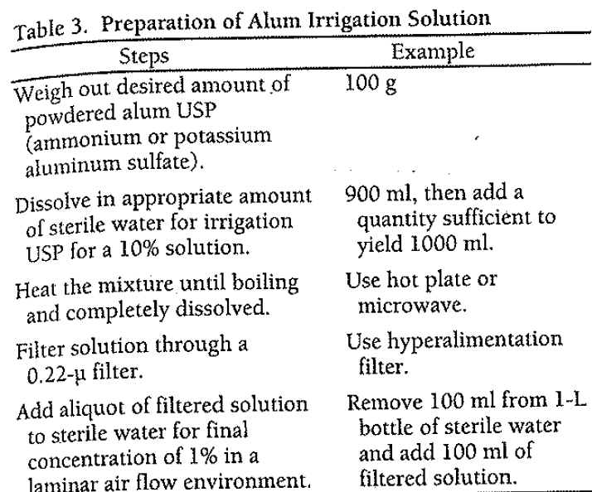
West NJ. Pharmacotherapy. 1997; 4: 696-706.

Slide 53
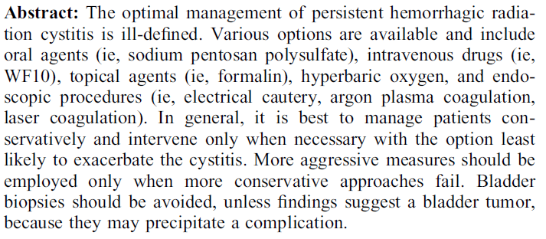

Slide 54
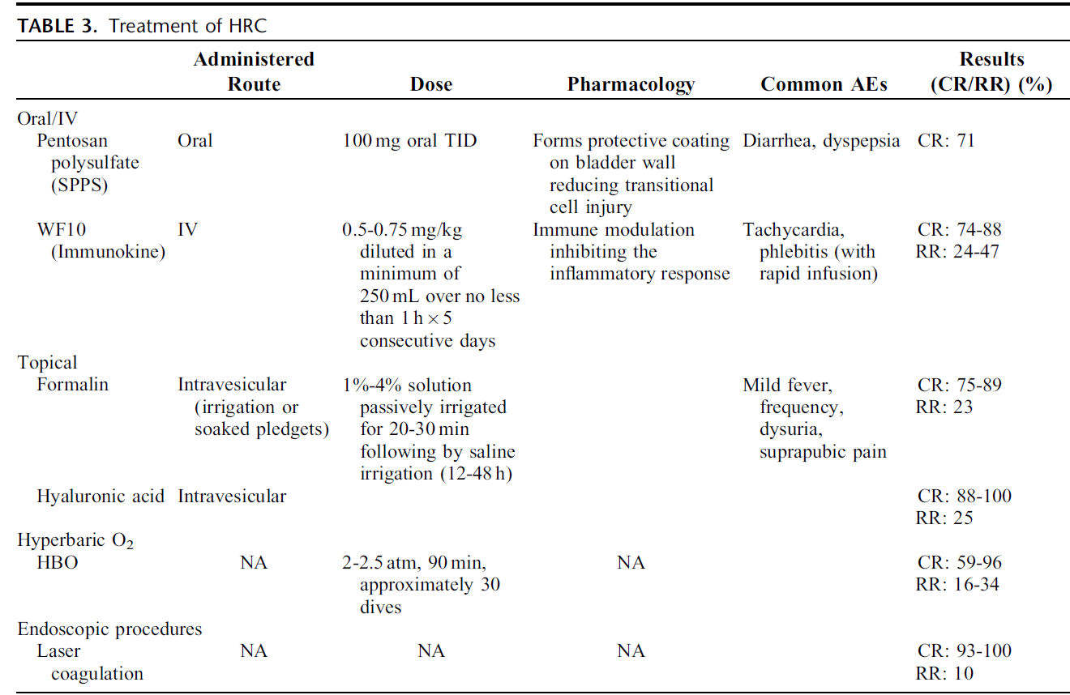

Slide 55
Prognosis of hemorrhagic cystitis
In general, cystitis caused by exposure to chemotherapeutic drugs can be expected to resolve after discontinuation of agent & treatment with irrigation/fulguration
Conversely, hemorrhagic cystitis due to pelvic radiation therapy tends to recur for months, or even years, after completion of radiotherapy
Seemingly minor events, such as UTI or bladder distention, may trigger florid hemorrhage
Close follow-up with periodic urinalysis & urine culture and sensitivity testing, along with aggressive management, may prevent recurrences
Basler J, et al. Medscape 2014.

Slide 56
Prognosis of hemorrhagic cystitis
Prognosis in pediatric patients with hemorrhagic cystitis is related to successful treatment of their primary oncologic condition
Most patients are successfully treated, with resolution of hemorrhagic cystitis
However, long-term effects on bladder may include increased bladder fibrosis, reduced bladder capacity & upper tract deterioration
Basler J, et al. Medscape 2014.

Slide 57
Prognosis of hemorrhagic cystitis
Complications are unusual in patients with chemical cystitis
Wound problems, urinary anastomotic strictures and leaks & bowel anastomosis problems are more common in patients who have undergone a urinary diversion procedure after radiation therapy
Patients with severe hemorrhagic cystitis refractory to medical intervention are at an increased risk for mortality
Basler J, et al. Medscape 2014.

Slide 58
THANK YOU!!!

