Slide 1
Benign Prostatic Hyperplasia Management
6th August 2015

Slide 2
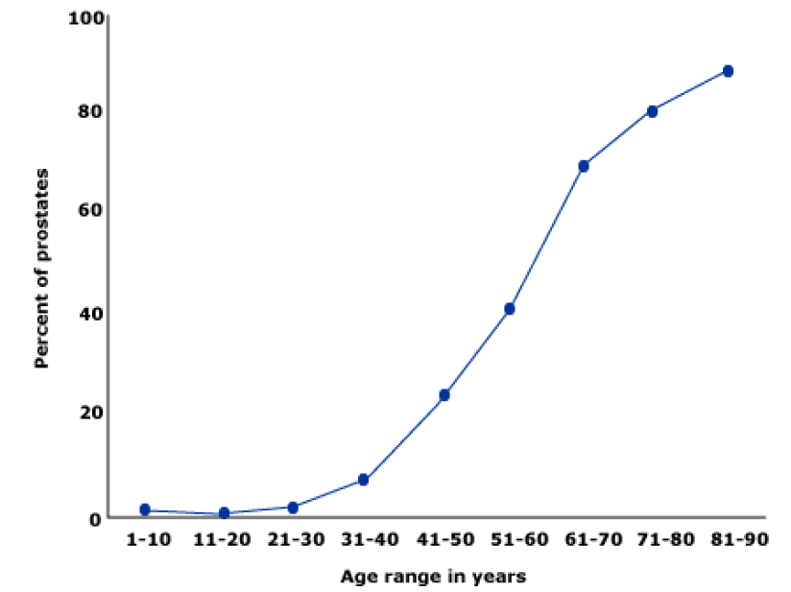
Benign Prostatic Hyperplasia: Introduction
Benign prostatic hyperplasia (BPH): Common problem among older men
Prevalence of histologically diagnosed prostatic hyperplasia increases from
31 - 40 yrs: 8%
51 - 60 yrs: 40 – 50%
> 80 yrs: 80%
Age-associated ↑ in pathologic evidence of BPH in 1075 men at autopsy. Percentage with BPH was determined during 10 yr intervals from 5 different studies; mean values are shown.
1. Cunningham GR, et al. UpToDate 2015 / 2. Berry SJ, et al. J Urol. 1984; 132: 474.

Slide 3
Age-specific prevalence of BPH
Simpson RJ. British Journal of General Practice. 1997; 47: 235-240.

Slide 4
Prostate Gland
Walnut-sized gland in males
Produces prostatic fluid to carry sperm (30% of seminal fluid volume)‏
2 lobes surrounded by capsule
Urethra passes through prostate gland
Weighs 20 + 6 gm at age 30 yr
bladder
trigone
bladder neck
prostatic urethra
prostate capsule
ejaculatory ducts
penile urethra
4
Notes:
4

Slide 5
Prostatic Growth Periods
Glandular growth
1st growth spurt 2nd growth spurt
14 25 45 years
5
Notes:
5

Slide 6
Prostate Growth and Androgens
Testosterone converted to DHT by 5α reductase enzyme
2 isoforms of enzyme exist
Type 1 enzyme: liver, skin, sebaceous glands & most hair follicles
Type 2 enzyme: genital skin, beard and scalp hair follicles and prostate
Prostate consists of 90% type 2 and 10% type 1
Testes
Adrenals
Testosterone
Testosterone
DHT
DHT
PROSTATE
Testosterone
DHT
Androgen Receptor
Cellular multiplication
6
Notes:
6

Slide 7
BPH and BOO
Benign Prostatic Hypertrophy
mechanical compression by growth
Static Factor
Dynamic Factor
contraction of SMC
to reduce prostate size
Bladder Outlet Obstruction
to relax SMC
hormonal therapy
blockade of SNS
BOO: Bladder Outlet Obstruction
7
Notes:
7

Slide 8
BPH and BOO
Normal prostate
Enlarged prostate
Obstruction to urine flow
BOO & LUTS
8
Notes:
8

Slide 9
Increasing Urethral Compression
residual urine
residual urine
Normal Early hypertrophy Advanced BPH
mild urethral compression
mild residual urine
moderate urethral compression
significant residual urine
9
Notes:
9

Slide 10
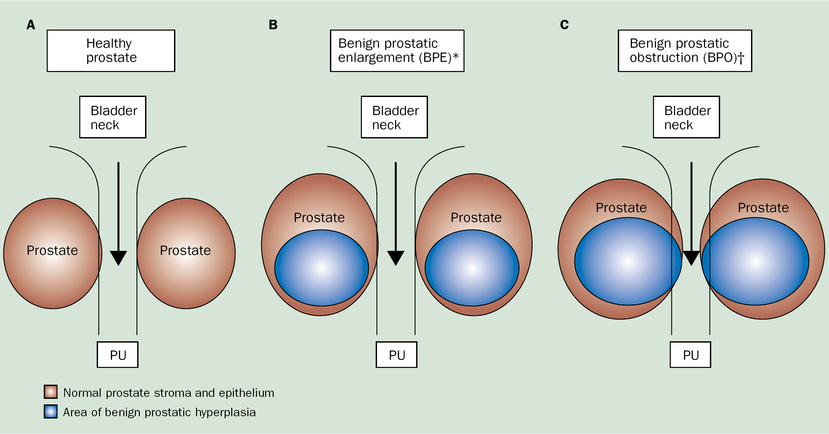
Healthy Prostate, BPE and BPO
Thorpe A, et al. Lancet. 2003; 361(9366): 1359-67.
10
Notes:
10

Slide 11
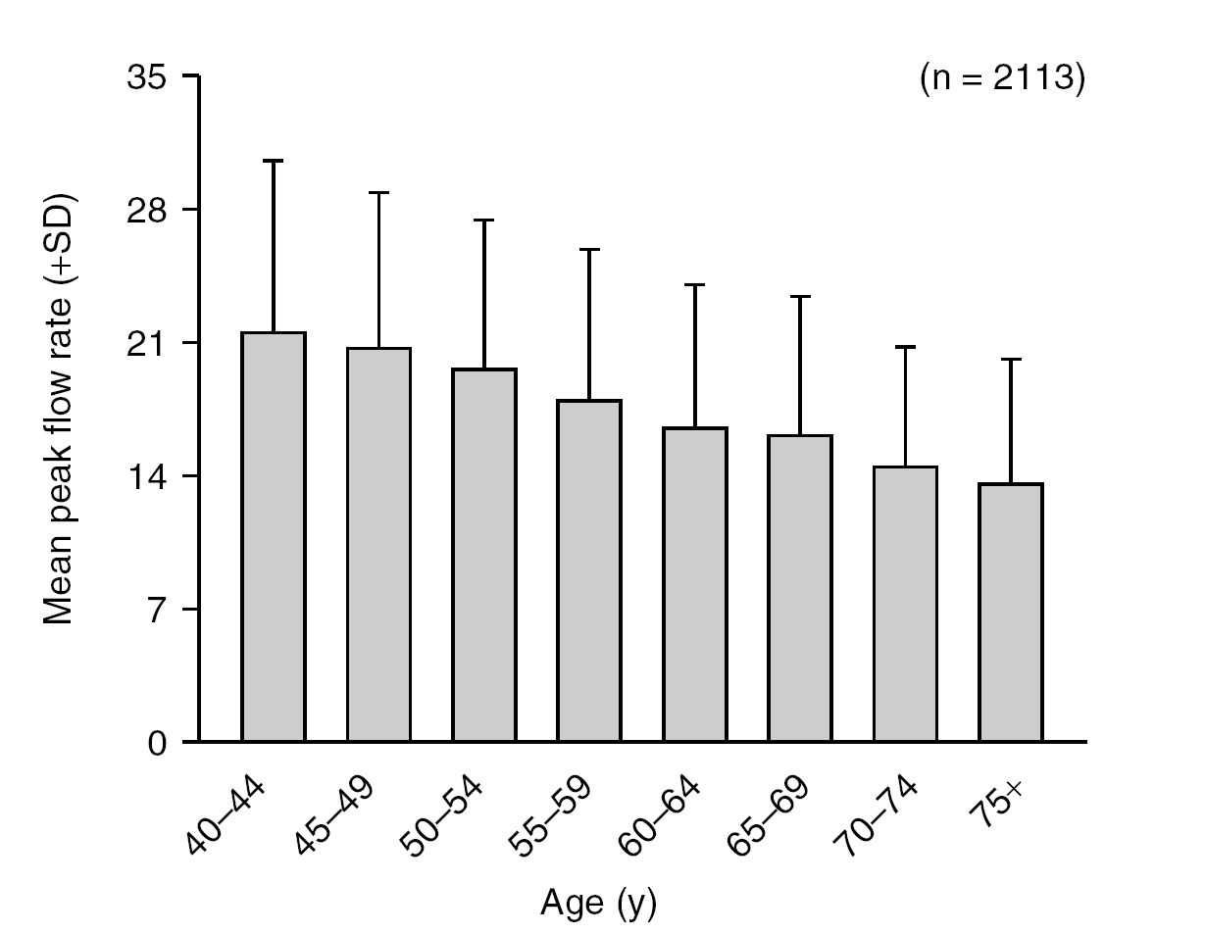
Olmsted County Study
Peak urinary flow rate declines by about 2 mL/s
per decade
11
Notes:
11

Slide 12
Understanding LUTS
Voiding symptoms
Storage symptoms
Hesitancy: delay in onset of micturition (time required by the detrusor muscle to overcome outlet resistance)‏
Urinary frequency: voiding too frequently during day (> 7 times)‏
Poor urinary flow & straining to void (flow rate <10 mL/s is suggestive of obstruction)‏
Nocturia is defined having to wake at night to void
Sensation of incomplete bladder emptying (bladder is unable to empty itself completely, causing residual urine)‏
Urgency (sudden compelling desire to void, which is difficult to defer)‏
Terminal or post-micturition dribbling (weakness in bulbo-spongiosus muscle, which aids urethral emptying)‏
Urge incontinence (involuntary leakage of urine accompanied by urgency)‏
Prolonged urination (reduced flow rate results in increased time taken to void)‏
Thorpe A, et al. Lancet. 2003; 361(9366): 1359-67.
12
Notes:
12

Slide 13
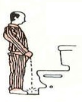
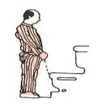
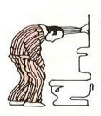
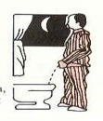
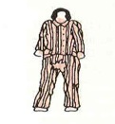
LUTS
Interrupted urinary stream
Urgency
Hesitation
Weak stream
Terminal dribbling
Nocturia
13
Notes:
13

Slide 14
Static and Dynamic factors in BPH
Benign Prostatic Hypertrophy
contraction of SMC regulated by α1A adrenoreceptors in SMC
mechanical compression by growth
Static Factor
Dynamic Factor
60% 40%
to reduce prostate size
Bladder Outlet Obstruction
to relax SMC
hormonal therapy
blockade of SNS
14
Notes:
14

Slide 15
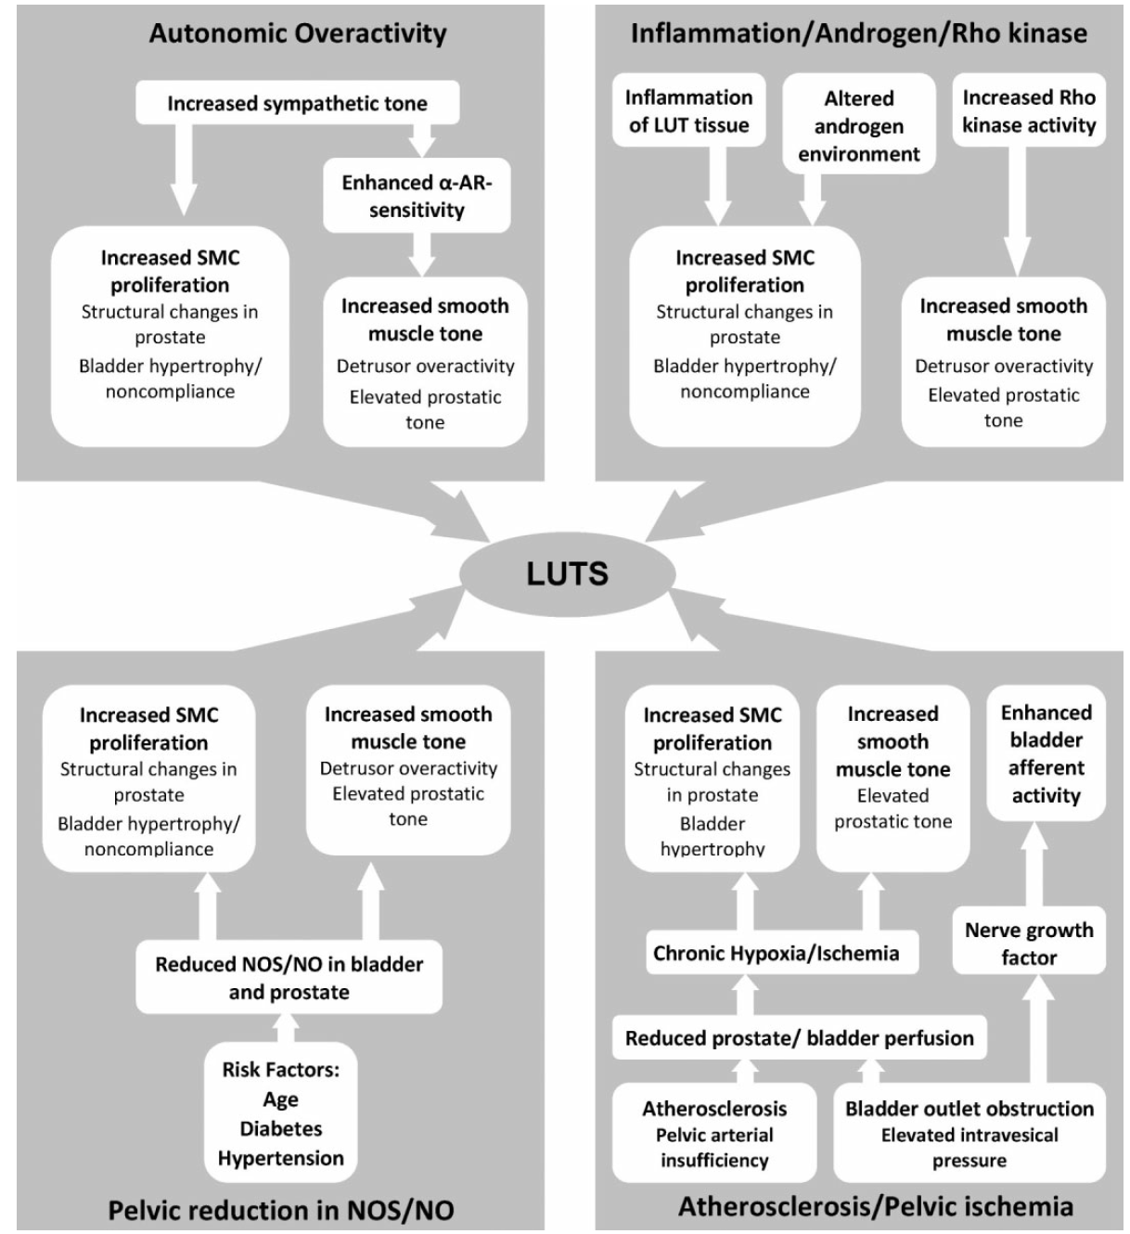

Slide 16
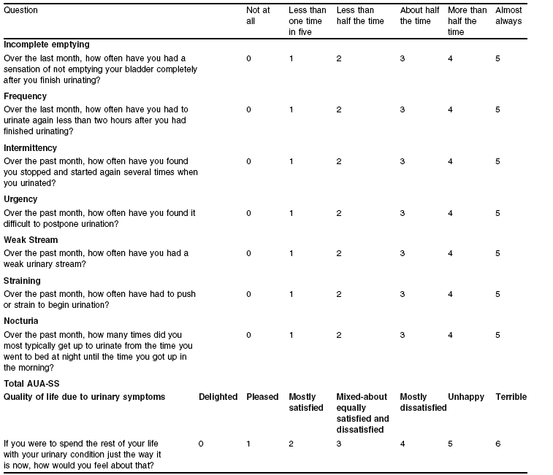
Scoring for BPH: AUA-SS and IPSS
16
Notes:
16

Slide 17
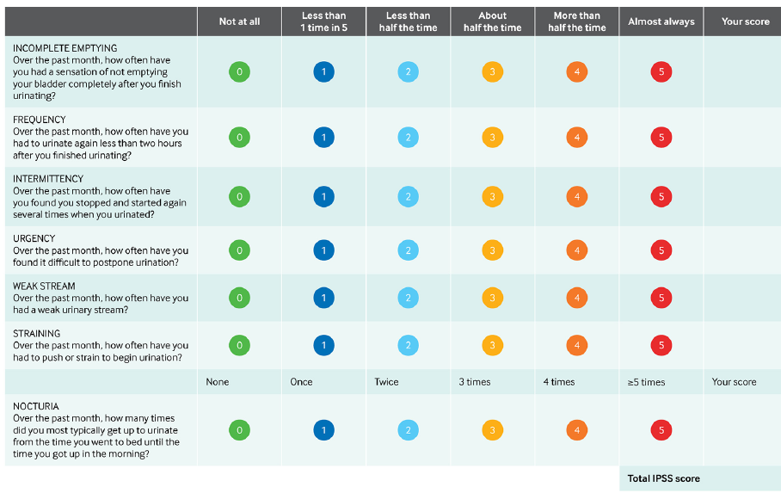
Hollingsworth JM, et al. BMJ 2014; 349: g4474.

Slide 18
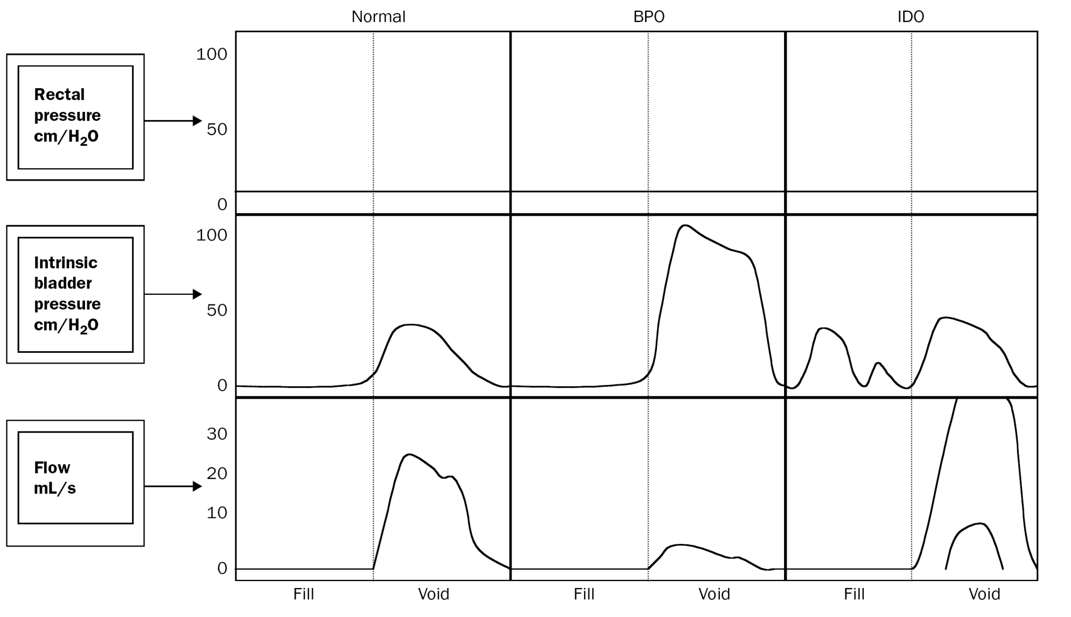
Urodynamic Studies and Detrusor Overactivity
Thorpe A, et al. Lancet. 2003; 361(9366): 1359-67.
18
Notes:
18

Slide 19
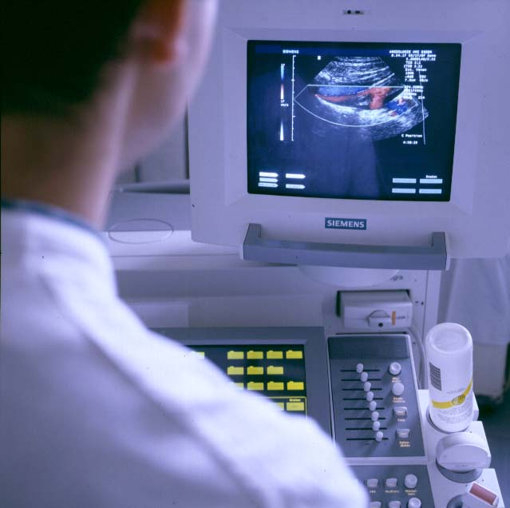
Diagnosis
Based on symptoms
Digital Rectal examination (DRE)
PSA
TRUS guided biopsy (transrectal ultrasonography)‏
Sonography
19
Notes:
19

Slide 20
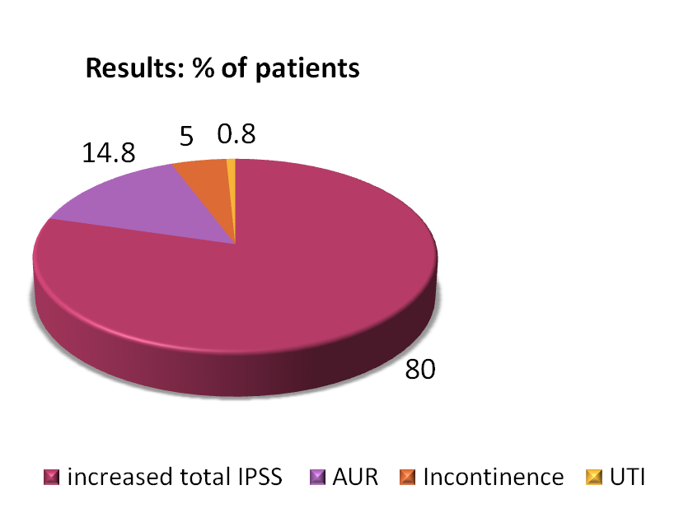
Need for therapy
Medical Therapy of Prostatic Symptoms (MTOPS) study of 3047 patients with LUTS/BPH evaluated impact of medical therapy for LUTS/BPH on clinical progression over mean follow-up of 4.5 years
80% had increased IPSS
14% patients had acute retention
MTOPS trial: Bautista OM, et al. Control Clin Trials. 2003; 24: 224-243.
20
Notes:
20

Slide 21
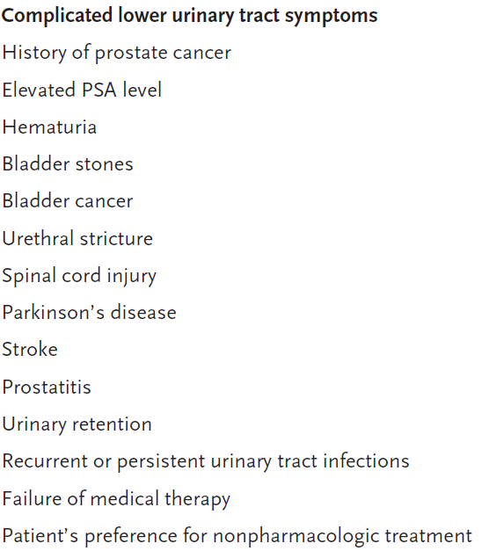
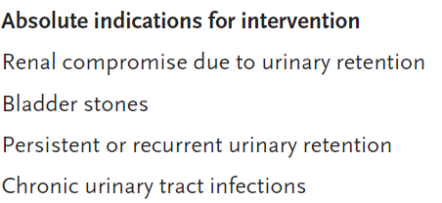
Indications for Referral to a Urologist
Sarma AV, et al. N Engl J Med. 2012; 367: 248-57.

Slide 22
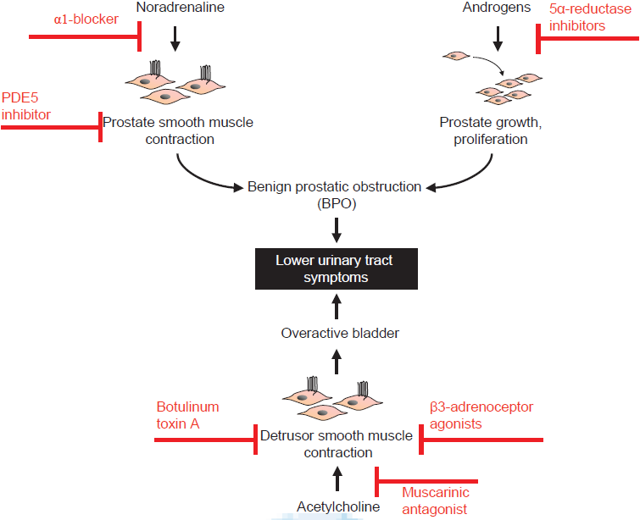
Pathophysiology & medical therapy of LUTS
Hennenberg M, et al. Indian J Urol. 2014; 30(2): 181-8.

Slide 23
Management of BPH
American Urological Association (AUA) symptom assessment
Symptoms
BPH with obstructing symptoms causing:
Kidney damage
Bladder stone
Haematuria
Urinary retention
Physical Examination
Moderate to severe
Symptoms interfere with daily life
Pharmacological treatment:
α-adrenergic blocker
5 α-reductase inhibitor
Novel therapies
Phytotherapy
Mild
Symptoms don’t interfere with daily life
Surgical treatment
Watchful waiting
Dhingra N, et al. Indian J Pharmacol. 2011; 43(1): 6-12.

Slide 24
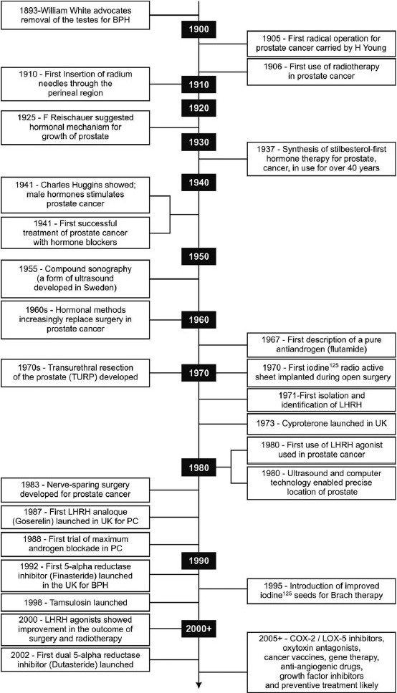
Milestones in understanding & treatment of BPH
Dhingra N, et al. Indian J Pharmacol. 2011; 43(1): 6-12.

Slide 25
Milestones in understanding & treatment of BPH
Dhingra N, et al. Indian J Pharmacol. 2011; 43(1): 6-12.

Slide 26
Medical Management of BPH
LUTS including obstructive symptoms & bladder storage symptoms:
Occur in > ½ of men in their 60s & ↑ with age
Watchful waiting: Appropriate for men with mild symptoms
For men with moderate-to-severe symptoms, bothersome symptoms, or both, benefits & risks of medication should be discussed
Sarma AV, et al. N Engl J Med. 2012; 367: 248-57.

Slide 27
Medical Management of BPH
Pharmacologic options:
α-adrenergic-receptor blocker, 5α-reductase inhibitor (if there is evidence of prostatic enlargement or PSA level >1.5 ng per milliliter), phosphodiesterase-5 inhibitor, or antimuscarinic therapy
Combination therapy with α-blocker & 5α-reductase inhibitor is more effective than monotherapy with either agent but has more side effects
Addition of antimuscarinic therapy may be useful in men with clinically significant storage symptoms not controlled with use of α-blocker alone
Sarma AV, et al. N Engl J Med. 2012; 367: 248-57.

Slide 28
Behavioural Modifications
Behavioural modifications may be helpful for all patients
Patients may also benefit from voiding in sitting position (rather than standing)
Avoid medications that can exacerbate symptoms or induce urinary retention: diuretics, sedating antihistamines & adrenergic agents such as decongestants
Behavioural modifications include:
Avoiding fluids prior to bedtime or before going out
Reducing consumption of mild diuretics such as caffeine & alcohol
Double voiding to empty bladder more completely
Cunningham GR, et al. UpToDate 2015.

Slide 29
Nutrition and BPH
Nutritional practices may provide for prevention & treatment of BPH and LUTS
Espinosa G. Curr Opin Urol. 2013; 23: 38–41.

Slide 30
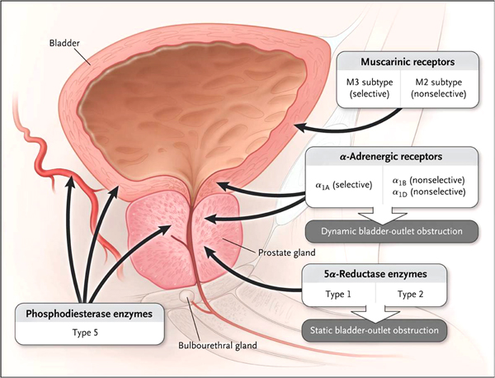
Different Pharmacological Agents
Sarma AV, et al. N Engl J Med. 2012; 367(3): 248-57.

Slide 31
Alpha Blockers
Hollingsworth JM, et al. BMJ 2014; 349: g4474.

Slide 32
Alpha Blockers
Alpha-blocker agents continue to be the most commonly used pharmacotherapy for BPH/LUTS
According to European Association of Urology (EAU) guidelines alpha-blockers should be offered to men with moderate-to-severe lower urinary tract symptoms and are considered the first-line drug treatment for these patients
Alpha-blockers rapidly relieve LUTS presumably by relaxing smooth muscle tone in prostate & bladder neck. However, it is also probable that blockade of α1-adrenoceptors outside prostate, in bladder & in spinal cord, plays a relevant role
Silva J, et al. Curr Opin Urol. 2014; 24: 21–28.

Slide 33
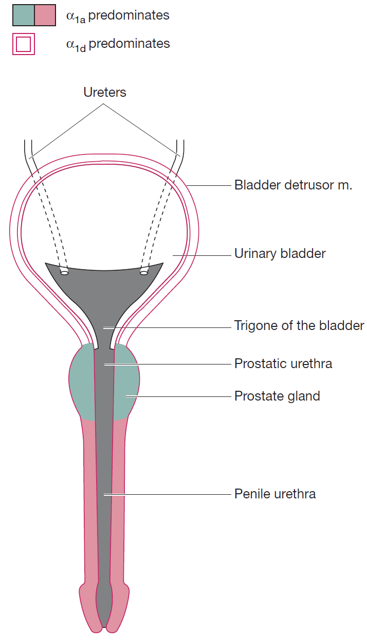
Alpha Blockers
Silodosin:
Only 1 selective to α1A-adrenergic receptor subtype that is predominant in human prostate
162-fold greater affinity for α1A than for α1B adrenergic receptor
About 50-fold greater affinity for α1A than for α1D adrenergic receptor
Systematic analyses of placebo-controlled studies:
Doxazosin, terazosin, alfuzosin, tamsulosin & silodosin are similarly effective and statistically significantly better than placebo in improving urinary flow & reducing symptoms
Distribution of α1-adrenoceptors subtypes in male LUT, as they relate to embryological development of trigone & ureters, bladder, urethra, prostate
Silva J, et al. Curr Opin Urol. 2014; 24: 21–28.

Slide 34
MOA: Alpha 1 blocker
With α1 blocker Without α1 blocker
Medscape.

Slide 35
Alpha Adrenergic Blockers: AUA Guideline
Alfuzosin, doxazosin, tamsulosin, terazosin are appropriate & effective treatment alternatives for patients with bothersome, moderate to severe LUTS secondary to BPH (AUA Symptom Index score ≥8)
Although there are slight differences in adverse events profiles of these agents, all 4 appear to have equal clinical effectiveness
AUA Guidelines 2010.

Slide 36
5-Alpha Reductase Inhibitors
Hollingsworth JM, et al. BMJ 2014; 349: g4474.

Slide 37
Dutasteride
Testes
Adrenals
5α reductase can be blocked by dutasteride & finasteride
5 AR is of two types
Dutasteride blocks both type 1 & 2
Finasteride blocks only type 2
Testosterone
Testosterone
DHT
DHT
PROSTATE
Testosterone
DHT
5 AR enzyme
Androgen Receptor
Cellular multiplication
37
Notes:
BII BPH Impact Score
1. Over the past month, how much physical discomfort did any urinary problems cause you?
2. Over the past month, how much did you worry about your health because of any urinary problems?
3. Overall, how bothersome has any trouble with urination been during the past month?
4. Over the past month, how much of the time has any urinary problem kept you from doing the kinds of things you would usually do?
37

Slide 38
Role of combination medical therapy in BPH
MTOPS Study (Combination: α1-ARA doxazosin & 5αRI finasteride):
Significantly more effective than either component alone in reducing symptoms (P =0.006 vs. doxazosin monotherapy; P<0.001 vs. finasteride monotherapy) & in lowering rate of clinical progression (P<0.001 vs. either monotherapy)
Combination of α1-ARA tamsulosin & 5αRI dutasteride:
Significantly greater ↓ in IPSS when compared with either monotherapy
Combination of α1-ARAs & anti-muscarinic agents:
Statistically significant benefits in QoL scores, patient satisfaction, urinary frequency, storage symptoms & IPSS scores
Studies have not shown increased risk of urinary retention associated with use of anti-muscarinics in highly select cohort of men with BPH
Greco KA, et al. International Journal of Impotence Research. 2008; 20: S33–S43.

Slide 39
Combination therapy on overall disease progression
Combination medical therapy when compared with placebo reduced risk of overall clinical progression by 66% over duration of study (vs. 39% for α1-adrenergic antagonist monotherapy & 34% for ARI monotherapy)
- McConnell JD, et al. N Engl J Med 2003; 349:2387–2398.
As compared with placebo, combination medical therapy reduced 4-yr cumulative incidence of overall clinical progression to 5%
Hollingsworth JM, et al. Current Opinion in Urology. 2010; 20: 1–6.

Slide 40
Role of combination medical therapy in BPH
Available data suggest that combination therapy can be beneficial in treatment of BPH & associated LUTS
Greatest efficacy for α1-ARA & 5αRI combination was shown in patients with larger prostate size & more severe symptoms
Combination of α1-ARAs & 5αRIs appears to prevent disease progression in these patients
Combination of α1-ARAs with anti-muscarinic agents is useful for relieving symptoms of BOO & detrusor overactivity
Greco KA, et al. International Journal of Impotence Research. 2008; 20: S33–S43.

Slide 41
Antimuscarinic Agents
Hollingsworth JM, et al. BMJ 2014; 349: g4474.

Slide 42
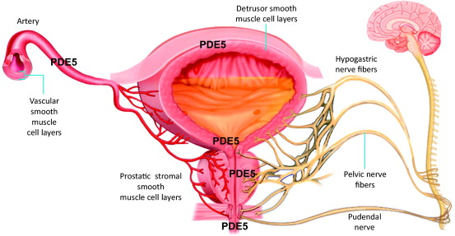
PDE5 inhibitors for LUTS secondary to BPH
PDE (phosphodiesterase) 5 inhibitors:
Effective & well tolerated, providing significant improvement in BPH-LUTS and QoL in addition to their established effects on improving erectile function (ED)
Laydner HK, et al. BJU International. 2010; 107: 1104-1109/ Giuliano F, et al. Eur Urol. 2013; 63(3): 506-516.

Slide 43
Phosphodiesterase type 5 inhibitors
Hollingsworth JM, et al. BMJ 2014; 349: g4474.

Slide 44
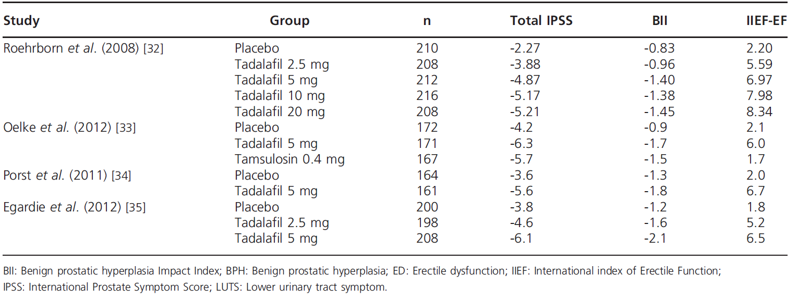
Total IPSS, BII & IIEF-EF change in BPH-LUTS patients with and without ED treated with tadalafil among Phase III clinical trials
Russo A, et al. Expert Opin Pharmacother. 2015.

Slide 45
Surgical Treatments
Open prostatectomy
Transurethral holmium laser ablation of the prostate (HoLAP)
Transurethral holmium laser enucleation of the prostate (HoLEP)
Holmium laser resection of the prostate (HoLRP)
Photoselective vaporization of the prostate (PVP)
Transurethral incision of the prostate (TUIP)
Transurethral vaporization of the prostate (TUVP)
Transurethral resection of the prostate (TURP)
AUA Guidelines 2010.

Slide 46
Surgical Treatment: When?
Surgical interventions: Considered in case of severe symptoms & complications like urinary retention, renal failure & infection that are weighed carefully against risk & benefits of various treatment options
Invasive procedures:
Gold standard: removal of obstructing tissue by open prostatectomy in early 1900s, which is now replaced by transurethral resection of prostate (TURP)
TURP is the hallmark of the urologist
Dhingra N, et al. Indian J Pharmacol. 2011; 43(1): 6-12.

Slide 47
HoLAP
Transurethral Holmium Laser Ablation of the Prostate (HoLAP):
Holmium:YAG laser may be used to treat prostatic tissue transurethrally using 550 micron side-firing laser fiber in noncontact mode
This technology delivers laser energy at wavelength of 2120 nm (infrared range) which is absorbed primarily by water & results in optical penetration depth of 0.4 mm
HoLAP procedure is intended to be comparable to TURP in that prostatic lobes may be vaporized down to surgical capsule resulting in TURP-like effect
AUA Guidelines 2010.

Slide 48
HoLEP
Holmium laser has been used to enucleate prostate adenoma, separating adenoma from surgical capsule, from apex to base, after any median lobe has been freed from bladder neck
Typically, technology is utilized for larger glands that previously would have been treated surgically with open prostatectomy
Generally, results compare favourably to open prostatectomy in hands of experienced surgeon
In other trials, improvements in symptom scores, QoL indices & flow rate, approach those obtained after TURP
AUA Guidelines 2010.

Slide 49
HoLEP
Nonetheless, long-term data beyond 2 yrs are still lacking & procedure requires specialized training and equipment
Operative times for holmium enucleation have been improved significantly with the advent of the tissue morcellator
By morcellating tissue within bladder, resection technique could be modified to allow complete enucleation of median & lateral lobes of prostate
AUA Guidelines 2010.

Slide 50
TURP & TUIP
Takes 20 to 30 minutes to resect an average gland weighing 30 g
Carry risks for complications: bleeding, infections, retrograde-ejaculation & low semen, low PSA level, and hospital stay including impotence and incontinence
Transurethral incision of the prostate (TUIP) or bladder neck incision: Recommended for smaller gland weighing <25 g and has been found to be less invasive than TURP, but long-term effectiveness in comparison with TURP is yet to be determined
Dhingra N, et al. Indian J Pharmacol. 2011; 43(1): 6-12.

Slide 51
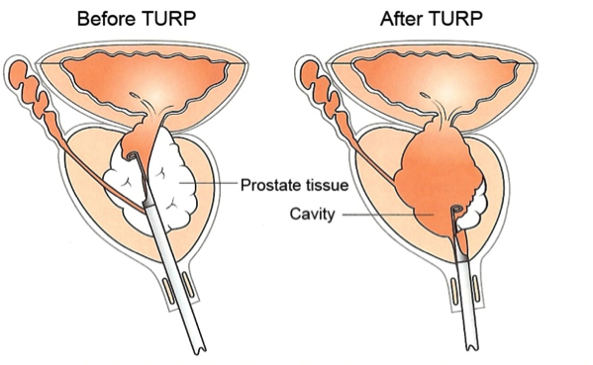
TURP

Slide 52
MIT and TUVP
Minimal invasive procedures (MIT):
Over last few years, number of MIT has been established to achieve substantial improvement in symptoms attributed to BPH
These MIT utilizes endoscopic approach to ablate obstructing prostatic tissue
Transurethral electrovaporization (TUVP)
TUVP is modification of TURP & TUIP
Utilize high electrical current to vaporize & coagulate obstructing prostate tissue
Long-term efficiency is comparable with TURP, but number of patients has been found to experience irritative side effects
Dhingra N, et al. Indian J Pharmacol. 2011; 43(1): 6-12.

Slide 53
TUMT & TUNA
Transurethral microwave thermotherapy (TUMT):
More specific destruction of malignant cells without affecting normal cells can be achieved by raising temperature of cells using low-level radiofrequency (microwave) in prostate up to 40 - 45°C (hyperthermia), 46 to 60°C (thermotherapy) & 61 - 75°C (transrectal thermal ablation)
Found to be safe & cost effective, with reasonable improvement in urine flow rate & minimal impairment on sexual function
Transurethral needle ablation (TUNA):
Simple & relatively inexpensive procedure which utilizes needle to deliver high-frequency radio waves to destroy the enlarged prostatic tissue
Successful treatment for small-sized gland
Poses low or no risk for incontinence & impotence
Dhingra N, et al. Indian J Pharmacol. 2011; 43(1): 6-12.

Slide 54
Laser Ablation
Laser prostatectomy has become an increasingly widespread form of MIT
4 types of lasers have been used to treat LUTS, namely neodymium: yttrium-aluminum-garnet (Nd: YAG) laser, holmium YAG laser (Ho:YAG), potassium titanyl phosphate (KTP), and diode laser
Found to be safe & effective technique, with significant improvement in urinary flow rates & symptoms
Short operative time, minimal blood loss & fluid absorption, decreased hospital stay, impotence rates & bladder neck contractures are few of advantages of laser prostatectomy over TURP & other conventional techniques
Dhingra N, et al. Indian J Pharmacol. 2011; 43(1): 6-12.

Slide 55
HIFU & Transurethral ethanol ablation of prostate
High-intensity focused ultrasound (HIFU):
Effective protein denaturation & coagulative necrosis of prostatic tissue have been achieved by using HIFU frequencies of 4 MHZ
Significant ↑ in uroflow & ↓ in postvoid residual volume have been observed, but cost is 3 times higher than that of TURP
Transurethral ethanol ablation of the prostate:
Transurethral injection of absolute ethanol into lateral lobes of prostate produces necrotic effect on prostatic tissues, leading to fibrosis & shrinkage
Significant improvement has been reported in AUA symptoms score
Continual research is going on to dilute negative factors like urinary retention, pain, dysuria & prolonged period of catheterization with aim to deliver safe, effective, and economical potential treatment
Dhingra N, et al. Indian J Pharmacol. 2011; 43(1): 6-12.

Slide 56
Water-induced thermotherapy & Plasma kinetic tissue management system
Water-induced thermotherapy:
Simple technique that uses cylindrical balloon to circulate hot water, resulting in even coagulation necrosis in prostate by raising temperature of prostatic cells up to 60 - 70°C, without having major effect on nontargeted tissues
Plasma kinetic tissue management system (Gyrus):
Gyrus: New technique under development & vaporizes obstructing tissue by using plasma energy in saline environment
Procedure has been found to be safe & effective with minimal risk of water intoxication (TURP syndrome) & generally reserved for patients on high risk
Dhingra N, et al. Indian J Pharmacol. 2011; 43(1): 6-12.

Slide 57
Latest pharmacotherapy options: BPH
Spectrum of available drugs for the treatment of LUTS is rapidly expanding ranging from α1-adrenoreceptor antagonists, 5α-reductase inhibitors, antimuscarinics to PDE5 type 5 inhibitors
Silodosin: α1-adrenoreceptor antagonist with almost no effects on BP &/ or heart rate, which makes it a very interesting therapeutic option for elderly men & for patients treated with several anti-hypertensive drugs
Tadalafil: Only PDE5i currently approved for LUTS in patients with or without ED & has shown to improve IPSS & QoL scores
Russo A, et al. Expert Opin Pharmacother. 2015.

Slide 58
Latest pharmacotherapy options: BPH
Russo A, et al. Expert Opin Pharmacother. 2015.

Slide 59
THANK YOU!!!

